Slide 1
West Virginia Emergency Management Division
Two Days Before the Day After Tomorrow
Jason Means, DEL

Slide 2
WVEMD – Public Assistance Section

Slide 3
WVEMD – Mitigation & Recovery Section Organizational Chart

Slide 4
WVEMD – PA Section Org Chart for PDA TTX

Slide 5
WVEMD – Regional Planning & Development Councils (RPDC)

Slide 6
WVEMD – Processes for submission of damages to public infrastructure
WVEMD recognizes each county has varying levels of capacity & resources
PA staff have been assigned to specific RPDC regions/counties
PA staff will create a share folder to serve as a central point for document collection/validation
PA staff will work hand-in-hand w/EM’s to gather necessary information efficiently
PA staff will monitor WebEOC for damages to eligible public infrastructure
PA staff will review damages in their assigned areas - will contact EM’s directly for details
PA staff will request specific information required by FEMA for cost estimation and validation
PA staff will fill out Survey123 on behalf of applicant to populate overall disaster dashboard
PA staff will compile information for internal validation prior to submitting joint PDA request

Slide 7
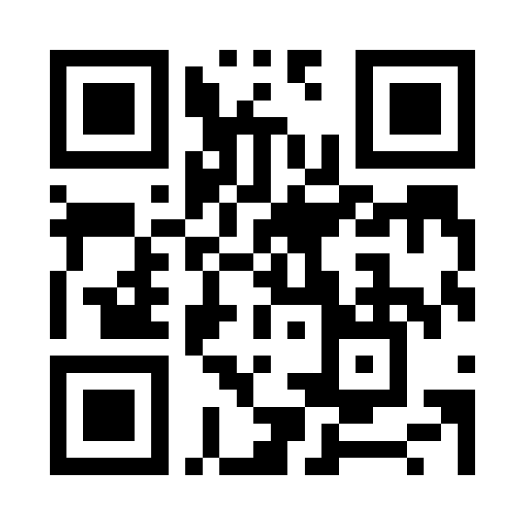
WVEMD – Survey123
Survey is used to track damages for:
Homeowners
Renters
Businesses
Private Nonprofits & Houses of Worship
Local / County / State Government

Slide 8
WVEMD – Survey123

Slide 9
WVEMD – WebEOC Incident Report / Resource Request

Slide 10
WVEMD – WebEOC Dashboard

Slide 11
WVEMD – Disaster Dashboard for Damage to Public Infrastructure

Slide 12
WVEMD – Disaster Dashboard For Damage to Private Infrastructure

Slide 13
WVEMD – Path to Success
Document infrastructure in the here and now
Leverage technology and cloud
Ensure entity is set up in SAM with active UEI #
Paper and digital copies of procurement, payroll & insurance policies
Create and/or update MOA’s/MOU’s with other stakeholders
Consider pre-positioned contracts
Have a plan to address deferred maintenance

Slide 14
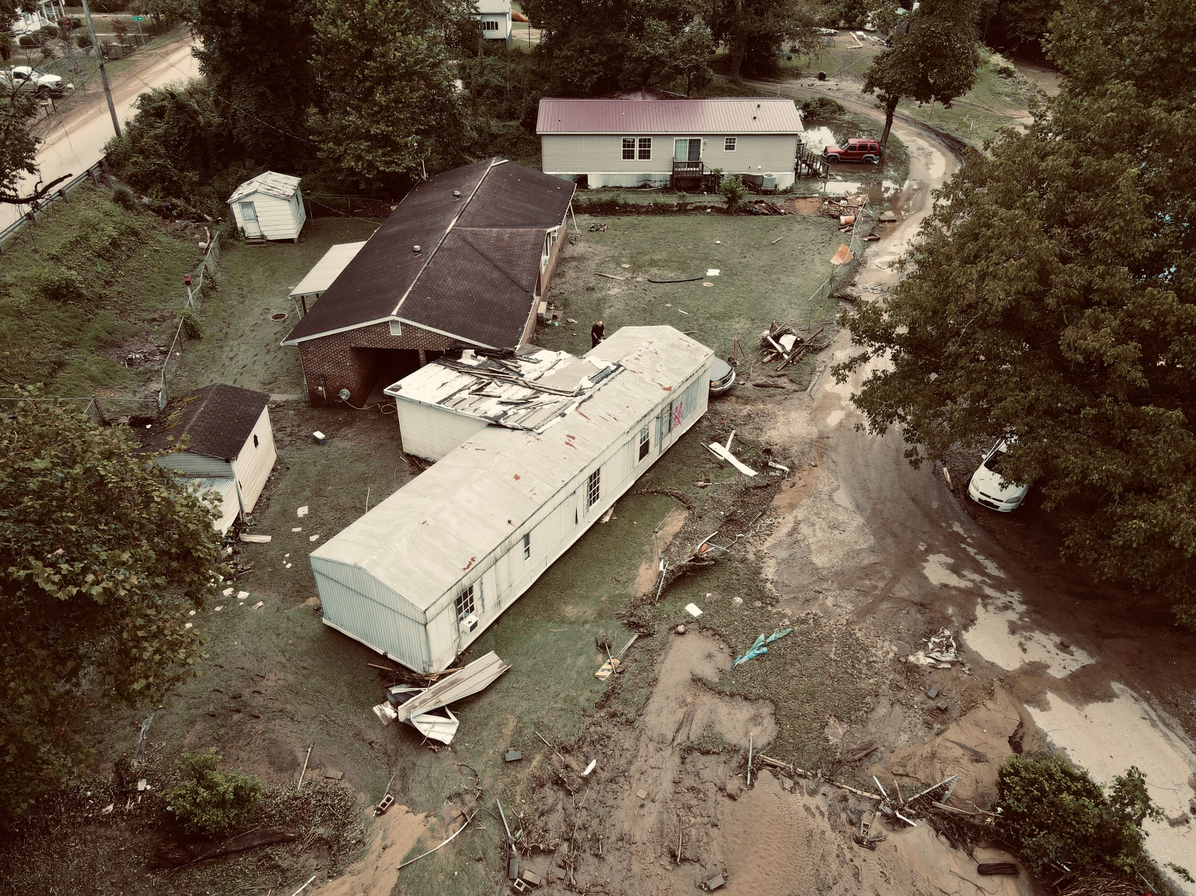
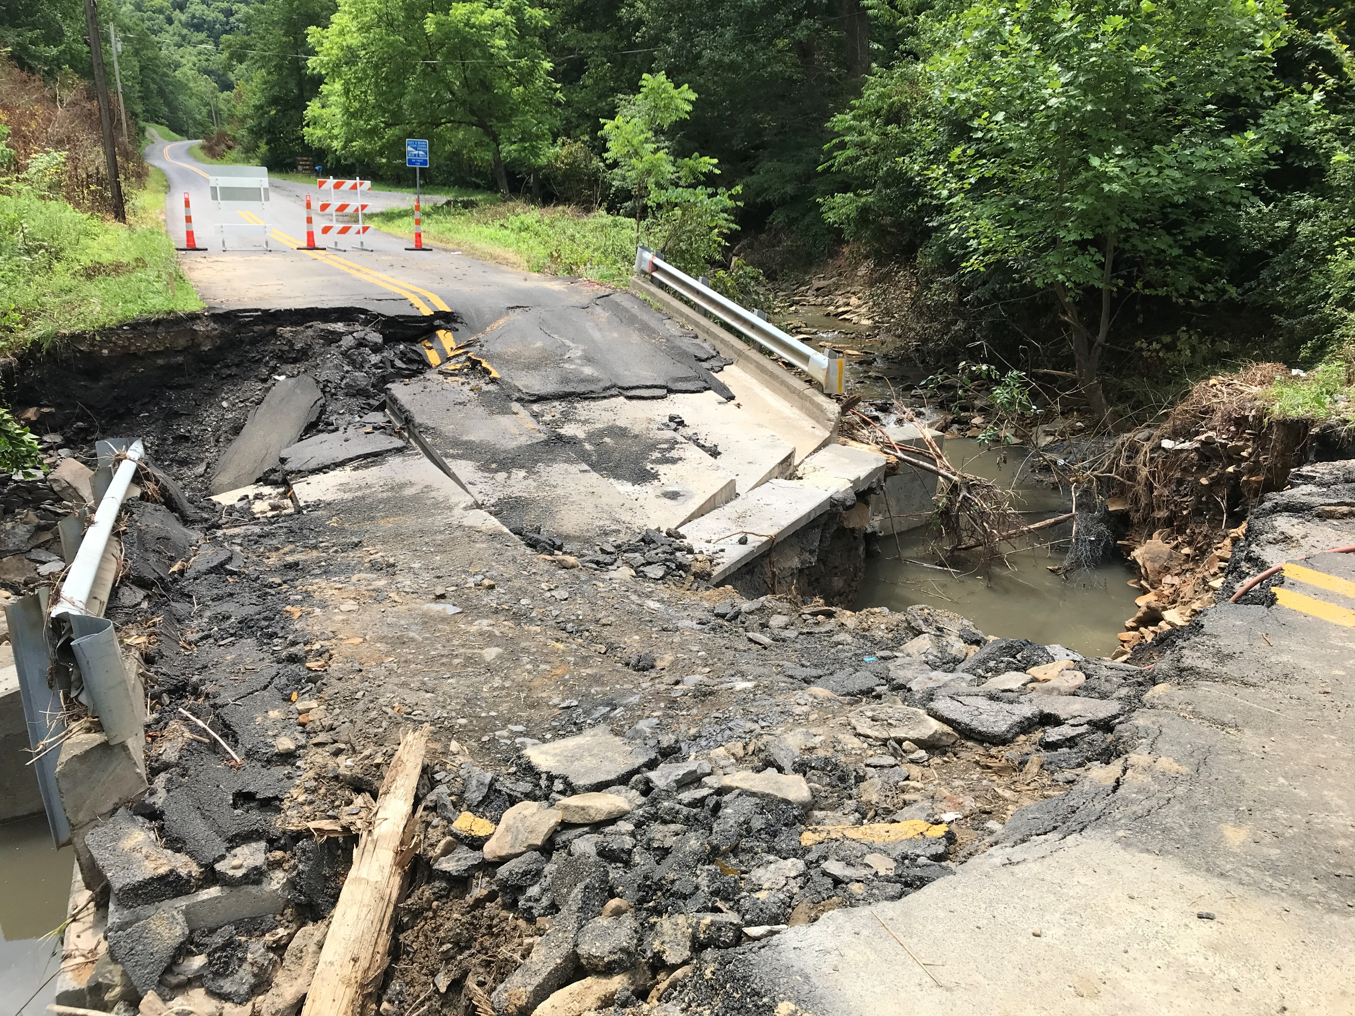
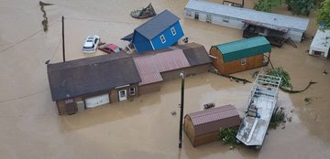
WVEMD – Documentation
Payroll Policy
Procurement Policy
Insurance Policy
Pre/Post Disaster Pictures
MOU’s / MOA’s

Slide 15
WVEMD – Takeaways
Each county is unique – WVEMD will apply tailor-made solutions that work in context
Continue to build relationships, refine processes and understand local issues that effect recovery
Use available tools more efficiently to streamline processes and reduce confusion
Improve and refine use of digital resources to increase speed and reduce errors
Prioritization and coordination with RPDC’s a critical component of success
Document everything in the here and now

Slide 16
WVEMD – Questions
Jason Means, DEL
Public Assistance Officer / Program Manager
WV Department of Homeland Security
Emergency Management Division
1700 MacCorkle Ave. SE 6th Floor
Charleston, WV 25314
jason.s.means@wv.gov
304-550-4571 (cell)

