Slide 1
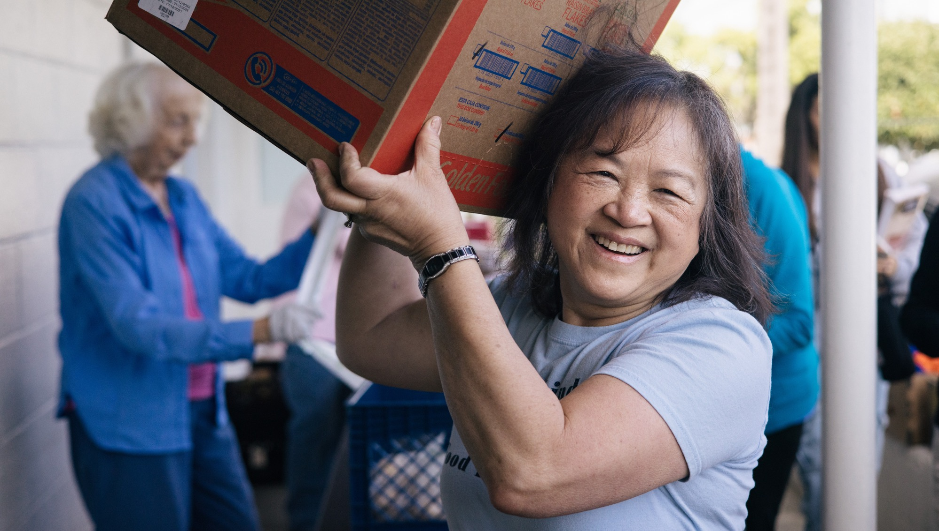


Sept 19, 2023
“Partnerships in Disaster Feeding – A Look Forward in the Post-Pandemic.”

Slide 2


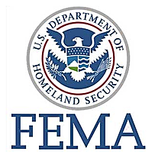






“During my career I have been privileged to serve in emergency management roles in the U.S military, government, disaster relief and corporate sectors.”
Vince Davis, Senior Director of Disaster Services at Feeding America.
1973-77 1979-2000 2002-2005
2006---2010
2011-2016 2017-2020 2020-
Notes:
As you can see, my Emergency Management career has taken me to many interesting and challenging assignments. For the past decade, my path has been mainly in the corporate sector with Iconic companies like Walgreens, Sony, and Amazon, before assuming m current role as Director of Disaster Services at Feeding America.

Slide 3



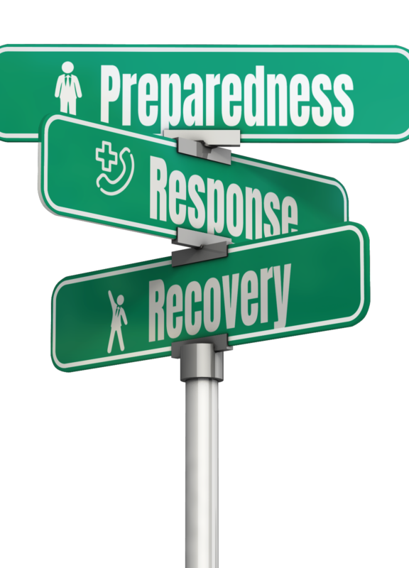

Together We Can Achieve Our Goal of Ending Hunger

Slide 4
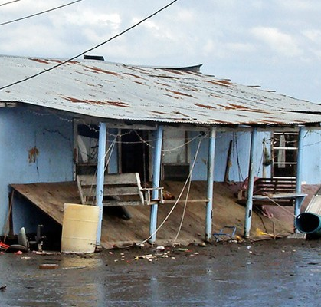
Appalachia Ice Storms – My First Disaster
Notes:
My first disaster, lessons learned I walked into a tiny county office with the power of the federal disaster system, and emerged as a humble servant, getting a lesson in what it means to listen, learn, and what neighbors helping neighbors really means

Slide 5
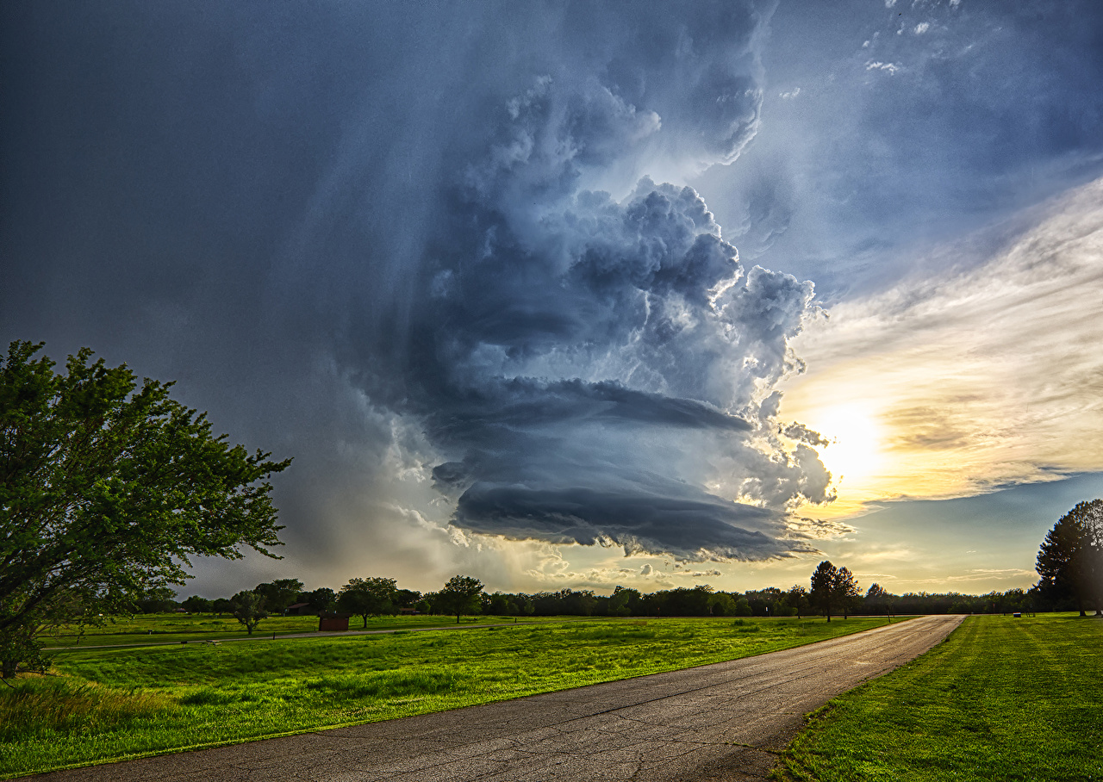
The Changing Landscape of Disasters
Hurricane Idalia became the 23rd “billion dollar” weather disaster to strike the United States this year,, eclipsing the previous record of 22 set in 2020.
And there are still four months left in this year, with the very real potential for more devastating weather ahead.

Slide 6
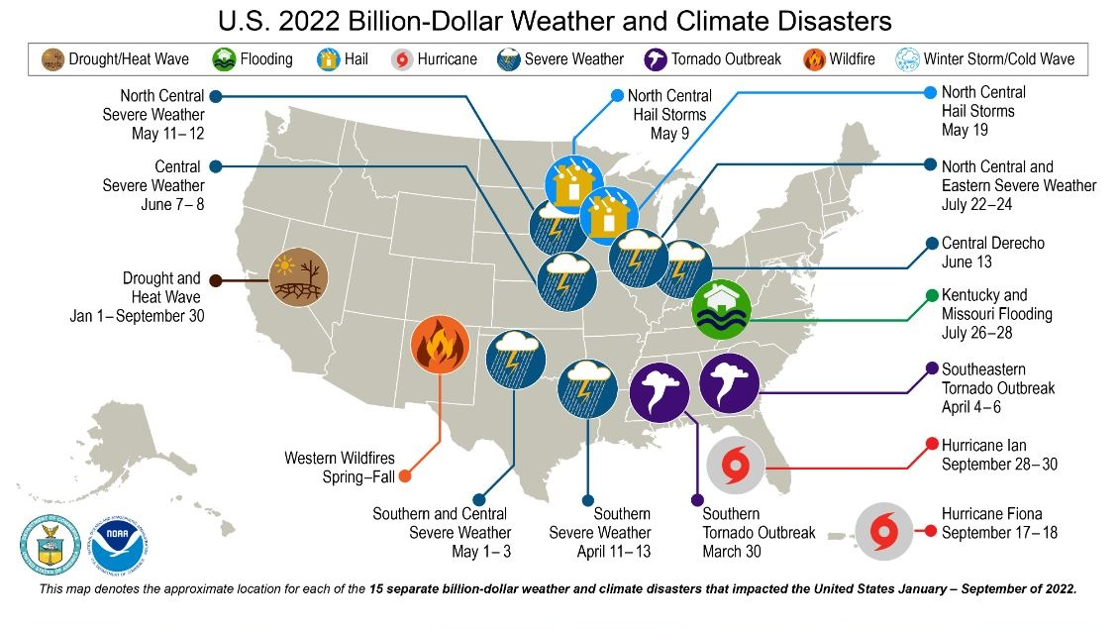
Notes:
In 2022, the U.S. continued its trend of record setting disasters in what has become the ‘new normal’

Slide 7
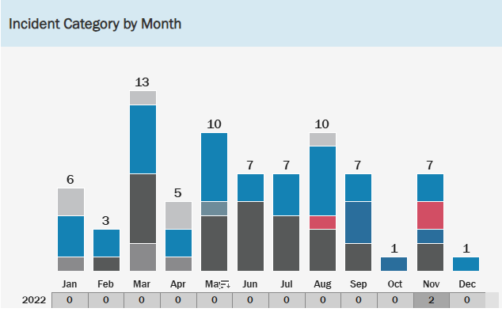
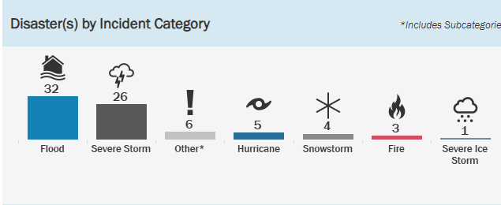
West Virginia experienced 77 FEMA Disasters from May 1953 thru June 2023.

Slide 8
Feeding America lost >50% of its food donations from grocers at the onset of COVID.
The affect was a pivot from the traditional model of food raising to focus on funds to purchase food.
Producers and corporate partners stepped up to fill the gaps.
Pandemic Impacts on Feeding America

Slide 9
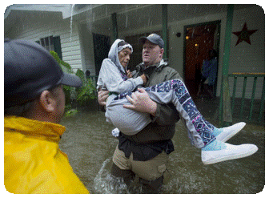

An Emergency Management Approach To Food Insecurity
Notes:
In addition to an overall increase in food pantry usage during the pandemic, we find that, while certain socio-demographic groups historically vulnerable to food insecurity experienced the predicted uptick in insecurity during the pandemic, other socio-demographic disparities were attenuated. These somewhat disparate findings illustrate the complex relationship between disasters and food insecurity in an urban context, offering several avenues for future research.

Slide 10
THE DISASTER CYCLE
Volunteer organizations must adapt a more balanced approach in the post-pandemic environment.
1
2
3
4
Prevention by identifying and mitigating known risks to feeding.
Recovery through ongoing stakeholder partnerships.
Response to address immediate impacts on disaster survivors.
Preparedness by pre-disaster planning, training, and exercises.

Slide 11

Regional Approach

Slide 12
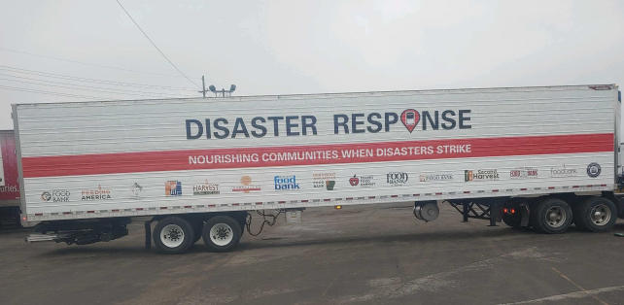
BENEFITS OF A REGIONAL APPROACH
Increased Readiness
Increased Capacity
Additional Resources
  Staff
  Supplies
  Equipment
  Food
  Expertise
Ability to serve more, faster, and more effectively

Slide 13
FOCUS OF A REGIONAL APPROACH
Focus on Training
Focus on Partnerships
Regional educational/preparedness meetings
Incident Command System Staff Training – Virtual or Onsite
Community Partner Agency Training
Disaster Readiness Training Video
Community Partner Agency Disaster-Ready Network Development
Memorandum of Understanding to Build Agency Level Response Network
Voluntary Organizations Active in Disaster
Assure Food Bank’s ‘Place at the Table’ as Valued

Slide 14





REGIONAL COLLABORATIVES
Maintenance
Action
Preparation
Contemplation
Pre-Contemplation
SUPPORT
KNOW-HOW
We can loan equipment, technical support, and commodities quickly and at a low cost.
UNDERSTANDING
The Network is quicker, better, and faster responding to common in-region disasters.
WANT
Donors, government agencies, and nongovernment partners are all focused on regional resilience approaches.
SENSE
To leverage the power of the network to improve service delivery following major events.
We are greater than the sum of our parts. The 200 Members food banks are natural force-multipliers.
ACTIVATION ZONE
ACTION ZONE

Slide 15



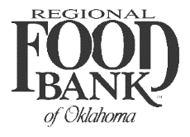










REGIONAL MUTUAL AID AGREEMENT: A REGIONAL APPROACH TO DISASTER RESPONSE
 | Regional Disaster Partner Food Banks
 | Community Food Bank of Eastern Oklahoma | Harvesters – The Community Food Network | Kansas Food Bank | Regional Food Bank of Oklahoma | Second Harvest Community Food Bank | St. Louis Area Food Bank | The Food Bank for Central and Northeast Missouri | Southeast Missouri Food Bank | Ozarks Food Harvest | Arkansas Food Bank | Food Bank of Northeast Arkansas | River Valley Regional Food Bank | Northwest Arkansas Food Bank | Harvest Regional Food Bank
Resource Sharing | Tulsa, OK | Kansas City, MO | Wichita, KS | Oklahoma City, OK | St. Joseph, Mo | St. Louis, Mo | Columbia, Mo | Sikeston, Mo | Springfield, Mo | Little Rock, AR | Jonesboro, AR | Ft. Smith, AR | Bethel Heights, AR | Texarkana, AR
Agency Liaison Staff |  | X |  | X |  |  |  | X |  | X | X |  | X | X
Drivers - CDL |  | X | X | X |  |  | X | X |  | X |  |  |  | X
Drivers - Non CDL | X |  |  |  | X | X |  | X |  | X |  |  | X | X
ICS Staff | X | X | X | X | X |  |  | X |  | X
Inventory Control Staff |  | X |  |  |  |  |  |  |  | X
IT Support Staffing |  | X |  | X
Safety Staffing |  | X
Volunteer Management Staff | X | X | X | X | X |  | X | X |  | X | X |  | X | X
Warehouse Staff |  | X | X | X | X | X | X | X |  | X |  |  | X | X
Staging Space | X | X |  | X |  | X |  | X |  | X |  |  |  | X
Trucks/Trailers | X | X* | X | X* | X* | X | X | X |  | X |  |  |  | X
Generator/s |  |  |  |  |  |  |  | X |  | X |  |  |  | X
Light Tower |  |  |  | X |  |  |  | X

Slide 16

The Role of
Convene and Coordinate National Organizations responding to disasters.
Engage numerous governmental, private sector and nonprofit organizations that served disaster survivors independently of one another.
Convene, National VOAD is a coalition of 70+ of the nation’s most reputable national organizations (faith-based, community-based and other non-profit organizations) and 56 State/Territory VOADs, which represent Local/Regional VOADs and hundreds of other member organizations throughout the country.

Slide 17

Current Situation
Well meaning partners
State & County Agencies
Random Volunteers
National Relief Organizations
God knows Who
State & Territorial VOADS

Slide 18



Community
Gov’t Agencies
National VOAD
Supply Chain
Data Gathering/After-Action & Improvement Planning
Feeding Networks
Desired State
Regional NGOs
State & Territory VOADs
Output
SitReps and Incident Action Plans
Local COADs

Slide 19
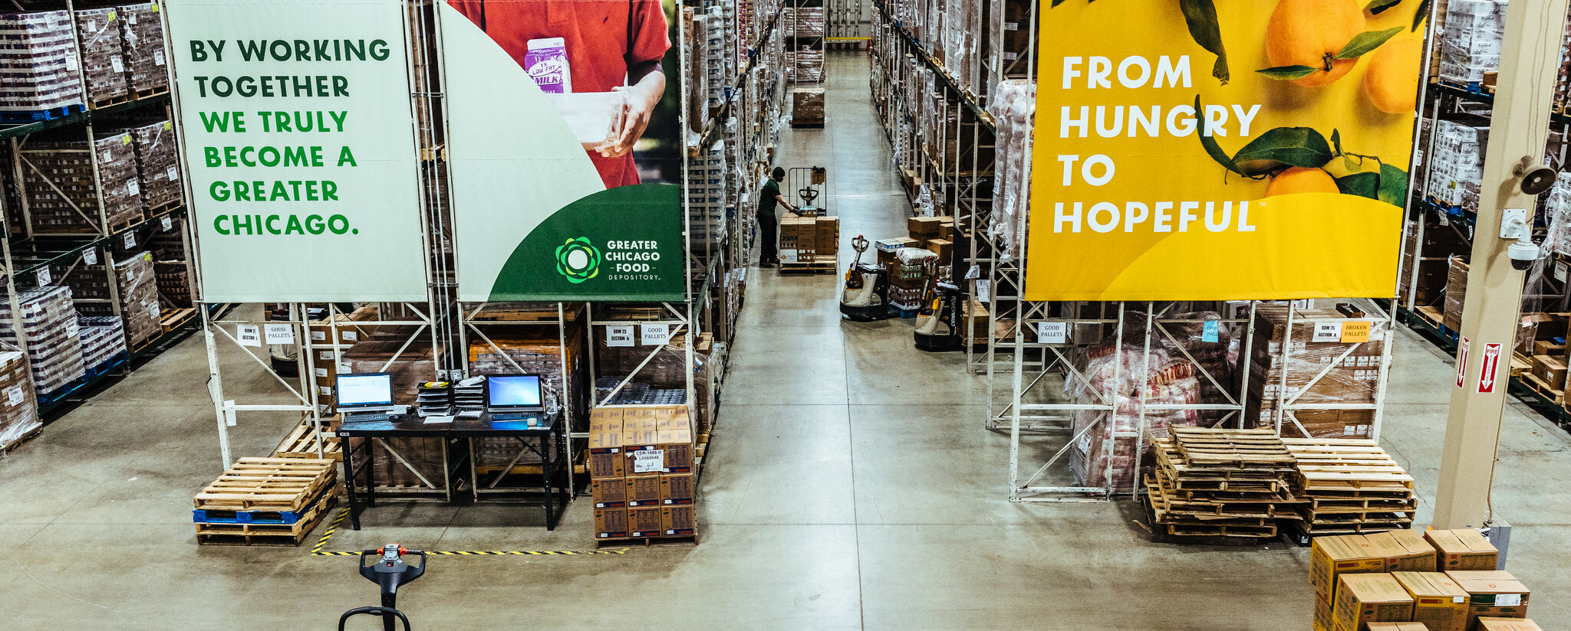
Partnerships

Slide 20





















Slide 21
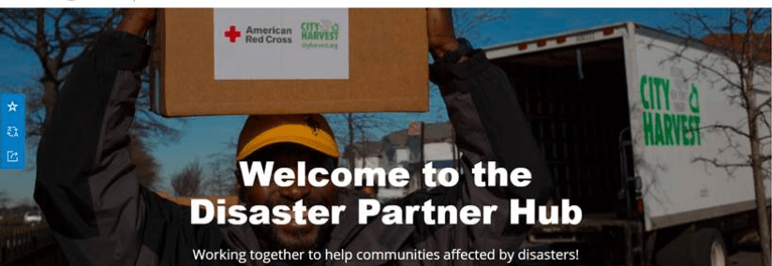
The American Red Cross’ Disaster Partner Hub shares the same tools with partners that the organization has used to get past paper-based workflows for a shared digital transformation.
Online mapping tools display needs and aid agency activities locally and across the country.
The data hub manages outreach information and supports gap analysis to prioritize missions.
Shared awareness helps food relief and other humanitarian partners act in unison.
Weekly disaster “check-in” calls with national partners
Notes:
“This revolutionary tool for disaster use is changing the landscape of coordination and collaboration among response and recovery organizations,” said April Wood, senior director, External Program Services, Disaster Operations, American Red Cross National Headquarters. “Red Cross is working with partners such as Feeding America, World Central Kitchen, Southern Baptist Disaster Relief, Salvation Army and Operation BBQ to name a few of the organizations actively involved.”

Slide 22
Government Partners
City, Township, Emergency Management Agencies
County Emergency Management Agencies
State Emergency Management Agency
Federal Emergency Management Agency
Depending on the scale and severity of the event, local jurisdictions may request assistance from county and state resources
States are eligible to request Federal assistance when disasters exceed local or state capabilities

Slide 23
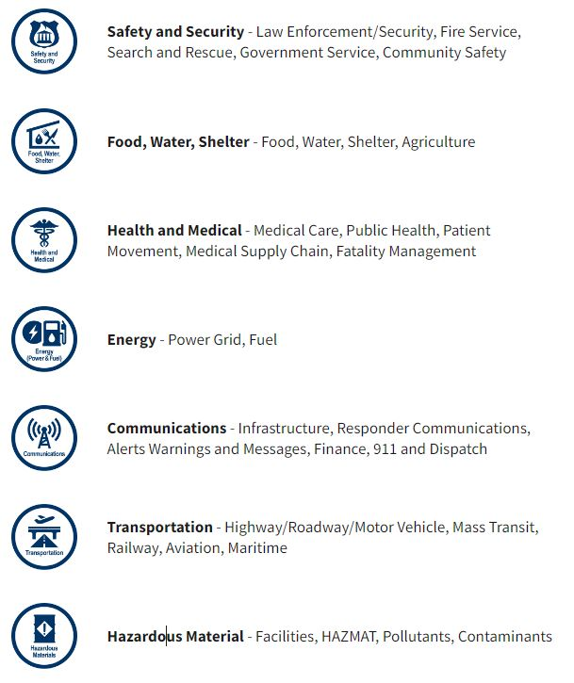
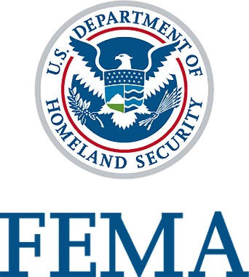
Community Lifelines Response
Established by FEMA in 2019 to help define community impacts of disasters
The goal is to stabilize each Lifeline and maintain a Common Operating Picture of the event to show:
What has been done?
What hasn’t been done?
What needs to be done?
Who needs to lead the response?
Notes:
Lifelines will help planners at the food bank in their decision process as to how much and where food is needed.

Slide 24
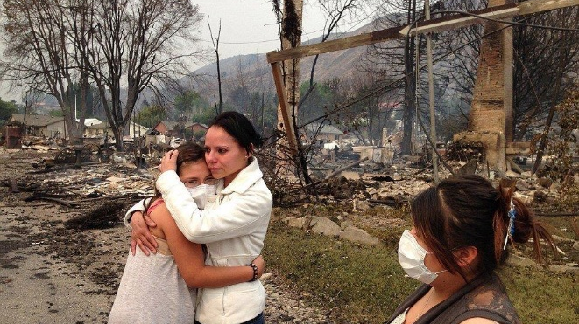
Feeding America National Office

Slide 25
National Office Disaster Team
Kathryn Strickland
Chief Network Officer
Patrick Crawford
Sr. Director Disaster Services
Vince Davis
Sr. Director Disaster Services
Steve Moran Regional Disaster Coordinator
Eric Davis Sr. Dir. Food Sourcing Services
Kent Coffland Field Operations Support Specialist
Notes:
The Disaster Services Team merges decades of food bank industry experience with disaster and emergency management expertise

Slide 26














Volunteers
Key Corporate Donors
Government
Key National partnerships

Slide 27

Feeding America National Office
Core Disaster Team
Member Engagement
Fundraising
Development
Marketing/Communications
Foundation Relations
Corporate Partnerships
Food Sourcing
Supply Chain
Transportation
Member Grants
Food Industry Partnerships’
Government Relations
Notes:
Consists of representatives from National Office departments and functions that is activated during certain incidents to support disaster relief operations for the member food banks.

Slide 28



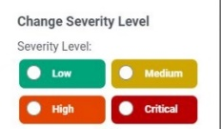












Slide Title
National Office Disaster Support Flow Process
Monitor Situational Awareness
Establish Common Operating Picture
Establish Response Issue Severity Level
Activate FANO Disaster Team
Monitor
Triage
Notify Stakeholders
Prepare Initial SitRep
Coordinate Financial Donations
Arrange & Track Food Donations
Assess Unmet Resource Needs
Coordinate Government Agencies
Coordinate & Collaborate
Re-Assess & Recover
Coordinate National Media
Coordinate Feeding Partners
Monitor & Update Lifelines Status
Update SitRep
Confirm Incident Stabilization
Evaluate & Improve
Deactivate FANO Disaster Team
Prepare
Conduct After-Action Review Meeting
Collect Post-incident Data
After-Action Report & Improvement Plan
Notes:
The disaster response process consists of multiple simultaneous efforts by the Core Disaster Team to support the response to significant events. The core team consists of national office staff from various functions including supply chain, member engagement, development, government relations, marketing-communications, corporate partnerships and others.

Slide 29



Feeding America’s Network
7,700,000
square feet of warehouse space nationwide stores food for distribution
200
food banks serve
all 50 states, Washington, D.C. and Puerto Rico
2,300
Vehicles are ready
to respond
90%
2 million
volunteers are ready to help
60,000
serve nearly every community
in the country
of food banks operate mobile pantry programs that help deliver food to hard-to-reach communities
Food Programs
Notes:
Feeding America’s Network is the backbone of our ability to move food quickly wherever the need arises.

Slide 30
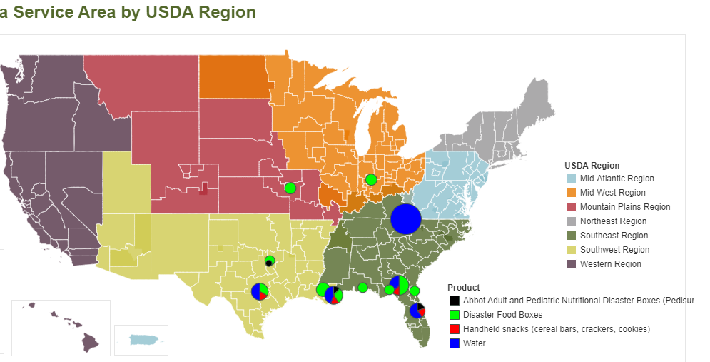
Staged Disaster Supplies
Notes:
One of the key support services provided by the national office is staged disaster supplies. These resources allow us to jump start the response to immediate community needs after an event. This enables member food banks to respond to demand while allowing time for putting the wheels in motion to acquire and deploy longer-term resources.

Slide 31
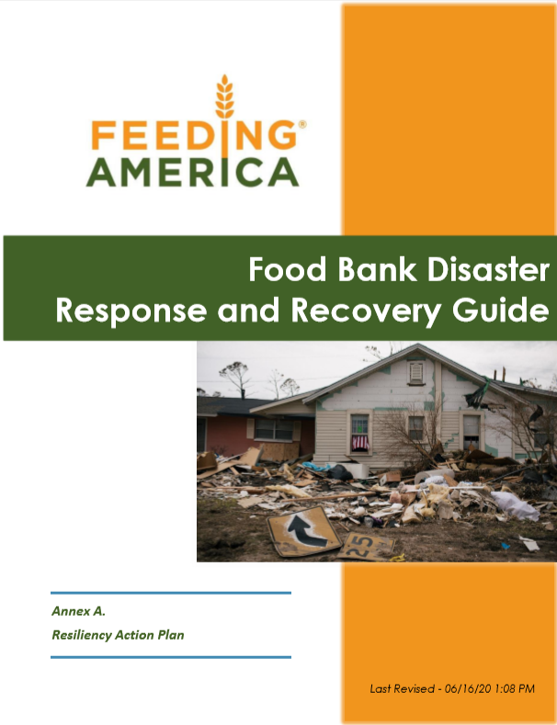
Disaster Planning Resources
Notes:
The guide contains easy to follow templates, tools and concepts for helping food banks achieve their emergency planning and preparedness goals.

Slide 32

Virtual Tabletop Exercise Series for Food Banks
Self Service Tabletop Exercise Toolkit includes:
Pre-scripted Tabletop Videos & PowerPoints
Situation Manuals
Facilitator/Evaluator Guides
Seven Scenarios for:
  Flood
  Earthquake
  Hurricane
  Public Health Crisis
  Tornado
  Wildfire
  Winter Storm
Notes:
Virtual Tabletop Exercises take the guess work and stress out of planning effective exercises so members can test emergency plans and procedures in a non-threatening but realistic environment.

Slide 33







Mobile Web-Based Disaster Collaboration Tool
Notes:
“A purpose-built platform that simplifies disaster collaboration, connecting cross-functional teams via actionable playbooks, intelligent workflows, and powerful communication services.”

Slide 34
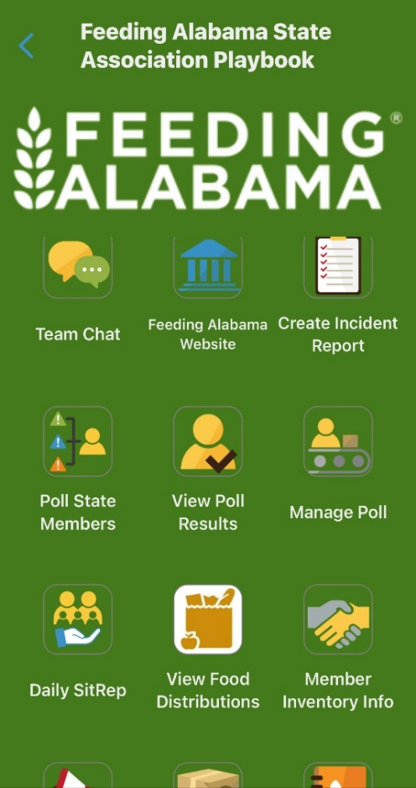
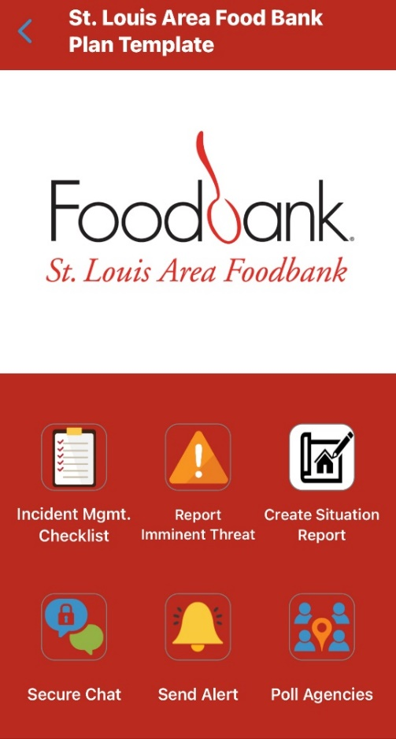
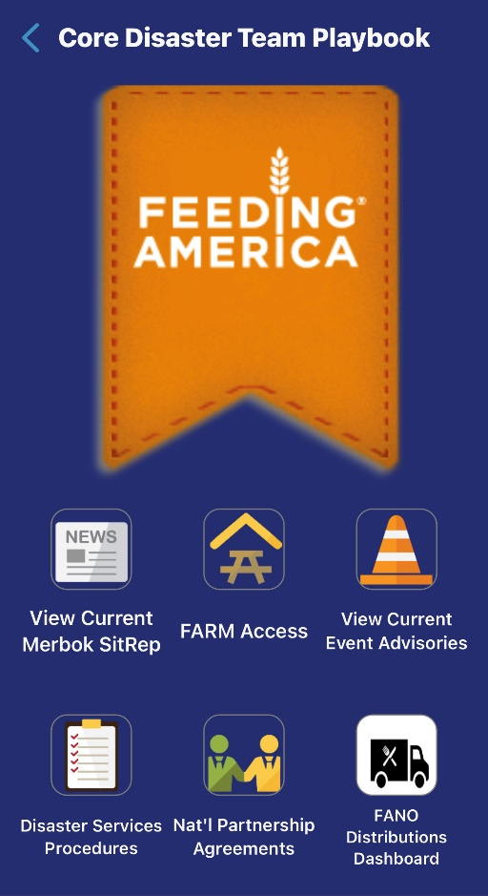
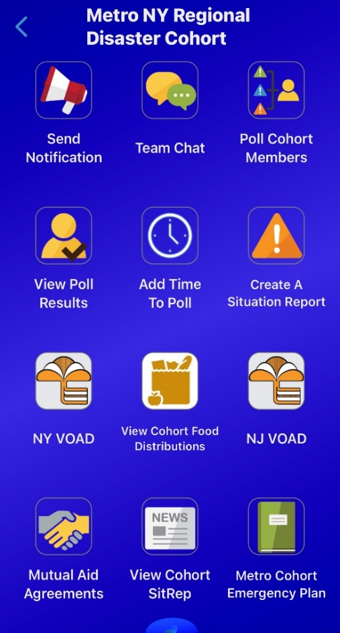
Sample Mobile App “Playbooks”
Notes:
These are three examples of playbooks used by various stakeholder groups to foster closer collaboration and help avoid missed, lost, or untimely communication during an event.

Slide 35
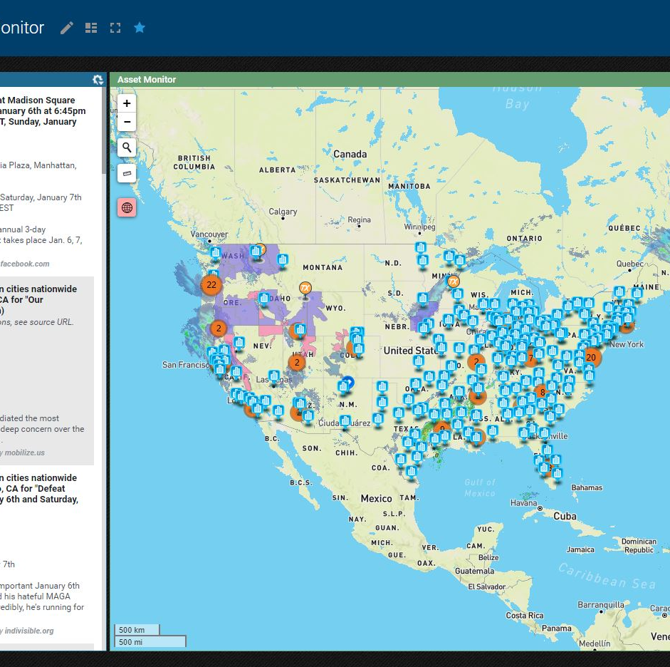
Threat Monitoring
State-of-the art threat monitoring capabilities allows FANO to anticipate natural/weather climate, human-caused and social threats, hazards, and trends that could affect the network.
Once significant threats are identified, we can provide alerts, warnings and stakeholder updates instantly to Member food banks.

Slide 36
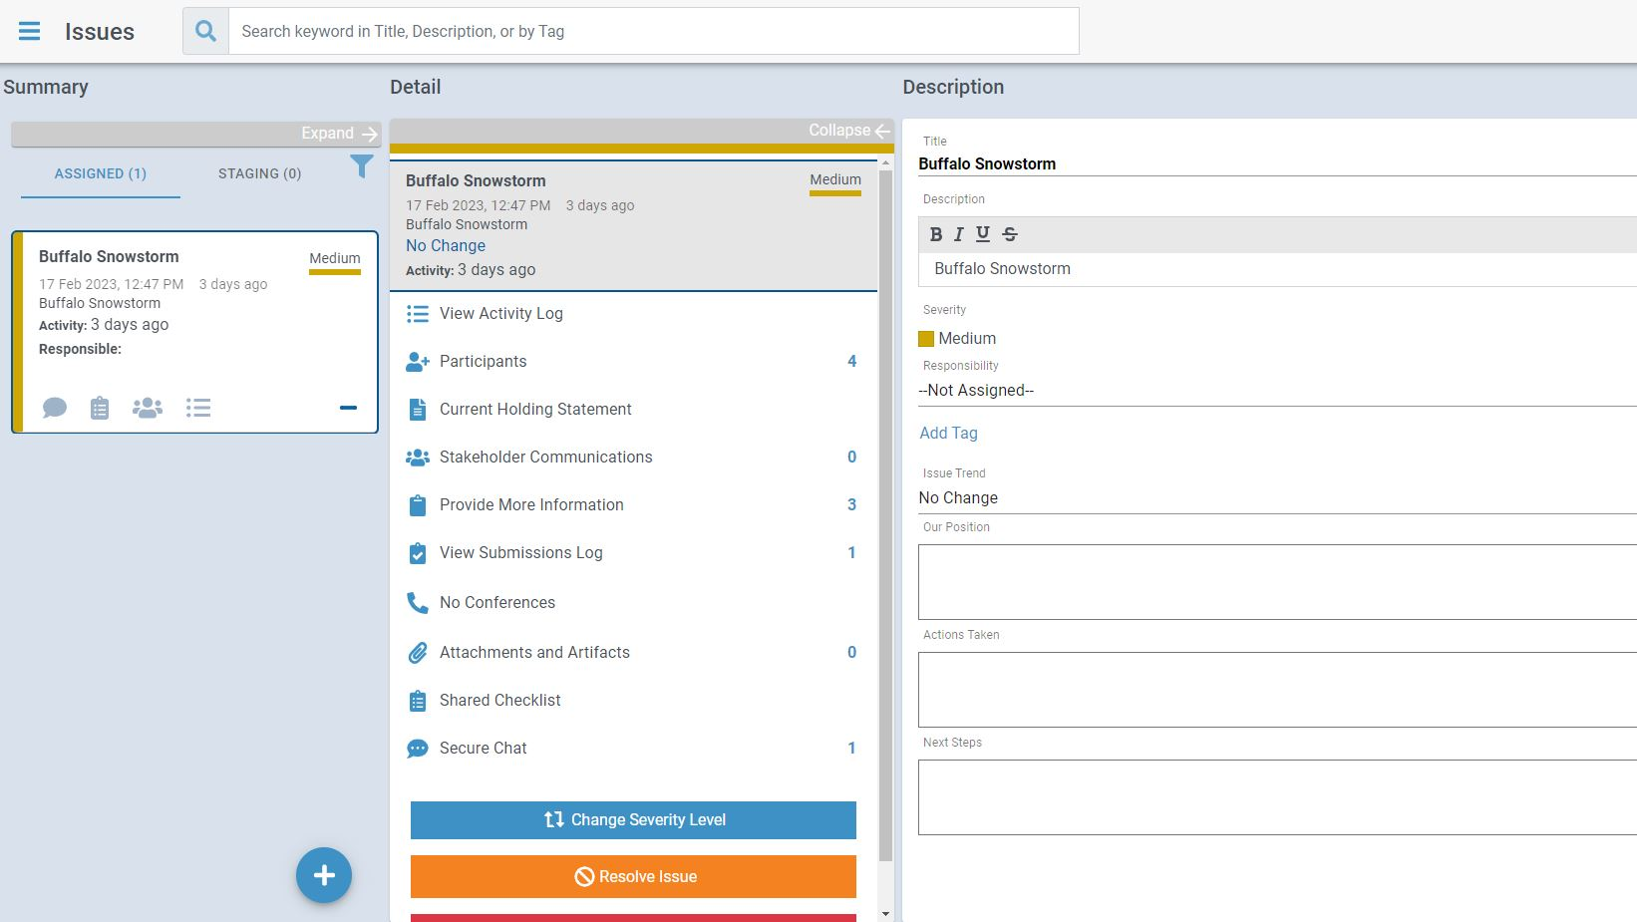
Issues Management System
Notes:
The issues Management portal provides a centralized virtual emergency operations center, housing all disaster related data and information sharing under a single platform, thereby creating efficiencies for communicating and data sharing essential to an effective response.

Slide 37
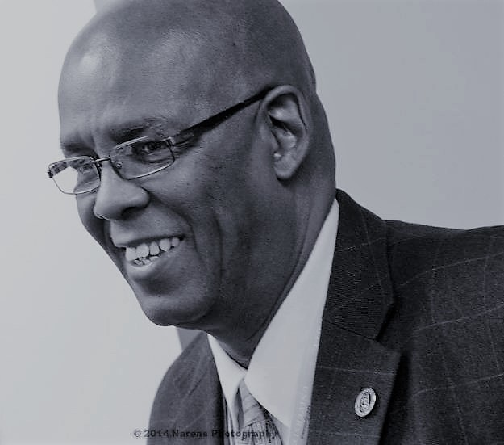
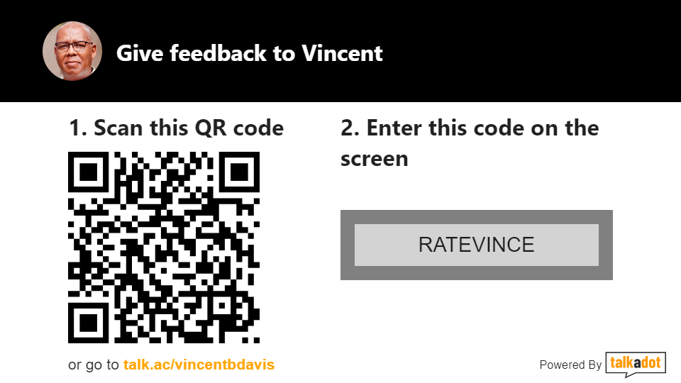



Questions
1-760.916.4328
LinkedIn https://www.linkedin.com/in/vbdavis/
Email vdavis@feedingamerica.org

Slide 38
“The tragedy of life is often not in our failure, but rather in our complacency; not in our doing too much, but rather in our doing too little; not in our living above our ability, but rather in our living below our capacities.”
Benjamin E. Mays
Civil Rights Leader
1894-1984
Notes:
I leave you with one of my favorite quotes.

