Slide 1
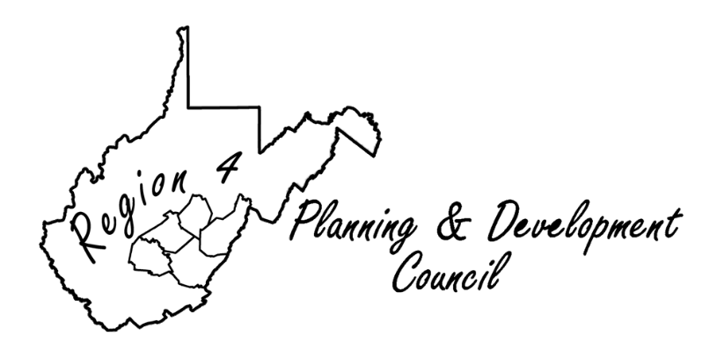
The CDBG Mitigation Grant to Review
PRIVATE WATER CROSSINGS
Damaged in the June 2016 Flood Disaster

Slide 2
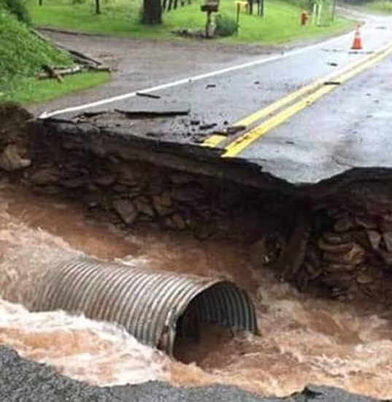
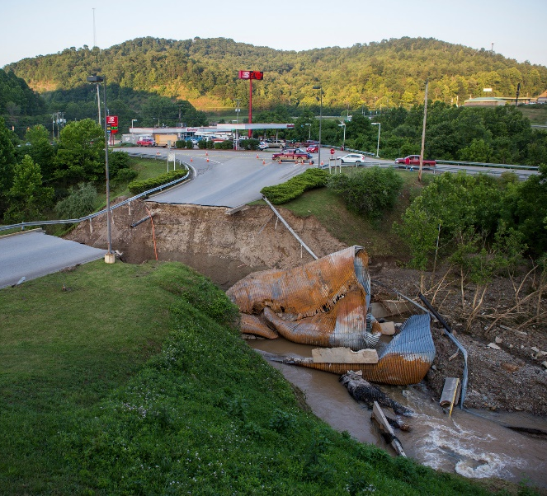
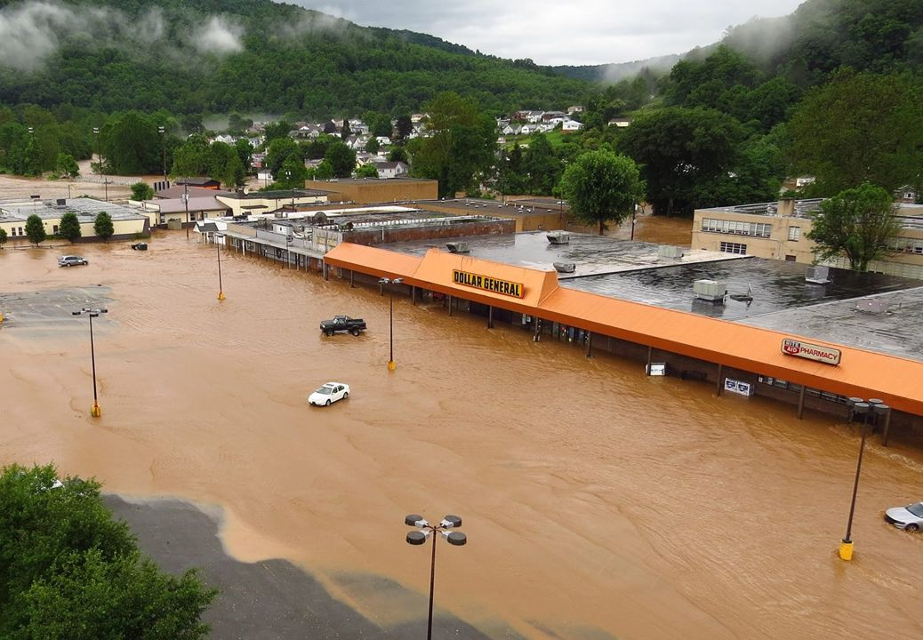
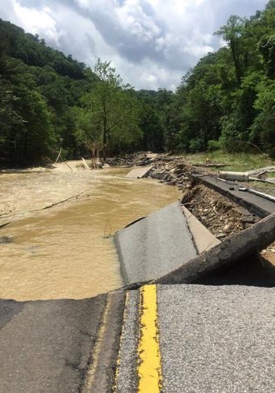
The Flood
On June 23rd, 2016, several rounds of thunderstorms brought intense rainfall to most of the state of West Virginia. The most intense precipitation occurred over the Central/Southeastern portions of the state, with observed 24-hour precipitation totals reaching over 7" in some areas (Rural, WV - southwest Nicholas County). Approximately 25 miles northeast, the Gauley River near Craigsville (Nicholas County) reached a crest of 29.04' (USGS), setting a new record crest at that location and shattering the old record by over three feet. Sadly, flash flooding across the state resulted in 23 fatalities, including 6 in Kanawha County, as well as 1 in both Jackson and Ohio counties in West Virginia.

Slide 3
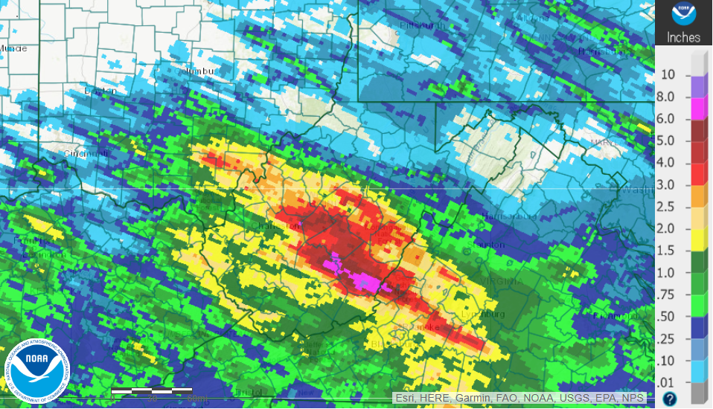
The Flood
June 23-24 (8AM - 8AM) Estimated Rainfall Amounts
Image Source: Advanced Hydrologic Prediction Service

Slide 4
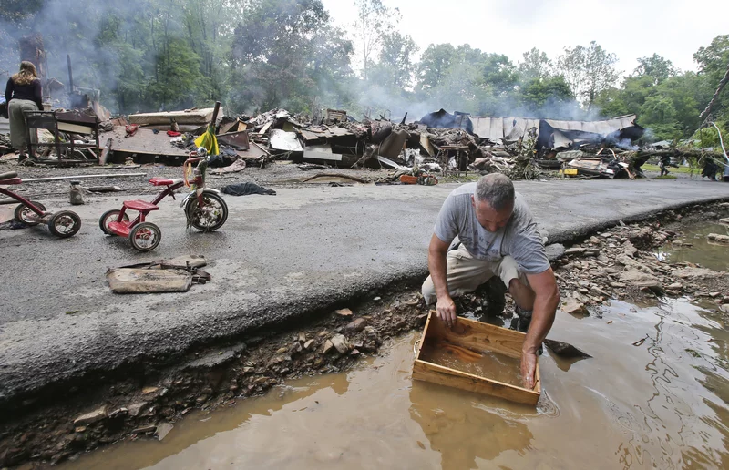
The Flood

Slide 5
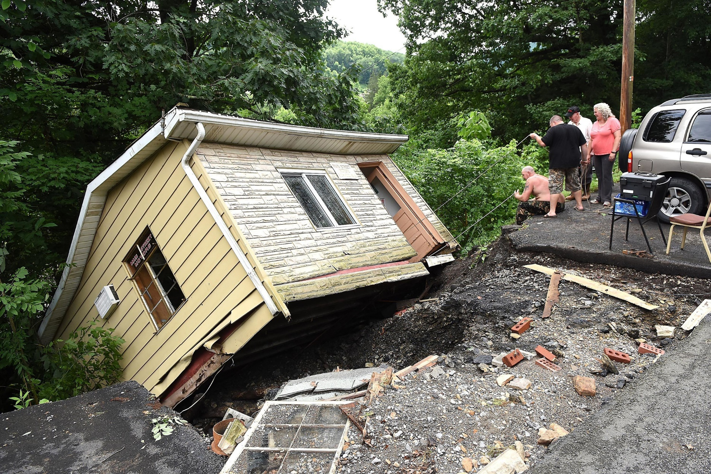
The Flood

Slide 6
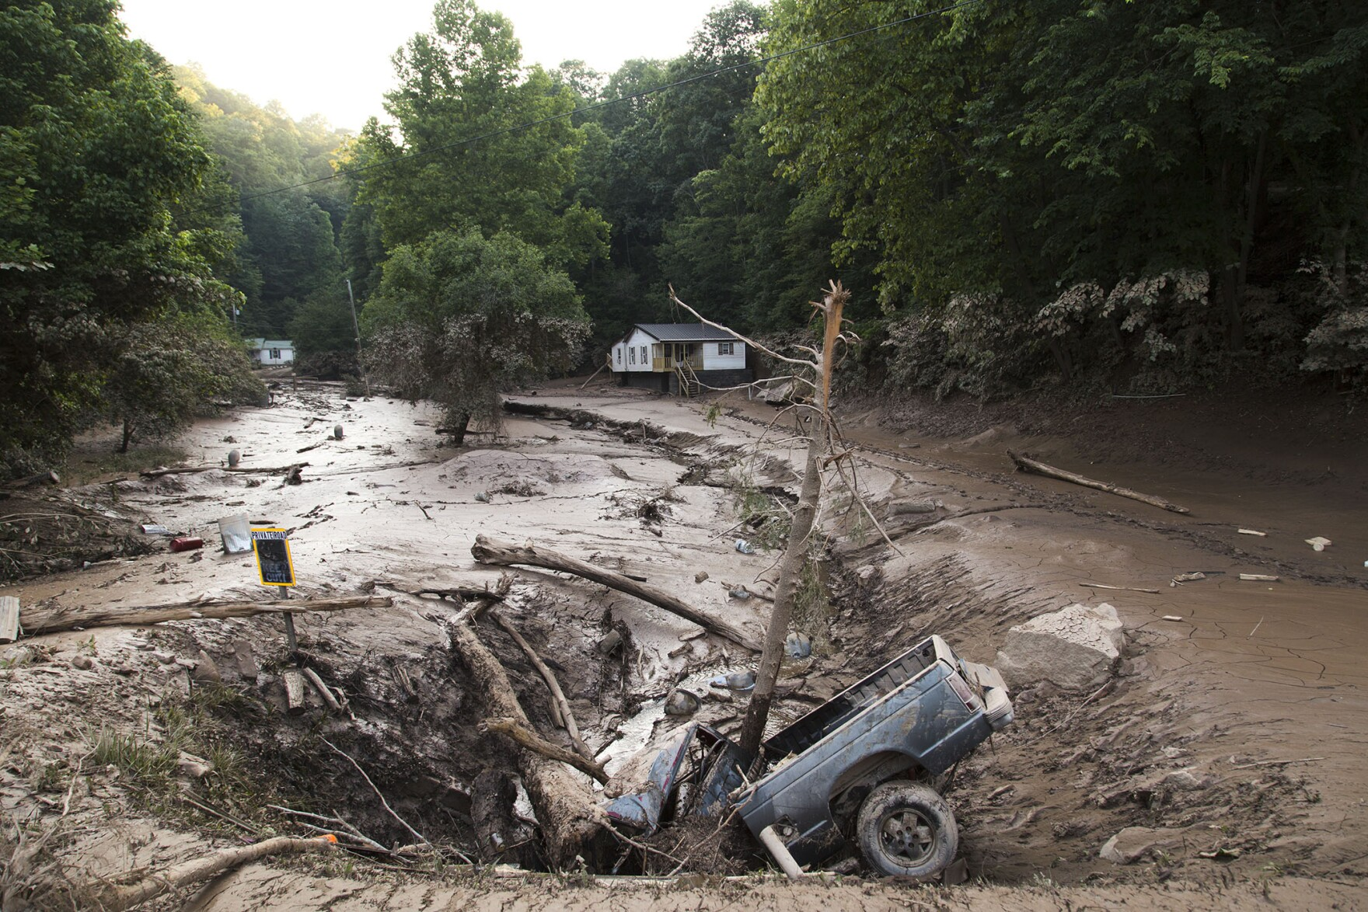
The Flood

Slide 7
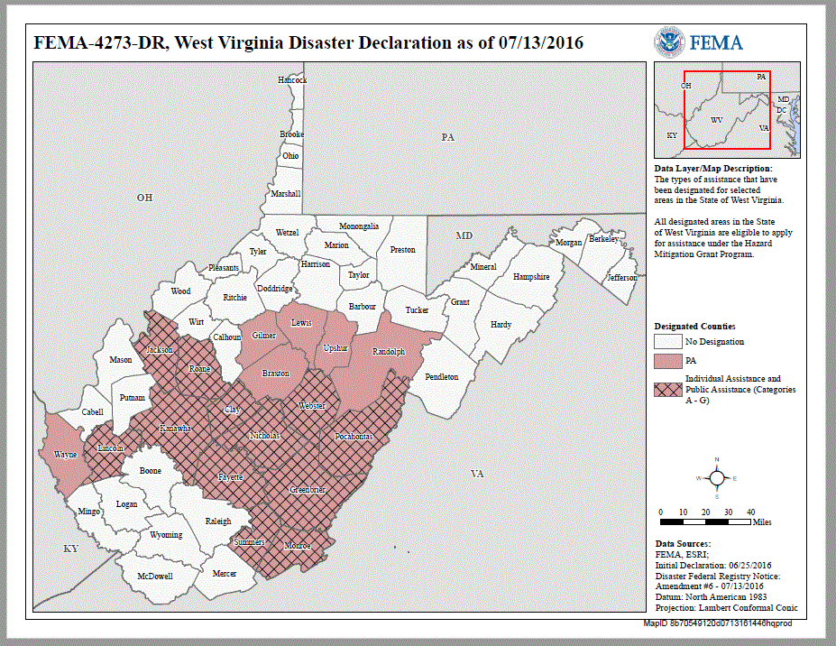
The Flood

Slide 8
The Flood
Resulted in 23 deaths
Deadliest flood since the 2010 Tennessee floods.
1,000-year event for parts of Kanawha, Fayette, Nicholas, Summers and Greenbrier Counties.
The Elk River rose to an all-time high of 33.37 ft., surpassing the previous record of 32 ft. set in the 1888.
Declared State of Emergency in 44 of the state’s 55 counties.
Greenbrier County was the hardest-hit with 15 deaths.
The National Weather Service has described the magnitude and intensity of the June 2016 rain as a “once in 1,000 years” event. Over 10 inches of rain fell, much within 12-18 hours.

Slide 9
Why discuss now?
This past June was the 7th anniversary of the flood event.
Much of the damage done on Federal and State routes have been repaired under funding sources provided.
But there are a group of individual owner's private water crossings that has still have crossings that show need of repair or replacement because of lack of resources to complete repairs or replacements.
These local residents are very resourceful working with the means they have and a sense of community to keep these crossing open.
Why this in so important?
Medical needs
Basic needs like obtaining food, etc.
Obtaining deliveries of propane.
Ability to have septic tanks pumped

Slide 10
Why discuss now?
There are many WV residents in need of help 7 years after the flood to repair or replace their privately owned water crossing.
The Community Development Block Grant Mitigation Program (CDBG-MIT) funds pose a unique opportunity for eligible grantees to use this assistance in areas impacted by recent disasters to carry out strategic and high-impact activities to mitigate disaster risks and reduce future losses.
Congress appropriated $12 billion in CDBG funds in February 2018 specifically for mitigation activities for qualifying disasters that occurred in 2015, 2016, and 2017, and HUD was able to allocate an additional $3.9 billion, bringing the amount available for mitigation to nearly $16 billion.

Slide 11
Why discuss now?
Regions 2 and 4 Regional Planning and Development Councils had motivation to seek assistance for their areas, knowing that there was need from local residents in context of private water crossings.
Let’s follow a roadmap of how the grant was applied and to discuss what was discovered.

Slide 12
MAKING IT HAPPEN
1
2
3
6
5
4
7
8
9
The Road to Evaluating Private Water Crossings in 9 Steps.

Slide 13
Region 4 PDC Grant
1
The Region 4 PDC applied and received a $250,000 planning grant from the US Department of Housing and Urban Development’s Community Development Block Grant Mitigation Program. The grant’s goal was to identify and verify locations of residents and businesses in need of mitigation efforts and to assess vulnerability of vehicular access during or after disasters.
Request for Proposals were advertised.
Submissions were submitted and reviewed.

Slide 14
Study
2
The Thrasher Group was awarded the contract.
The study had little precedence as to previous types of similar studies.
Concept was to anticipate flexibility in process as data was obtained.
To provide success in the vision of the study, a task group was forms of the stakeholders to make sure deliverables were implementable.
Contract was a “lump sum” contact.

Slide 15
Study
2
Objectives for the study included:
Obtain and review list of potential water crossings as obtained from WV VOAD.
Contact owners of crossing with a survey.
Contact other sources of information (911, County Floodplain Coordinators, etc.)
Conduct Tier 1 initial review of locations and narrow down to Tier 2 review of 50 crossings in the field.
Review approximately 50 locations in the field and provide recommendations.
Provide Final Report for implementation.

Slide 16
Tier 1 Location Review
3
355 locations determined eligible for review from 6 counties in Region 2 and 4.
Fayette (36)
Greenbrier (103)
Lincoln (84)
Nicholas (79)
Pocahontas (10)
Webster (43)
Unique designated reference provided for each location (Ex: Lincoln County: 02-22-XXX)
Master spreadsheet developed for all locations to collect information.
Preliminary GIS Database developed.

Slide 17
Tier 1 Location Review
3
Residences with only PO Boxes listed for address were problematic and out of 57 none could be located.
Crossings with a physical address were assigned coordinated to allow review. Actual crossing location was then determined where possible using Google Earth.
A “Desktop” review was conducted for each location to evaluate crossings on categories to assist in determine list of crossings to be considered for the Tier 2 field evaluation.

Slide 18
Tier 1 Location Review
3
Tier 1 crossing review (Desktop Review)
Determine coordinates for crossing.
Identify type of crossing (Ex: Bridge, pipe, etc.).
Is there an alternate access?
Endanger species potential (IPaC)
Floodplain Information (In 100-Year Floodplain)
Ownership (Same as applicant?)

Slide 19
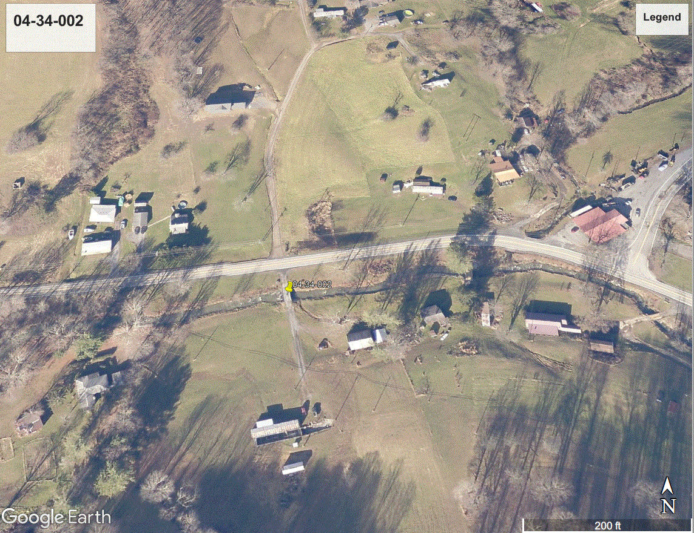
Tier 1 Location Review
3
Plan View of Crossing and Coordinates

Slide 20
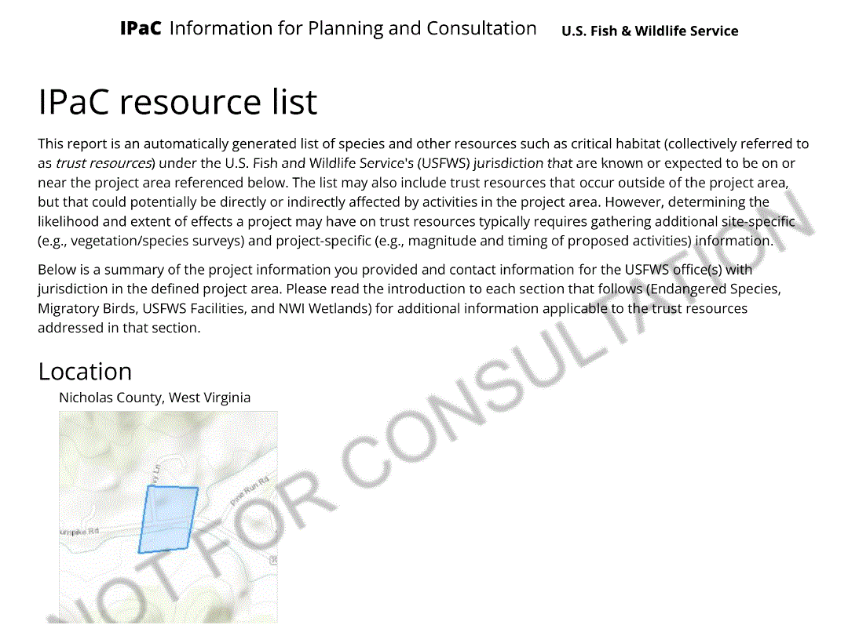
Tier 1 Location Review
3
IPaC Documentation of Potential Endangered Species

Slide 21
Tier 1 Location Review
3
Floodplain Information

Slide 22
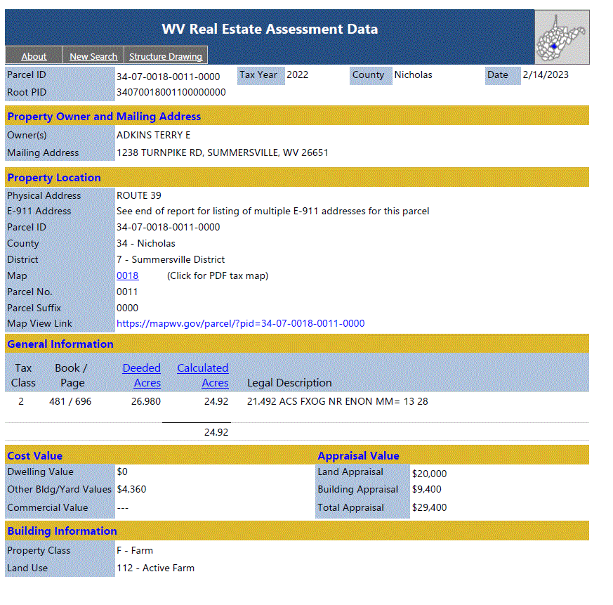
Tier 1 Location Review
3
Tier 1 crossing review (Desktop Review)

Slide 23
Tier 1 Location Review (GIS)
3
The use of Geographic Information Systems (GIS) was vital in every step of the process. How?
It allowed the initial development of coordinates based on physical addresses.
ArcGIS was utilized to place locations as nodes on maps to show the extent of locations.
A “dashboard” was developed which allowed the display of all documentation. It became the modern version of a file cabinet.

Slide 24
Tier 1 Location Review (GIS)
3
Layers in GIS allowed overlap of data including:
Drainage structure locations
WV DOH District designation maps
Economic districting show income limits
WV Flood data
2015 HUD LMI data
Dashboard allows filtering of data for review. Including:
Filter by County
Filter by Tier
Filter by Structure

Slide 25
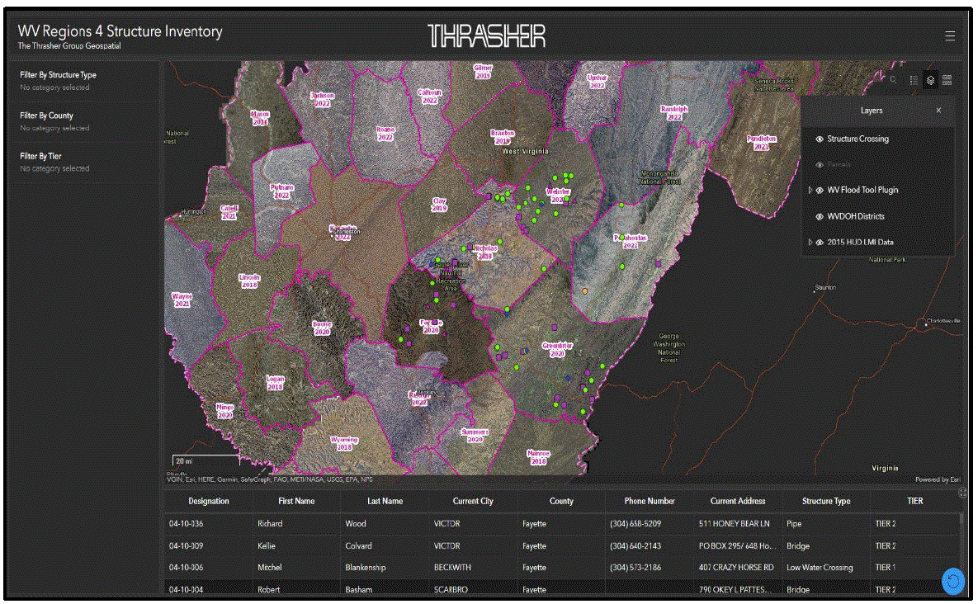
Tier 1 Location Review (GIS)
3
Screenshot of Dashboard

Slide 26
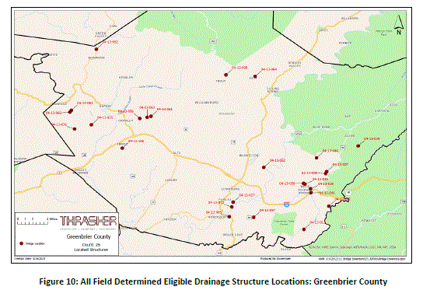
Tier 1 Location Review (GIS)
3

Slide 27
Survey
4
Tier 1 was a “Desktop” review meaning that information was very limited and reviewed using available web-based information. It was decided early to send a survey to each location in an attempt o obtain crucial information to assist in evaluating each location. The survey was designed to collect information that paralleled the mitigation requirements of the grant.

Slide 28
Survey
4
Key points from letter:
Who is conducting survey.
Emphasized the 2016 flood event.
The Thrasher Group provided assistance.
Survey could be returned via self addressed stamped envelope or done electronically.
A gift card was given to one lucky submission to encourage submissions.
Gave contacts of Region 2 and 4.
Placed on the Region’s website.
Letter to Applicants of Water Crossings

Slide 29
Survey
4
Information desired included:
Type of crossing
Access (only?)
Daily use?
Number households using crossing.
Number school age children
Does school bus cross?
Number residents > 65 years of age.
Individuals with special medical needs.
Can emergency vehicle reach home?
Fire hydrant across crossing?
Business past crossing?
Frequency of flooding?
Does it have need of repair or replacement?
Do you own location or ROW?
Survey of Applicants of Water Crossings

Slide 30
Survey
4
Out of 346 surveys sent, the following was determined:
Received 33 completed surveys
23 surveys were returned as “non-deliverable”
Information received was very helpful.

Slide 31
Tier 1 and Tier 2 Data
5
Analysis of all data obtained from surveys and “Desktop” review was entered into the Excel database.
The evaluation of all data of the 346 locations were placed into an Evaluation Matrix (Rubic) to assist is rating each location as to priorities as noted in the grant.
The Rubic was to prioritize locations to allow approximately 50 crossings to be reviewed in the field.

Slide 32
Tier 1 and Tier 2 Data
5
The 50 locations were proportion to number of locations evaluated per county to allow even distribution to all locations.
Rubic used measurable categories scoring each category ranging from a 1 to 10 with categories weighted up to a 3 factor if deemed critical.
Rubic also rated categories for locations where assumptions had to be made .
Guidelines were provided to ensure a consistent approach to evaluation.

Slide 33
Tier 1 and Tier 2 Data
5
Keys to categories that made a crossing a high priority:
Mitigation of issues lessen impact of future disasters at location.
During flooding, families are affected by insufficient vehicular access, especially medical.
Individuals with medical needs.
Would improvements reduce repetitive loss of properties.

Slide 34
Tier 1 and Tier 2 Data
5
After evaluating the 346 locations and scoring each via the Rubic, it was decided to field visit locations in the 6 counties as the following:
Fayette (5)
Greenbrier (9)
Lincoln (16)
Nicholas (8)
Pocahontas (4)
Webster (9)

Slide 35
Tier 1 and Tier 2 Data
5
A Field Review form was prepared for each location and data collected. Details included:
General Information
Pipe Information (If applicable)
Structure Information (If applicable)
Waterway opening information
Recommendation:
Do nothing
Repair
Replace
Estimated Cost:
The goal of the collection was to determine condition and also predict if structure could survive another storm event.

Slide 36
Findings
6
13 of 51 locations (25.5%) were designated as “Repair”. Examples: Deck replacements, scour mitigations, headwalls replaced, etc.
14 of 51 locations (27.5%) were designated as “Replace”. Issues leading to replace included:
Structure would not allow residential vehicular use.
Damage apparent
Substructure or superstructure elements deemed critical based on visual inspection.
Residence has medical needs and requires use of emergency vehicles
Multiple residents use.
53% of all crossings reviewed were recommended to be repaired or replaced.

Slide 37
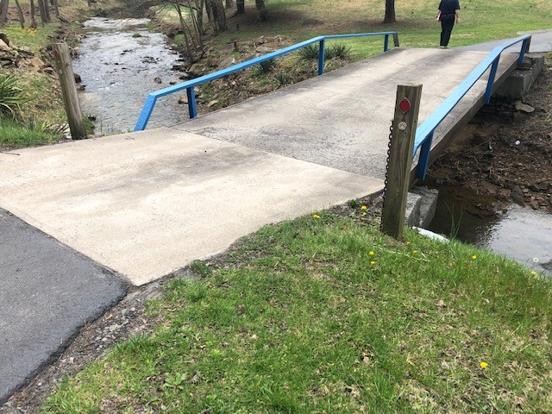
Findings
6
The Good:

Slide 38
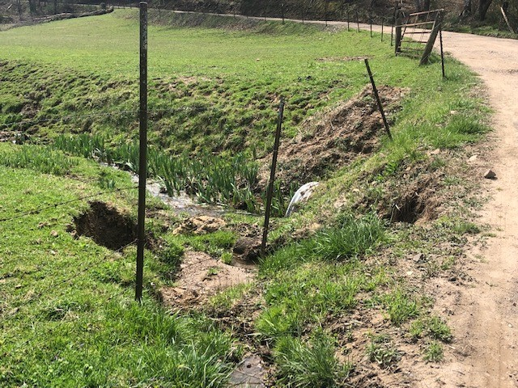
Findings
6
The Good:

Slide 39
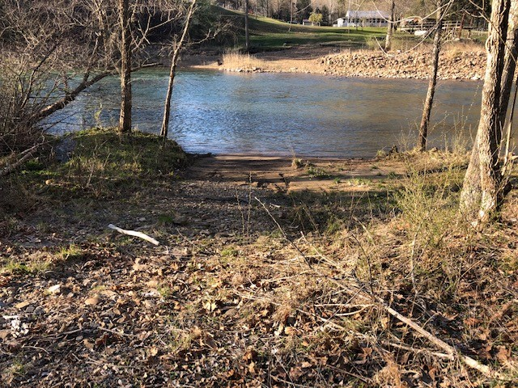
Findings
6
The Good:

Slide 40
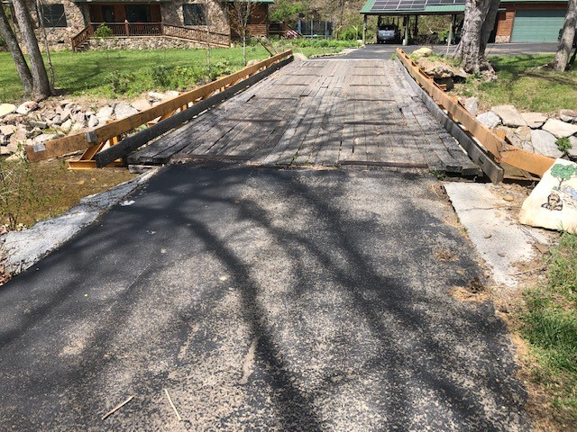
Findings
6
Repairs (New Deck Proposed):

Slide 41
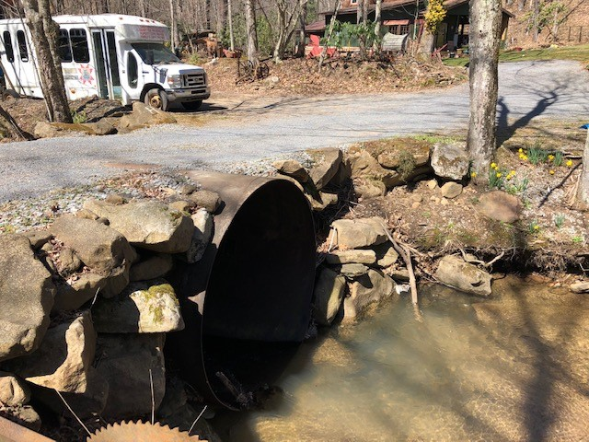
Findings
6
Repairs (Headwall Required):

Slide 42
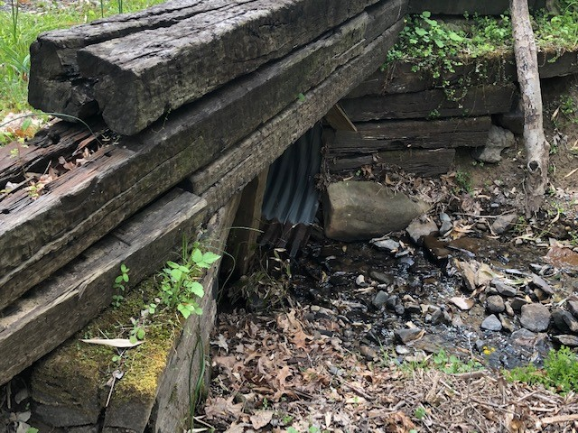
Findings
6
Repairs (Downstream Timbers Require Replacement):

Slide 43
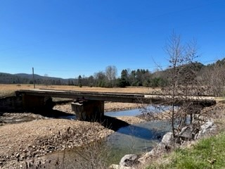
Findings
6
Recommended Structure Replacements: Failing Pier

Slide 44
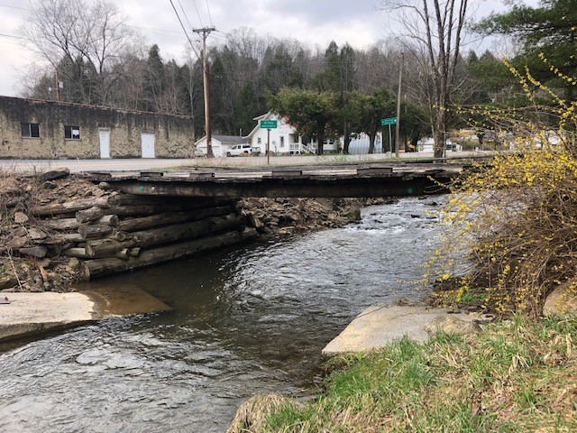
Findings
6
Recommended Structure Replacements: (Replaced abutments
Timber and Telephone Pole Stringers Deflecting.

Slide 45
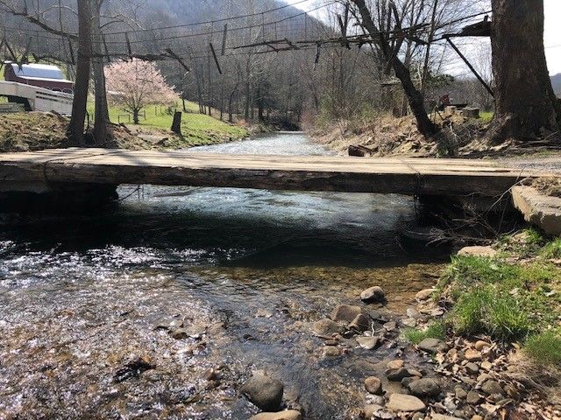
Findings
6
Recommended Structure Replacements: Crane Mat Spanning
Washed out Low Water Crossing.

Slide 46
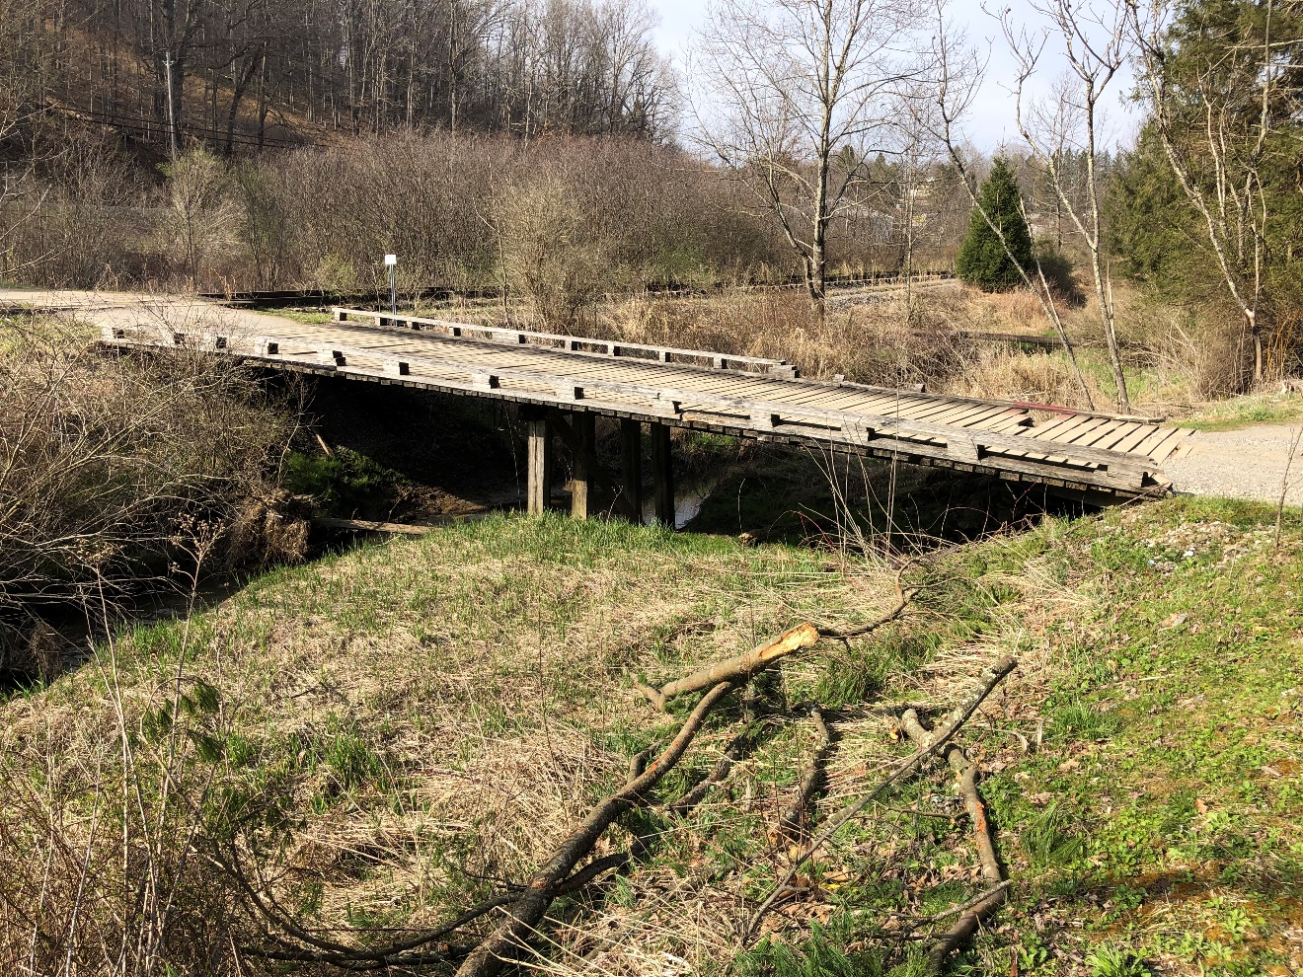
Findings
6
Recommended Structure Replacements: Two Span Structure
To Multiple Residences. Railroad Steel Stringers and Failing
Superstructure.

Slide 47
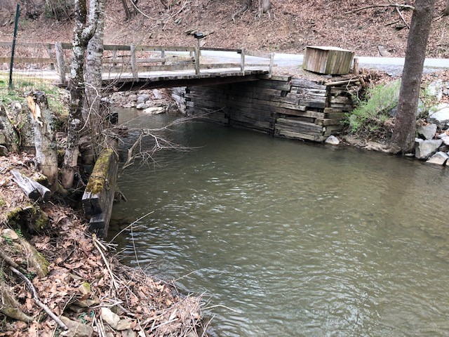
Findings
6
Recommended Structure Replacements: Failing Abutments

Slide 48
Cost for Repair or Replacement
7
WV VOAD and their partners is the primary source on the repairs and replacements of these types of crossings.
WV VOAD uses resources donated and often volunteer assistance to provide the means necessary for the help these residents require.
Funding is required to assist in aspects such as equipment rental, engineering, etc.
It is estimated that a replacement can cost as much as $50 to 75K and repairs vary.

Slide 49
Cost for Repair or Replacement
7
A very preliminary cost estimate to repair or replace the 27 structures recommended is approximately:
$830,000

Slide 50
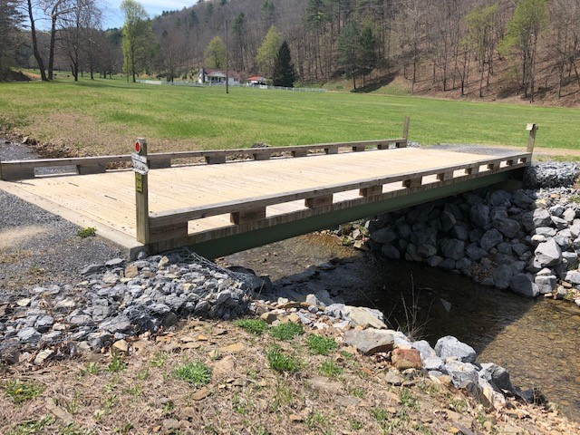
Cost for Repair or Replacement
7
WV VOAD Replacement of Structures

Slide 51
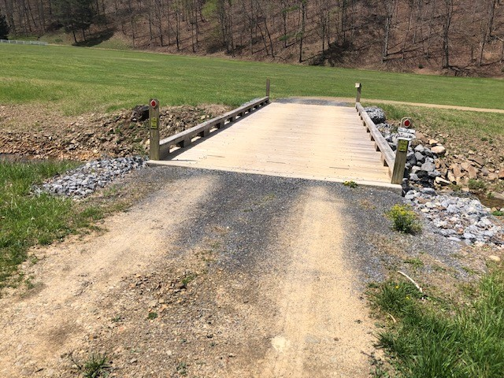
Cost for Repair or Replacement
7
WV VOAD Replacement of Structures

Slide 52
Current Conditions
8
The study has been completed and a final report is available at the Region 2 and 4 websites.
A supplemental study is being undertaken to look at the bridges to be replaced in more detail.
Funding sources are being evaluated to secure funds to do needed repairs or replacements.
7 years later, these structure are facing the reality that many are one storm event away from collapse.

Slide 53
What’s Next?
9
Find funding and resources.
Continue collaborating with multiple resource agencies for assistance.
Always looking for counters to offer resources to assist in repairs and replacements.
Understand that these structures are in desperate need at locations where owners often don’t have resources to repair or replace.

Slide 54
Any Questions?
Thank You
Visit us online
WV VOAD - wvvoad.org
Region 2 Planning and Development Council - region2pdc.org
Region 4 Planning & Development Council - reg4wv.org

