Slide 1
The Changing Face of Volunteering From Affiliated to Spontaneous Models

Slide 4
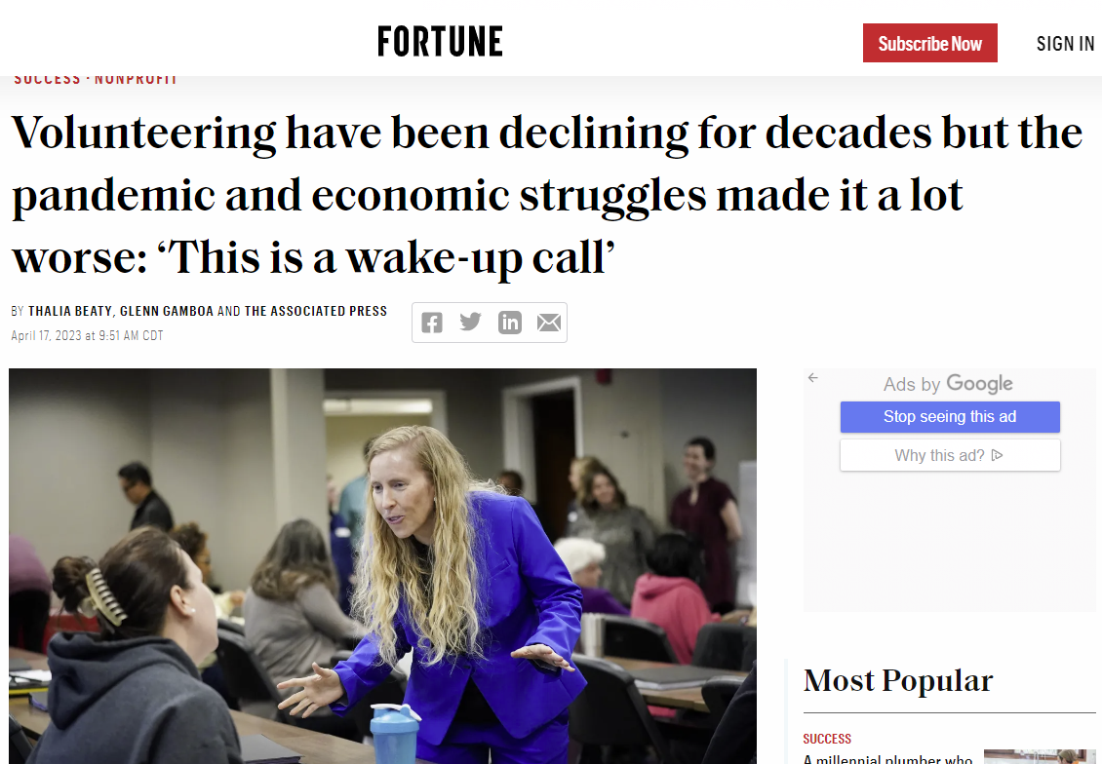
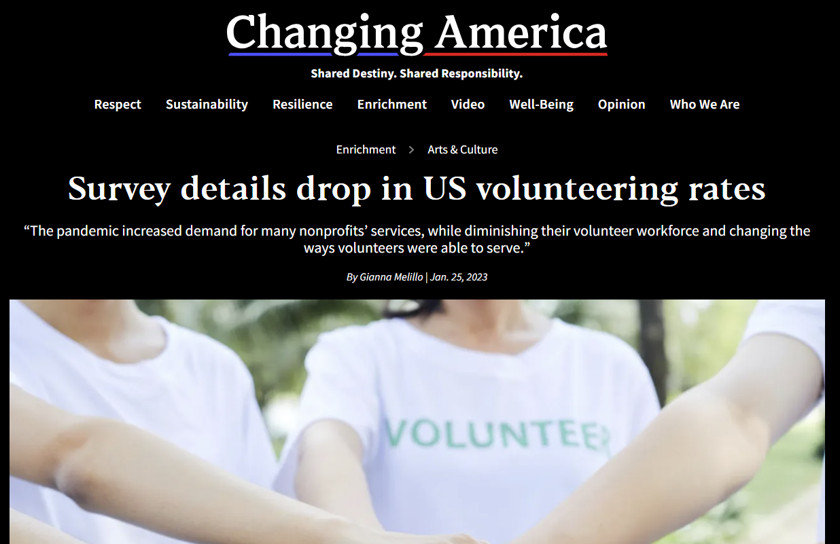
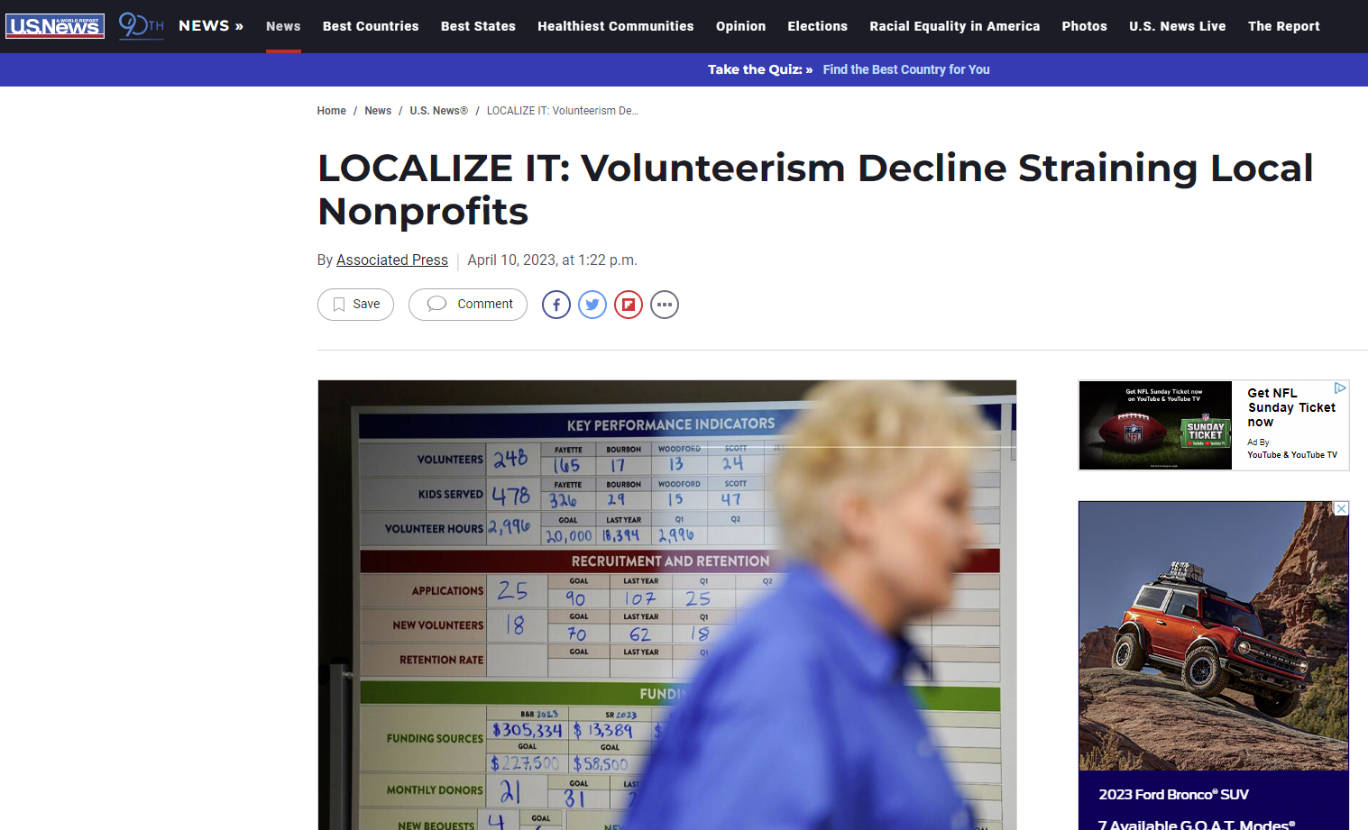
Notes:
We've all been feeling the effects of the declining volunteer population over the years, including Team Rubicon, that was only exacerbated by COVID. As we continue to assess how we can make major impacts during disasters, Team Rubicon looked internally to identify things we could do to position the organization for the future.
https://www.usnews.com/news/business/articles/2023-04-11/localize-it-volunteerism-decline-straining-local-nonprofits
https://thehill.com/changing-america/enrichment/arts-culture/3829623-survey-details-drop-in-us-volunteering-rates/
https://fortune.com/2023/04/17/nonprofit-volunteering-declining-covid-pandemic-economic-hardship/

Slide 5
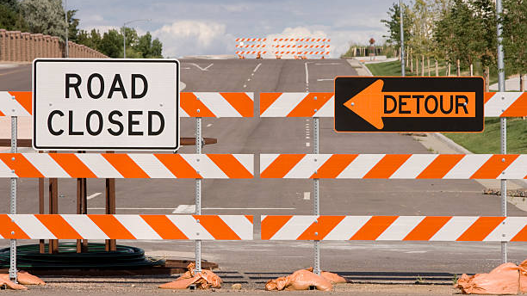
Notes:
Things Team Rubicon has done to begin to pivot away from a holistic affiliated volunteer model and become more flexible to utilizing local, spontaneous volunteers:
Adjusted training requirements for our volunteers.
Incorporate additional emphasis on meeting with local houses of worship and community leaders. (This does duel-purpose in furthering our DEI efforts as well as activating and empowering local volunteers to assist in their own recovery.)
Reviewed our deployment requirements.
Adjusted local, daily minimum service hours (full days, half-days.)
Adjusted flight waves to weekdays instead of shutting down operations and transitioning personnel on the weekends. (The weekends are prime opportunities to engage spontaneous volunteers.)
Added additional options for flights (8-day flight wave vs work week wave.)
Lastly, and the newest change, we have exposed our deployment information publicly.

Slide 6
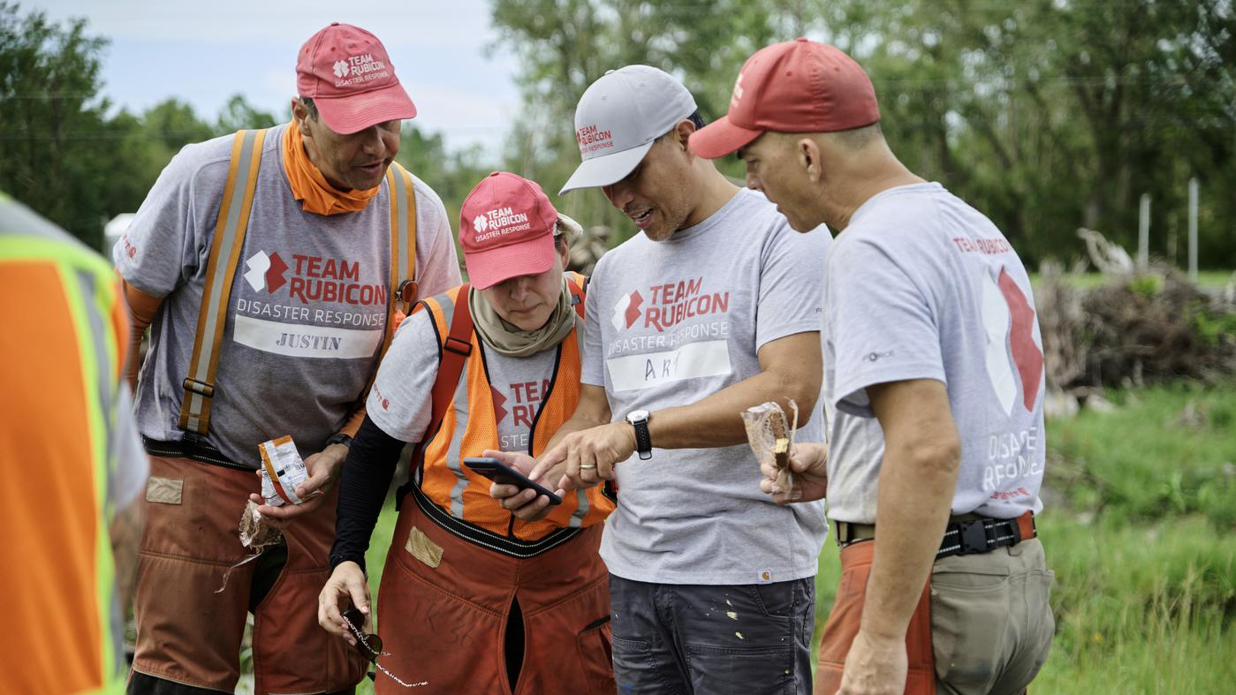
Notes:
Team Rubicon has created our own roadblocks to volunteerism. This included increasing requirements for training and experience just to be a Greyshirt (what Team Rubicon refers to our volunteers as.)
Typical requirements before changes:
C&G – Position Specific Class, Core Ops Class, TR Instructor 1 Class, ICS Classes, Multiple Deployments
Strike Team Leader – Core Ops Class, TR Instructor 1 Class, ICS Classes, Multiple Deployments
Greyshirt – ICS 100, 200, 700, 800, TR Introductory Course, Recon/ADVON Class, Core Ops Class, Roof Tarping Class, Saw 1 Class

Slide 7
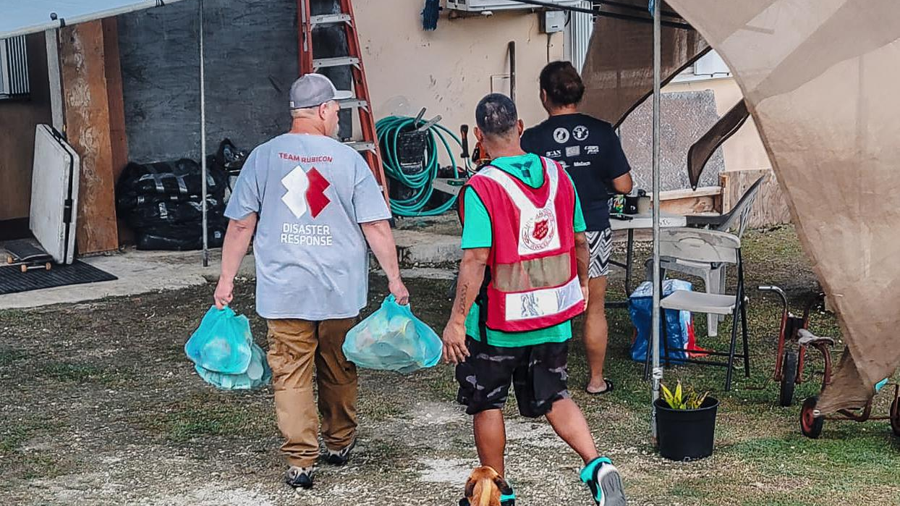
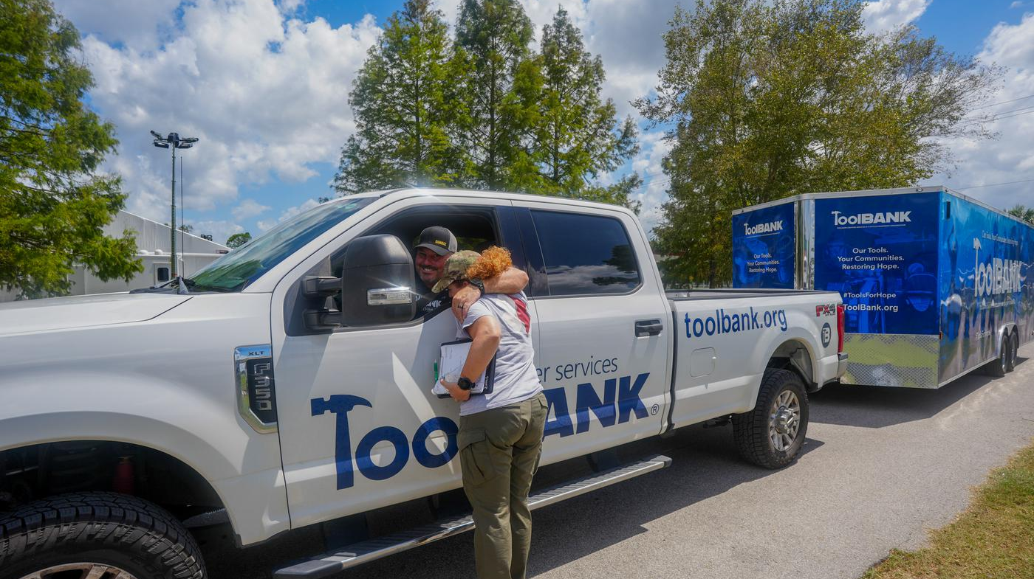
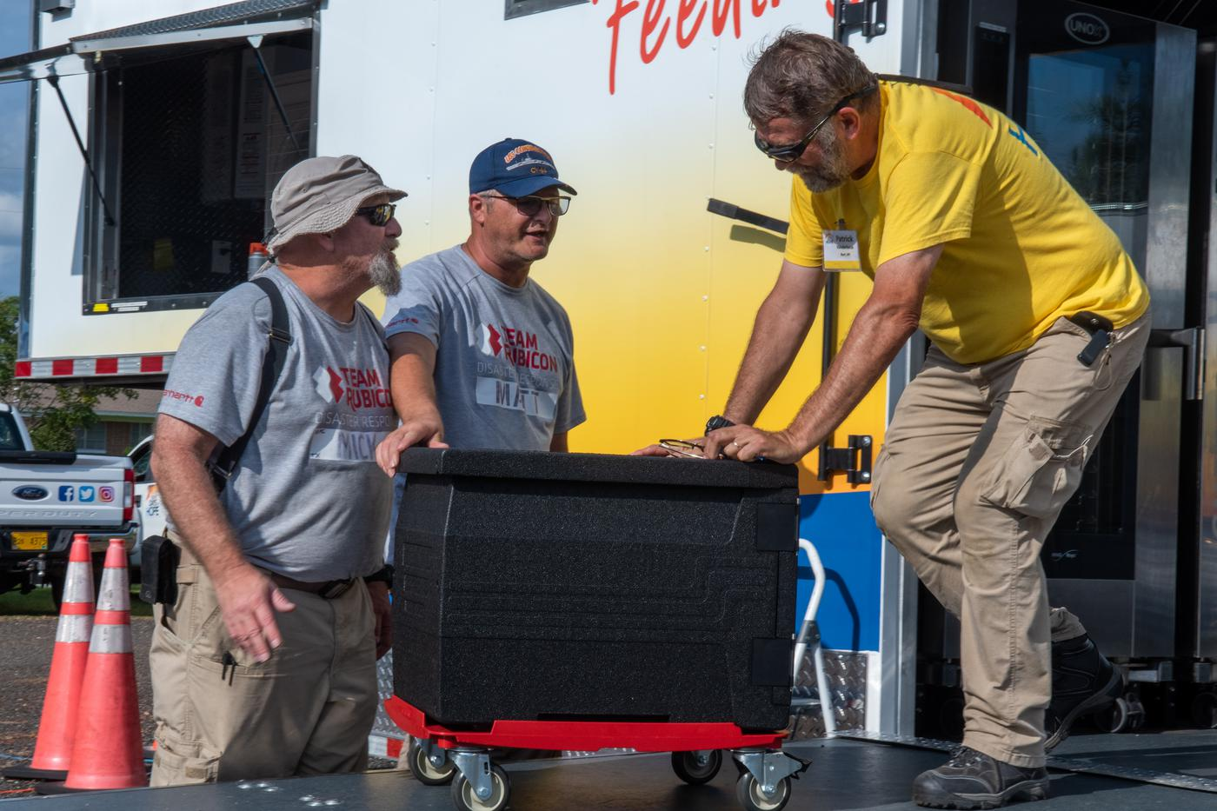
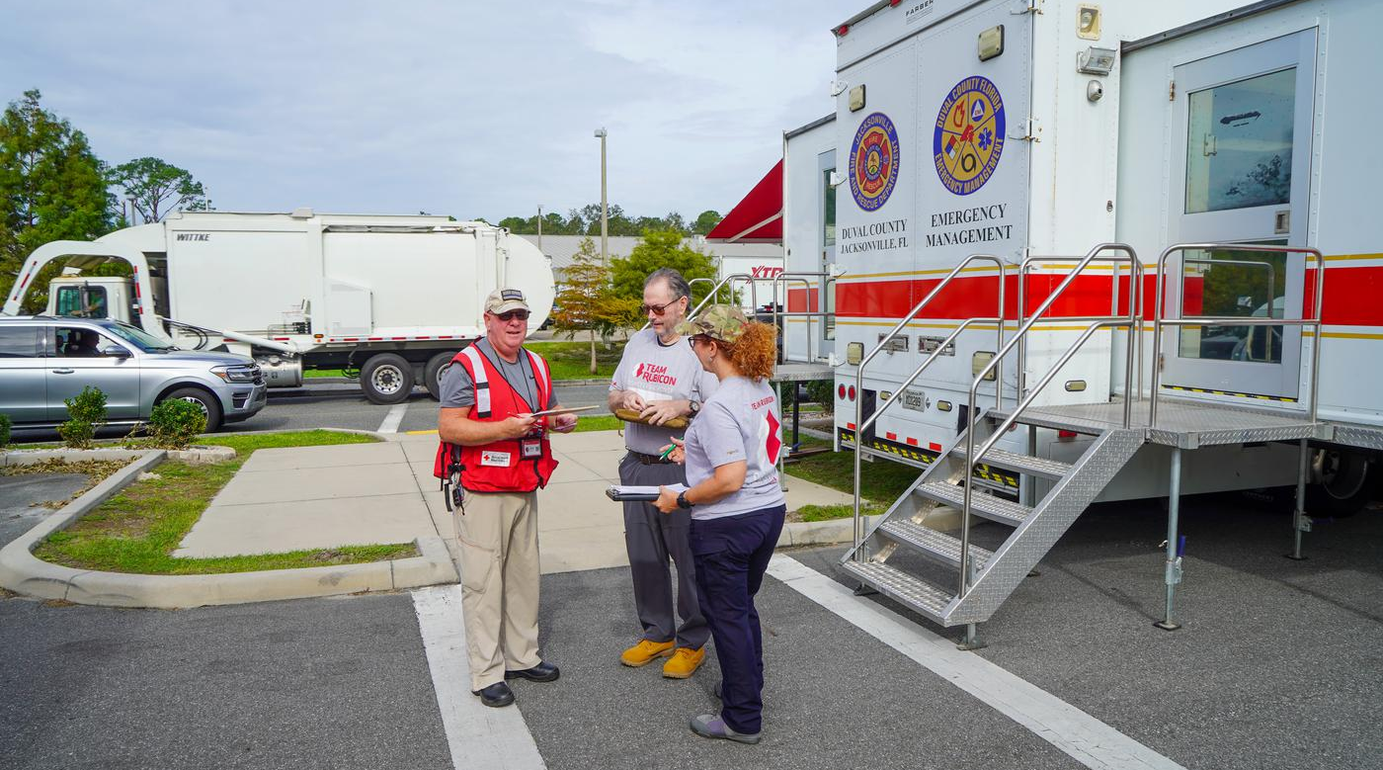
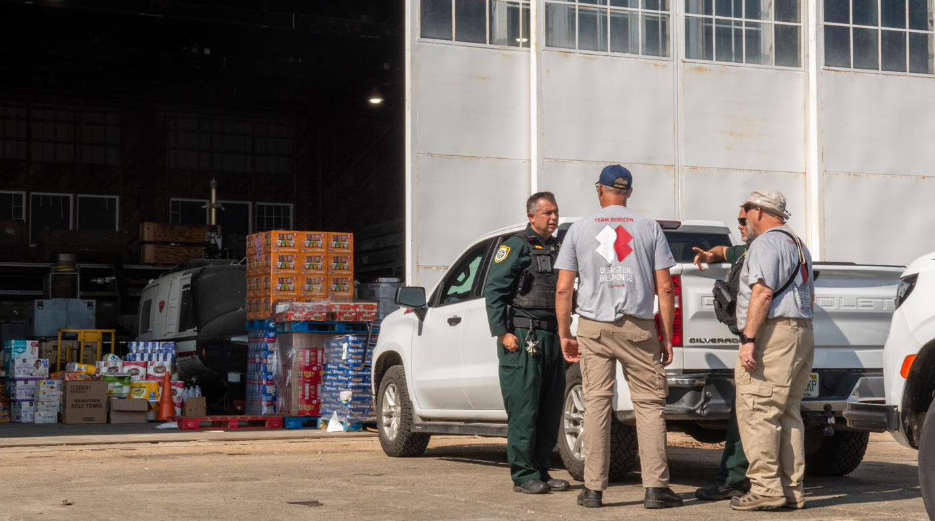
Notes:
Team Rubicon is also now being more diligent regarding making local connections with Emergency Management, Police, and Fire personnel as well as identifying and interfacing with local NGOs, houses of worship, and community leaders.

Slide 8
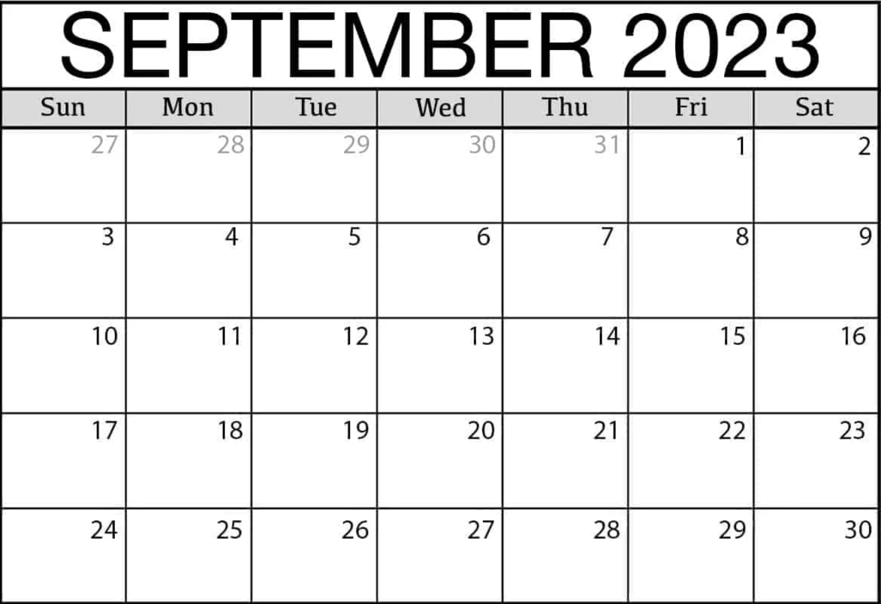
Notes:
Team Rubicon also looked at how we deploy people when we can't source all of our volunteers locally (And we look at this in two ways: Sending competent cadre of C&G and Strike Team Leaders to lead local personnel and sending flight waves.)
Sending competent cadre of C&G and Strike Team Leaders is preferred but that requires a strong base of local, spontaneous volunteers. Our teams can organize, train, and equip these volunteers to produce impactful work and build resiliency. There's also a secondary affect of by activating these local personnel, it helps them with their psychological processing of the disaster and speeds up recovery.

Slide 9
Notes:
This calendar depicts how Team Rubicon deployed Greyshirts in the past (when local volunteers weren't available.) We heavily invested in flying Greyshirts with availability into disaster areas to support recovery. In order to maximize their time, we created 8-day flight waves that started and ended on a weekend day. This allowed the Greyshirt to only have to take, usually, 5 days off of work.
However, what this also did was essentially shut down our operations on the weekends – primetime for activating local, spontaneous volunteers.

Slide 10
Notes:
So Team Rubicon has continued to utilize our 8-day flight waves, but we've ensured the travel and transition days occur on weekdays, that way we have sufficient personnel on the ground to employ those local, spontaneous volunteers.

Slide 11
Notes:
We've also taken it a step further during large-scale disasters. In order to maximize personnel on the ground, we created and provide two options for non-local Greyshirts to deploy: an 8-day deployment and a "work week" deployment that allows for travel on a Monday and Friday. This has also allowed Team Rubicon to beef-up assessments or prep work during the week in preparation for larger bodies of local, spontaneous volunteers on the weekends.

Slide 12
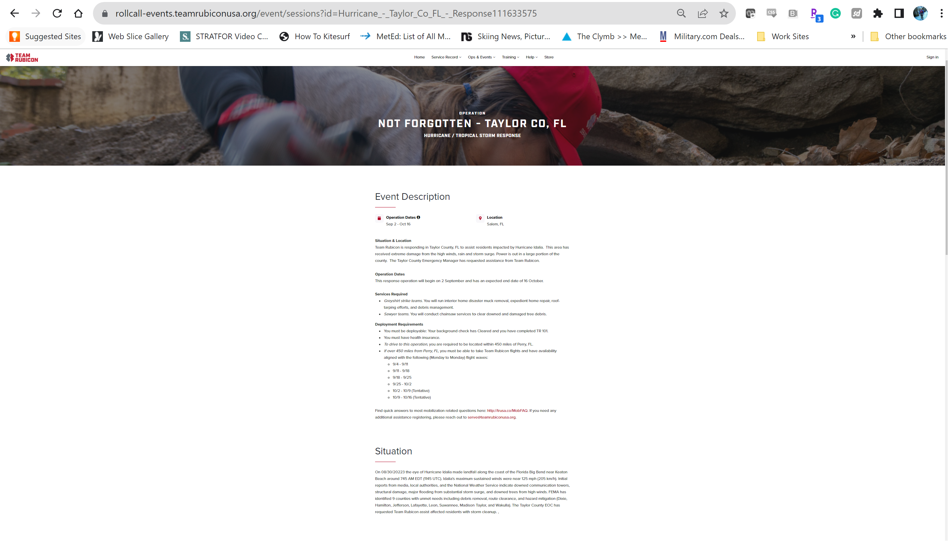
Notes:
https://trusa.co/44z1ci3

Slide 13
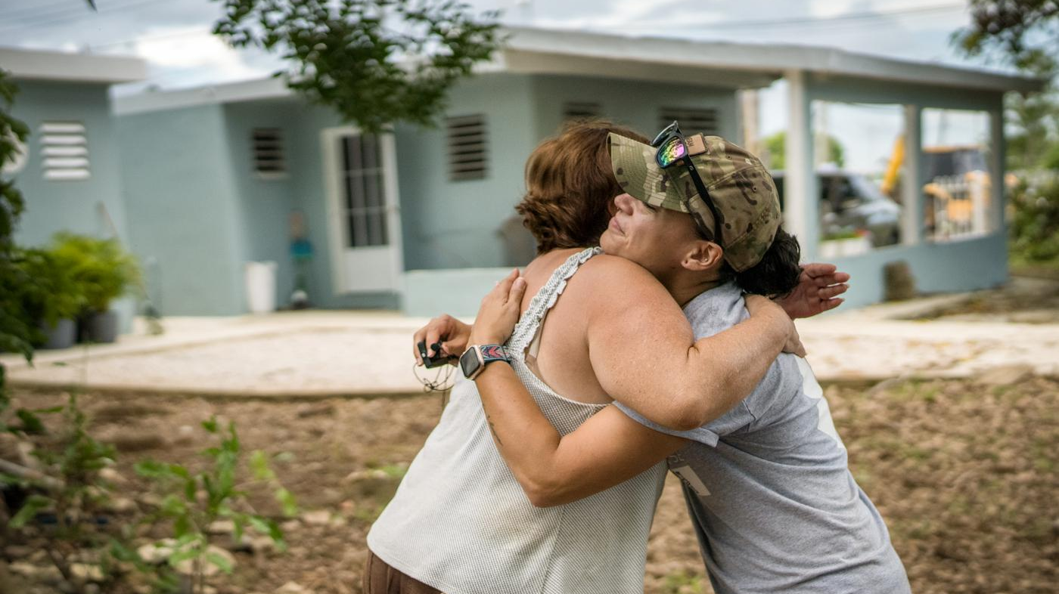
Notes:
Questions?

