Slide 1
Improving mass care feeding through public assisatance
WVVOAD 2023

Slide 2
Pre-pandemic days of OBR
MOU with NGO’s
Meal prep and cook, partners deliver
Fraction of meals reimbursed by those who had the state MOU’s
Leaned heavily on CSR of private sector

Slide 3
Covid-19 Feeding
MOU with Commonwealth of PA
Last mile delivery
Operation Restaurant Relief
Afghan refugees
Collaboration with the tribal nations

Slide 4
The disasters began to outpace our resources
Capacity
Long term sustainability
Branding
Control of food safety and waste

Slide 5
work with FDEM prior to disaster
Participating in training exercises
Opportunity to provide disaster meals.
WebEOC training in Tallahassee 2023
Meeting with county and state EOC
Obtain Vendor registration (System for Award Managementor SAM # with active UEI)
Develop programs that allow us to pivot and maintain capacity.
Technology
Ensuring we have Teams available to staff EOC

Slide 6
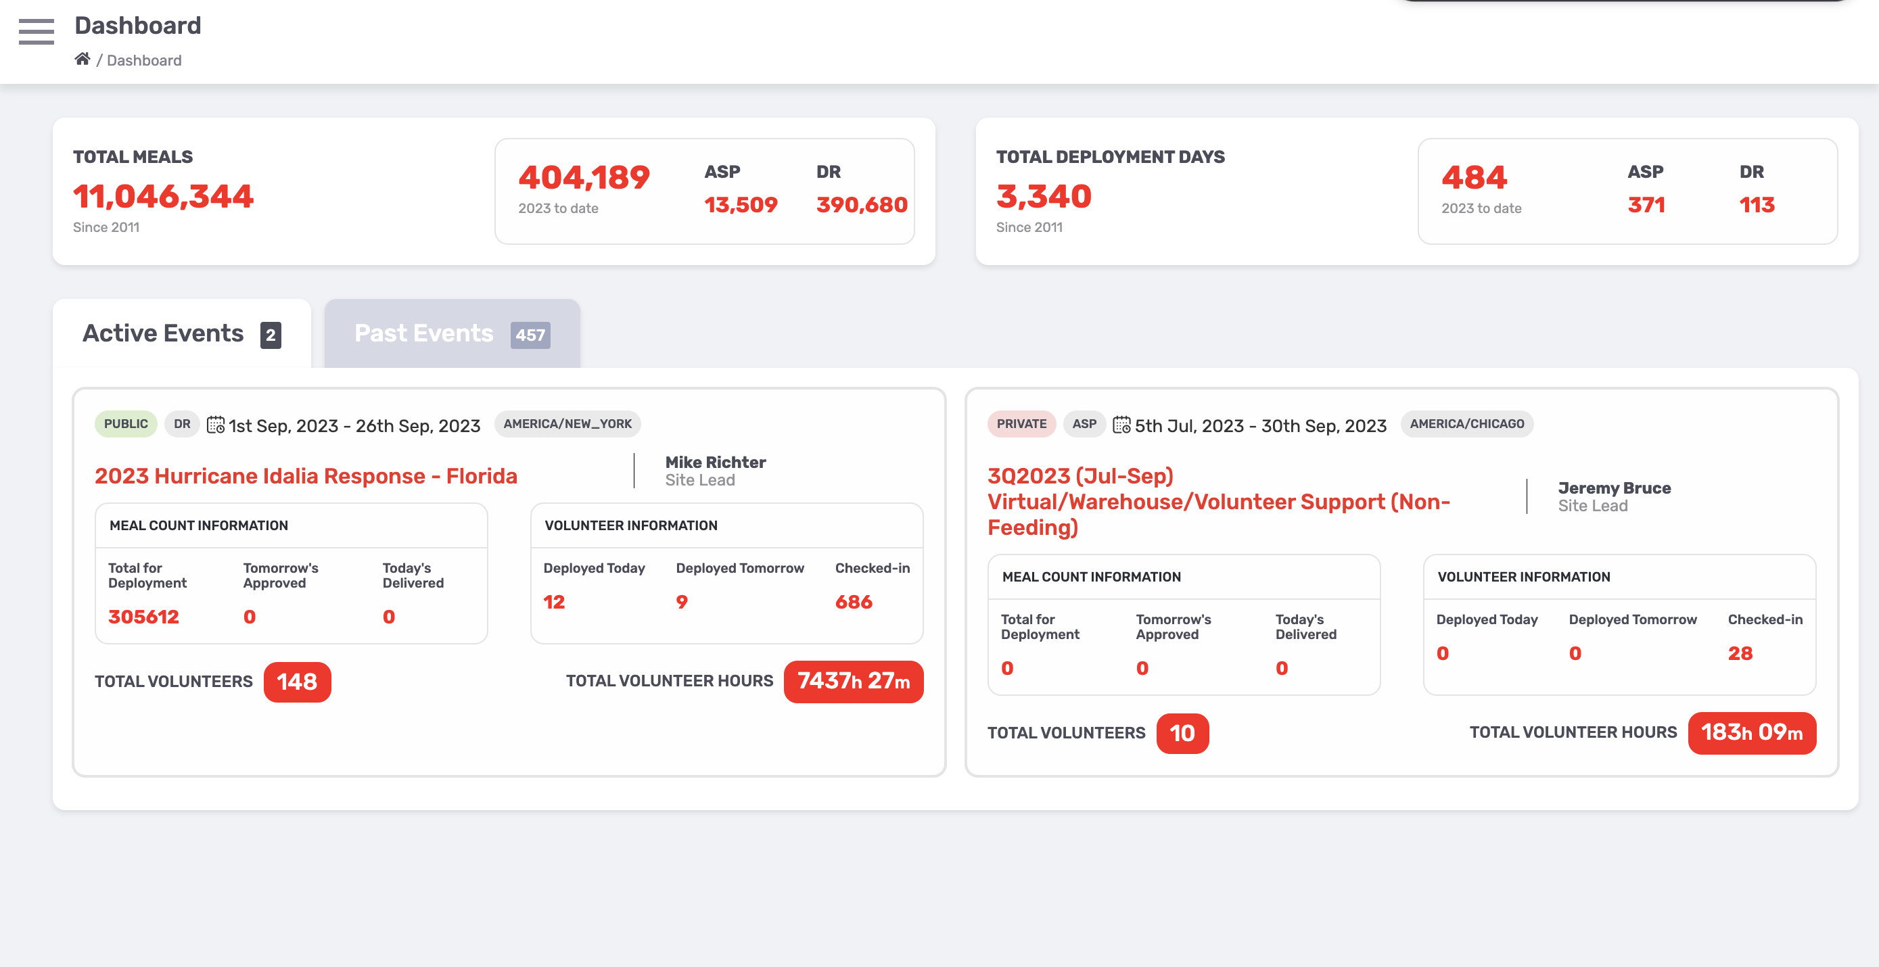
CHARLESTON & WHITE SULPHUR SPRINGS, WEST VIRGINIA (FLOODING) / 30,657 MEALS OVER 8 DAYS

Slide 7
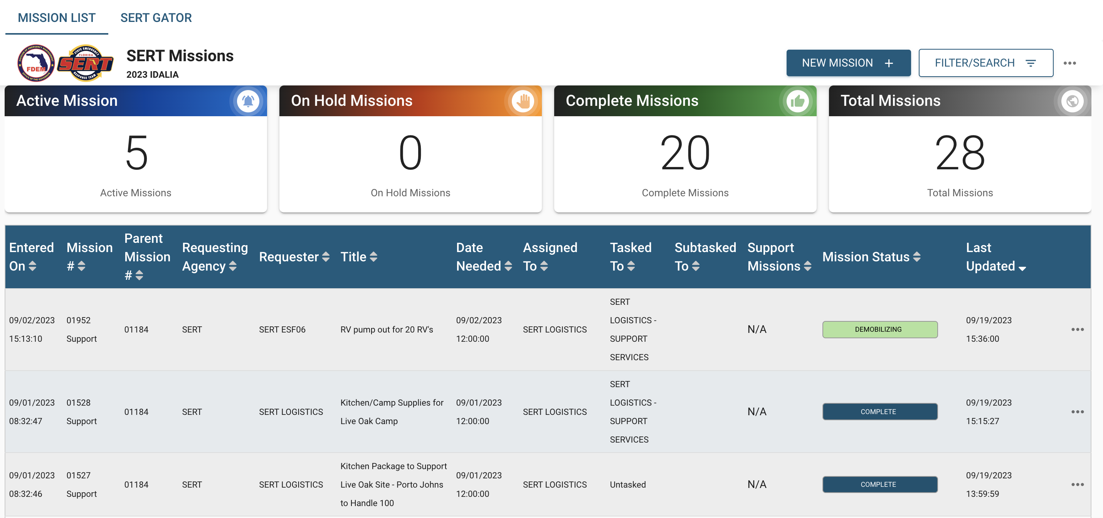
Lesson Learned in Ian and Idalia
Real time tracking of mobile units
Utilization of technology to improve
feeding to underserved/marganilzed communities
WeBEOC training
Capture additional information on Volunteer hours.

Slide 8
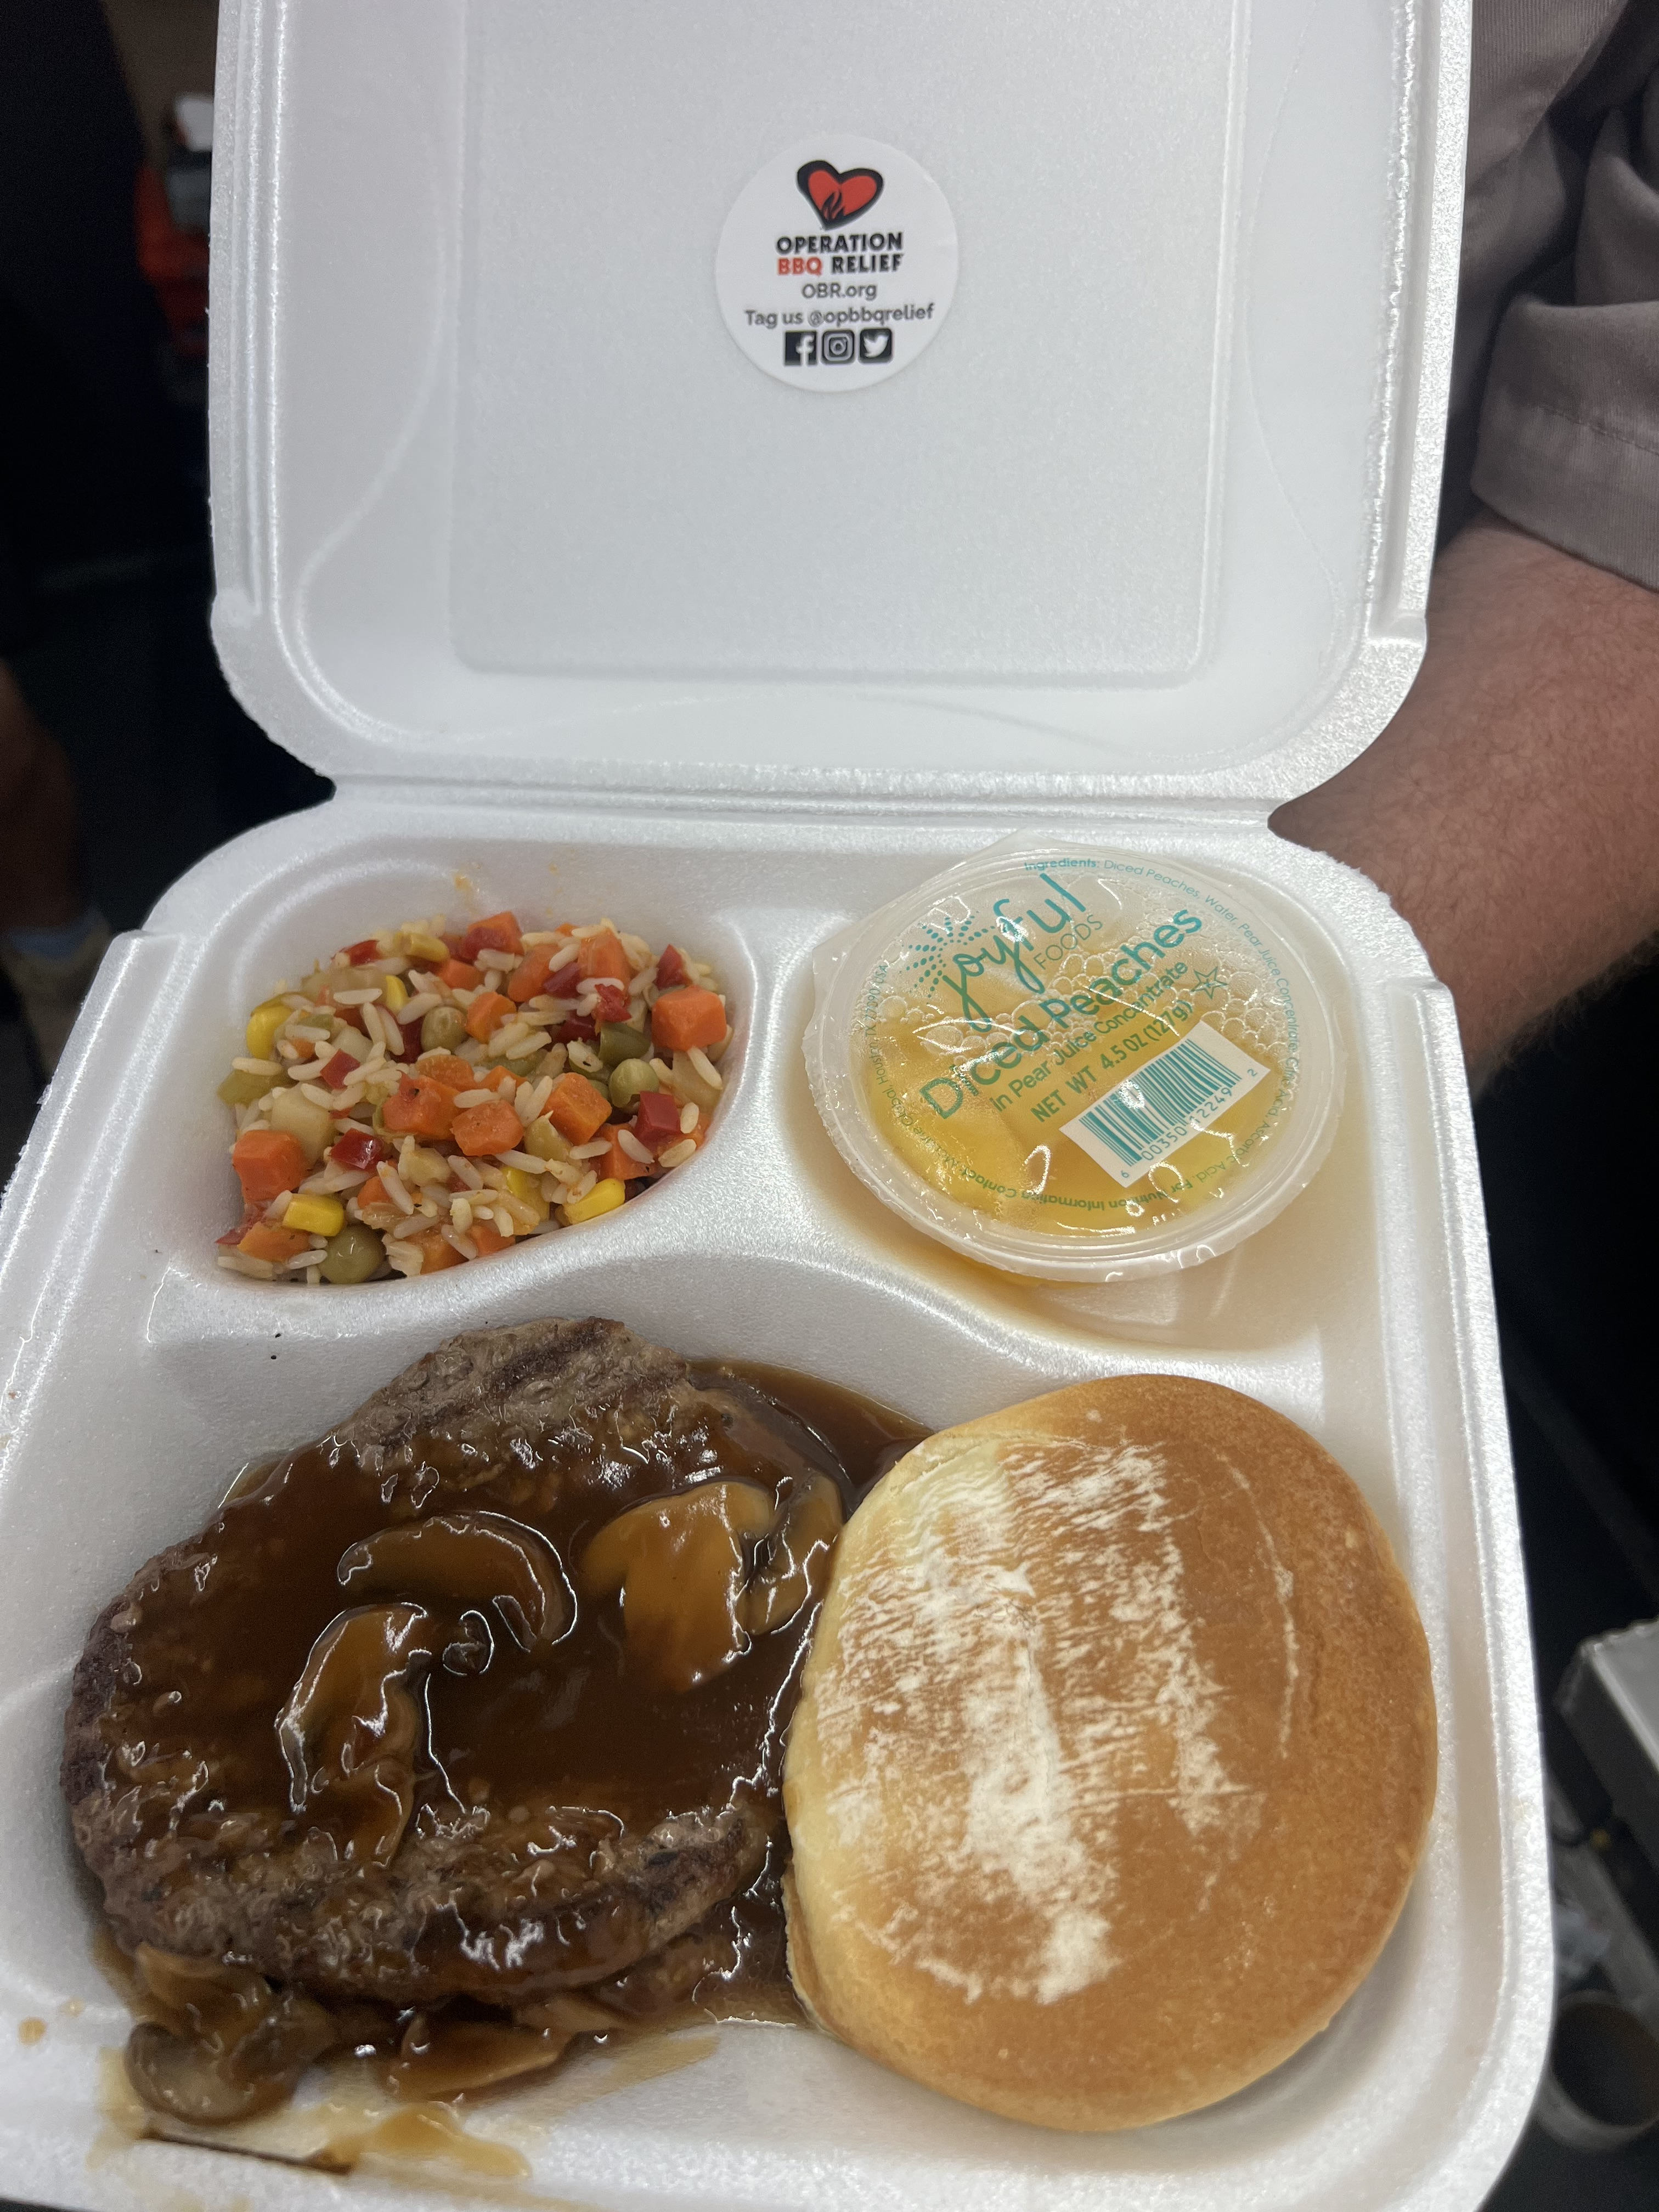
Forward facing
Drone delivery
Last Mile delivery
Increasing capacity
Reaching vulnerable, marginalized and underserved communities
Continued pursuit of MOU’s with states

