Slide 1
Partnering for West Virginia Disaster Resilience
September 2023

Slide 2
Session Goal
Identify opportunities and next steps for deeper partnership between Good360 and West Virginia .

Slide 3

OUR MISSION
Good360’s mission is to close the need gap.
As the global leader in product philanthropy and purposeful giving,
we partner with some of the world’s largest corporations to source essential goods and distribute them through our network of diverse nonprofits, supporting people in need and opening opportunity for all.

Slide 4
We Know There Is Enough
We live in a world of plenty, yet millions of people find themselves in critical need every day, creating a vast need gap.
At Good360, we know there is enough to go around.
That’s why we work to move donated goods where they can do the most good, to close the need gap to open opportunity for all.

Slide 5





Nonprofit Channels
Donation
Catalog
Direct Truckload Program
Retail Match Program
Redistribution Partners
Disaster
Recovery
Receive donations sorted and shipped from our warehouse(s)
Receive a large volume of needed goods delivered by the semi-trailer
Match with a local retailer in your area to receive regular donation pickups
Source needed goods from a local redistribution partner in your area
Receive appropriate goods delivered throughout all stages of a disaster

Slide 6
DISASTER RECOVERY
Our disaster recovery efforts are focused on providing support for natural disasters and humanitarian crisis that overwhelm regional capacity. We are committed to ensuring that the right goods are delivered to the right people at the right time, with a focus on long-term recovery.

Slide 7
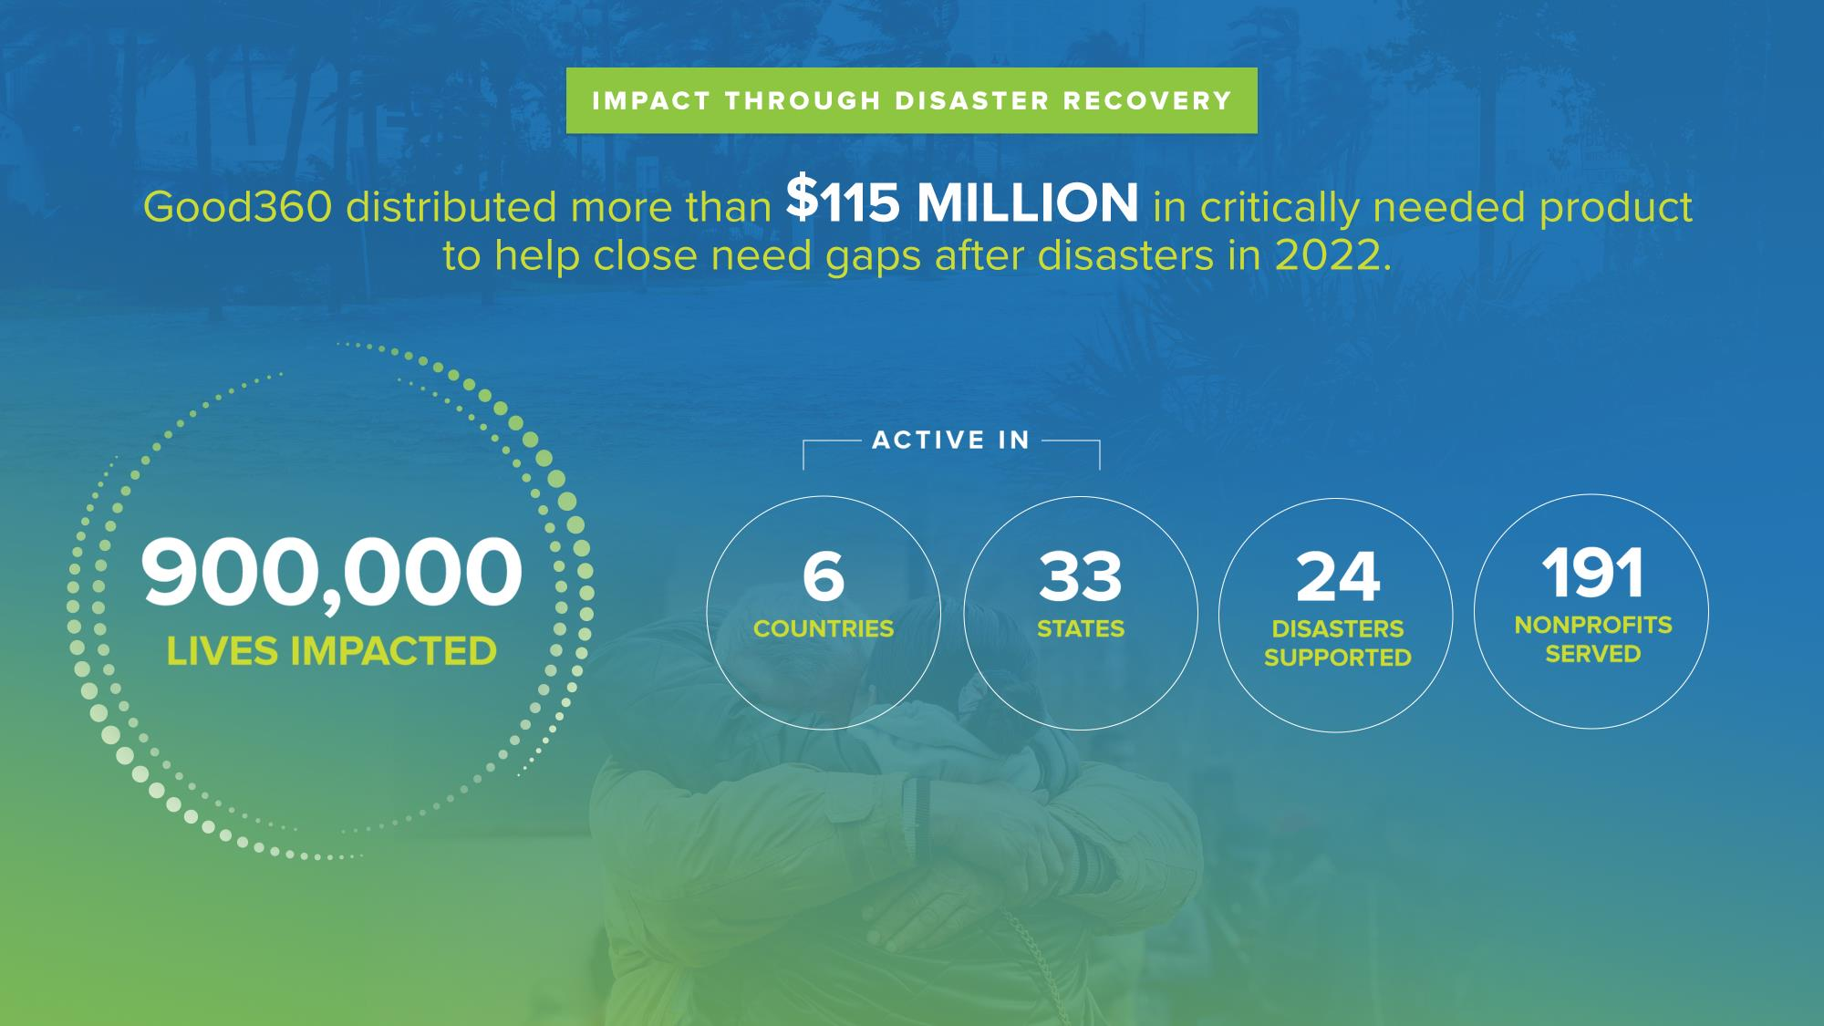

Slide 8
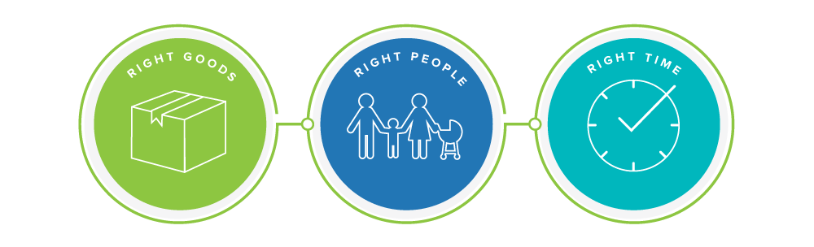
Closing Disaster Recovery Need Gaps
60% of goods donated during disasters end up in landfills
12% of giving is allocated to long-term recovery
80% of donations occur within the first six weeks of a disaster

Slide 9
Right Goods
Identify product needs pre-disaster
  leverage what you already know based-upon experience
  by disaster type, phase and population
Data as an art
  how much product is needed, and where?
Be confident
  don’t be afraid to make specific asks … or to make repeated asks.
The Power of No
  there are significant costs to “being nice” (time, effort, $)

Slide 10
Right People
Duplication of effort
  are organizations making the same ask of the same donor for the same need?
  are requests being made nationally for product that is already available locally?
Do you know….
  who at the local & statewide level(s) can verify that organizations are doing right by survivors?
Know thy neighbor
  who is already doing non-congregate distribution to vulnerable populations?
  who has capacity to create order from disorder?
Influencers aren’t just a millennial thing
  Who are the elected & unelected influencers that can help to persuade/dissuade donors?

Slide 11
Right Time
15-minutes of fame
  do you have warehouse space to accept valuable donations that are offered in the immediate aftermath of an event?
Pre-staging
  do you have a plan in place to pre-stage product for all phases of recovery?
  68% of every dollar spent on disaster is for logistics (post-event “FEMA tax”)

Slide 12
Our Capabilities in Disaster
Excess Product Redistribution - Through our robust network of vetted nonprofit organizations, we can help to redistribute unsolicited donations that overwhelm your community.
Donation Intake & Fulfillment - We can help to support your jurisdiction with the virtual intake and fulfillment of donations to meet the needs of your donors, survivors, and community.
Warehouse Space Support - Through our network of corporate and nonprofit partners, we can help to identify available warehouse capacity post-disaster.
Messaging - We can help your jurisdiction to craft messaging that promotes thoughtful disaster giving and mitigates donation of unneeded goods.
Coordination Support - We have the experience and capacity to help coordinate and/or facilitate post-disaster product donation coordination calls to prevent duplication of effort.
Transportation Support - Through the generosity of our donor and carrier partners, we may be able to support the pick-up and delivery of critically need items for your community.

Slide 13
Product Pre-Staging

Slide 14
The Need Gap
Lack of warehouse space is a major challenge for nonprofits engaged in disaster recovery.
Unsolicited
donations
become
unmanageable
Mixed truckload
donations
rejected due to inability to sort
Long-term recovery product donations received too early and rejected
Corporate
product
donations turned away
Product donations destroyed by companies
Notes:
Unsolicited donations become unmanageable/expensive to sort and re-distribute
Mixed truckload donations unable to be accepted due to inability to store or sort.
Long-term product donations received early and rejected due to lack of space
Corporate product donations turned away due to lack of ability to store
Product donations destroyed by companies unable to find nonprofits to store them

Slide 15
Good360’s Value Add
Through partnerships with nonprofits and socially responsible corporations, Good360 DR is building a network of warehouses that allows us to pre-position known relief and recovery goods
The ability to pre-position needed donations in disaster-vulnerable communities is critical to our mission of supplying the right goods to the right people at the right time in the right amount.

Slide 16

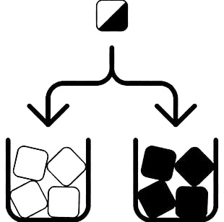

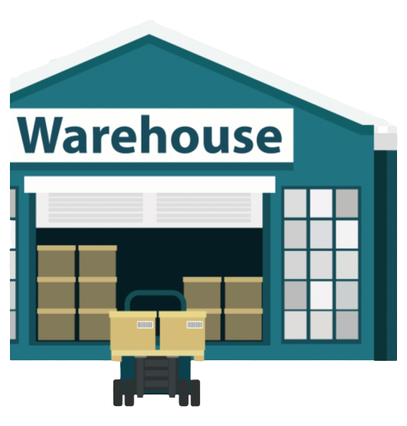
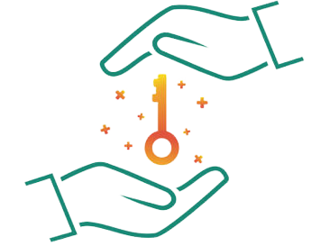
Benefits
Reduce the amount of time needed to get product into a disaster-impacted
community
Sort mixed-SKU
truckloads into logical
categories that are aligned with disaster needs
Accept & store valuable goods offered during
response that are not needed
until long-term recovery
Provide State VOAD & Government with Multi-Agency
Warehouse
Good360 can
solicit goods that match
hazards,
vulnerabilities, and socio-demographics of the community
Notes:
Unsolicited donations become unmanageable/expensive to sort and re-distribute
Mixed truckload donations unable to be accepted due to inability to store or sort.
Long-term product donations received early and rejected due to lack of space
Corporate product donations turned away due to lack of ability to store
Product donations destroyed by companies unable to find nonprofits to store them

Slide 17




Benefits
Reduce the amount of time needed to get product into a disaster-impacted
community
Reduce cost by avoiding post-disaster rate increases; 68% of disaster spending is on logistics.
Increase our contribution to the circular economy by accepting large volume donations that would otherwise end up in landfills
Leverage data to ensure that we are storing product outside of flood zones
Notes:
Unsolicited donations become unmanageable/expensive to sort and re-distribute
Mixed truckload donations unable to be accepted due to inability to store or sort.
Long-term product donations received early and rejected due to lack of space
Corporate product donations turned away due to lack of ability to store
Product donations destroyed by companies unable to find nonprofits to store them

Slide 18
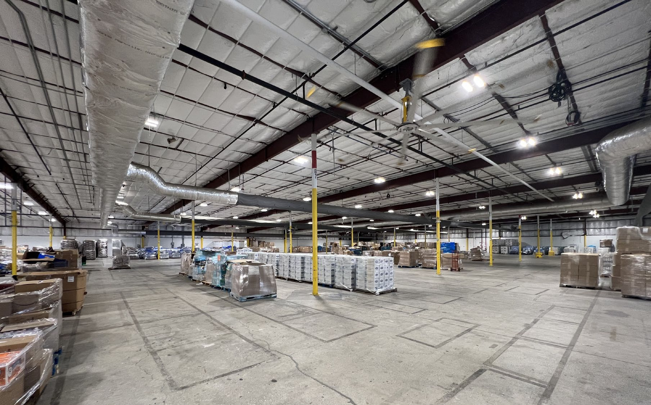
Recent Example
Multi-Agency Warehouses
in FL after Hurricane Ian
Amazon donated 3 warehouse locations
  Coral Springs (DFH8) – 215,486 sq ft
  Fort Myers (DFM2) – 60,000 sq ft
  Sarasota (DSR1) – 55,234 sq ft
Adventist Community Services staffed.
Millions of dollars of donated product distributed to more than 50 locally vetted organizations supporting statewide recovery efforts.
Zero cost to local/state/federal taxpayers

Slide 19
THANK YOU!
For more information or questions:
Damian Morales at damian@good360.org

