Slide 1
We Are Building The Alliance… Now Where Do We Go From Here?
September 20| 2023

Slide 2
What We Can Do For You
In partnership with DHS & FEMA Region provide virtual and in-person technical assistance and briefings
Help your constituents navigate the federal government to access resources and opportunities for non-profits.
Be a source of information before, during and after disaster.
www.fema.gov/faith

Slide 4
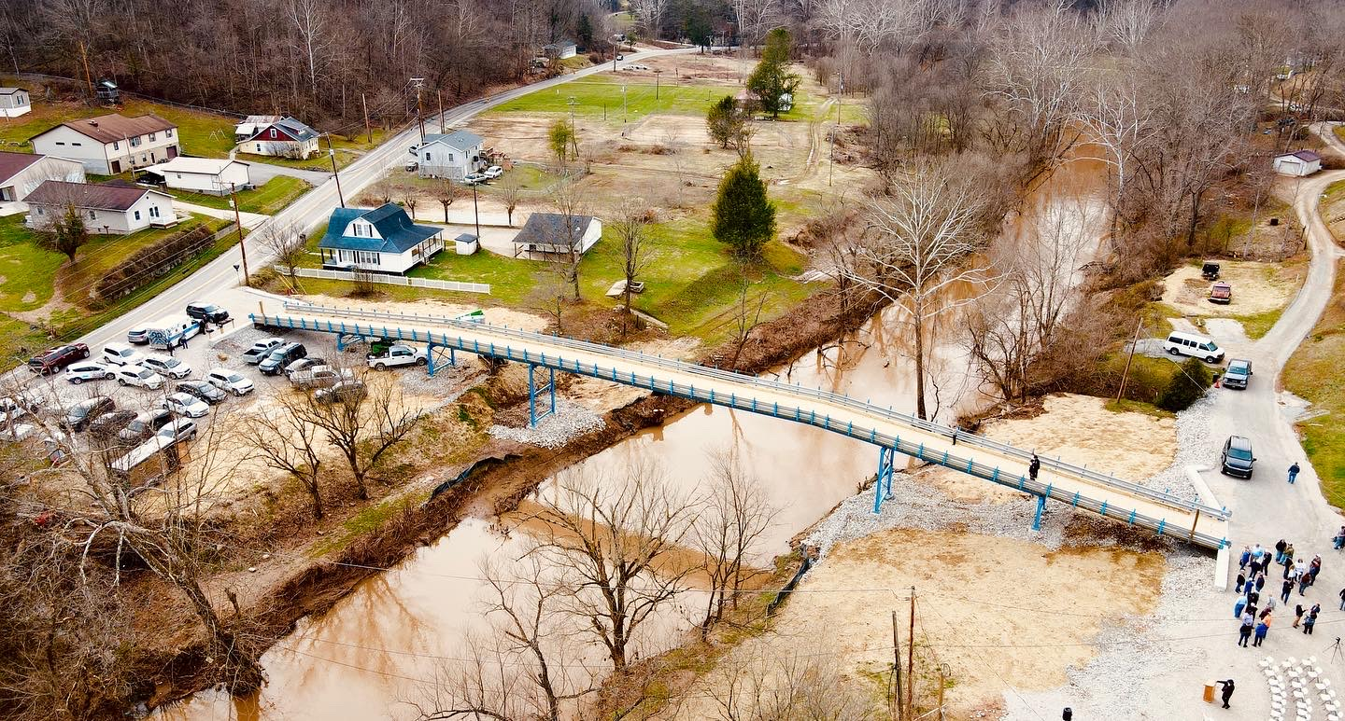

Slide 5
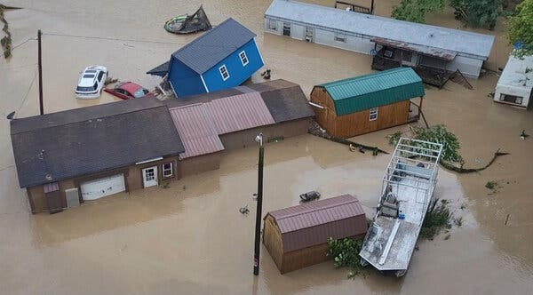
“I know a lot of people have it worse from other states, but we’ve got it bad too. You can’t leave us out.”
- Rhonda Hudson of Kanawha County

Slide 8
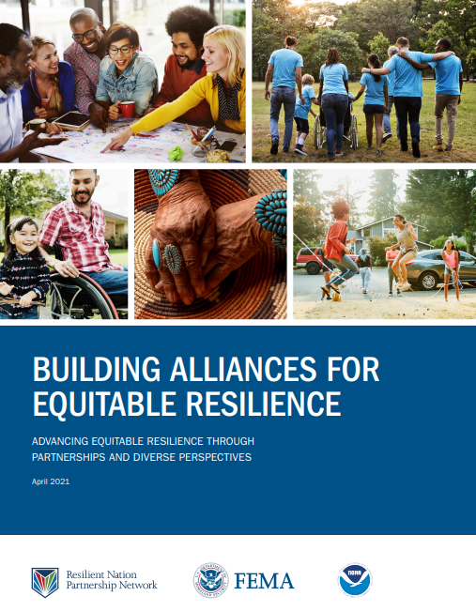
Where do we go on instilling equity in emergency management?
5-minute Check-In

Slide 9
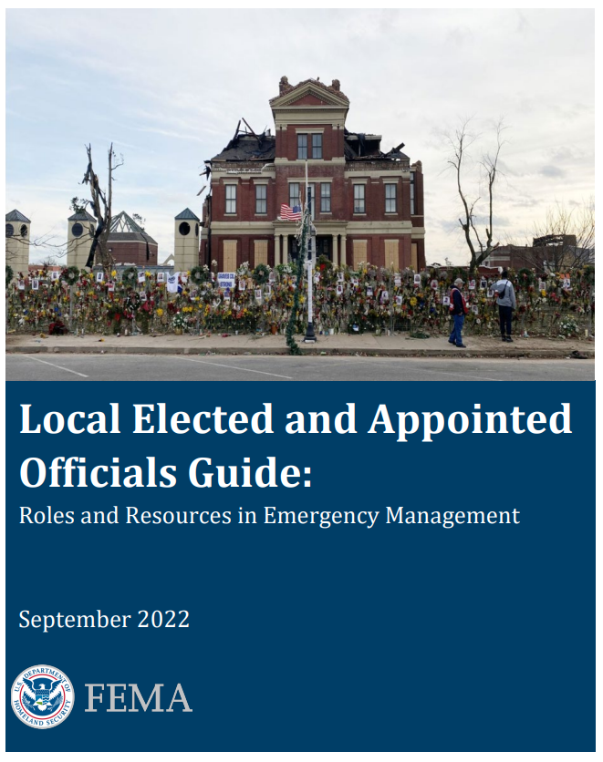
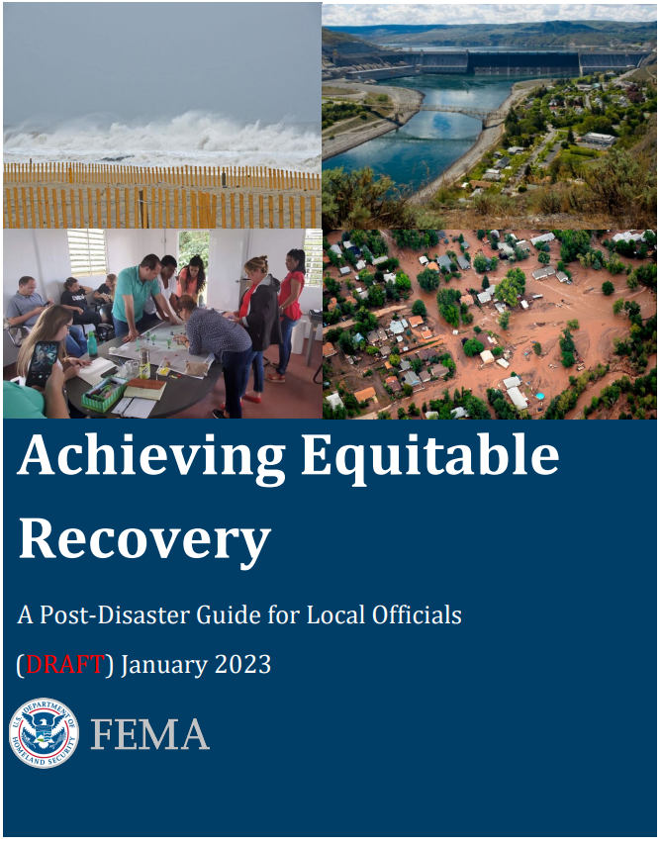
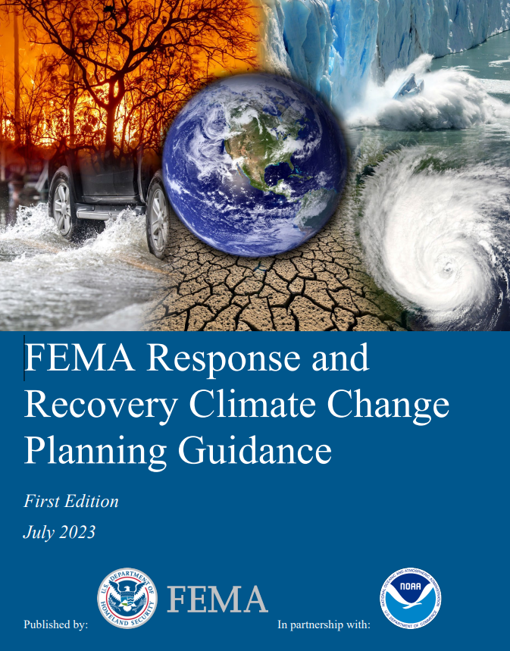
Where FEMA’s Going to Rethink Equity
Local Elected and Appointed Officials Guide (fema.gov)
Achieving Equitable Recovery (fema.gov)
Climate Change Response and Recovery Planning Guide (fema.gov)

Slide 10
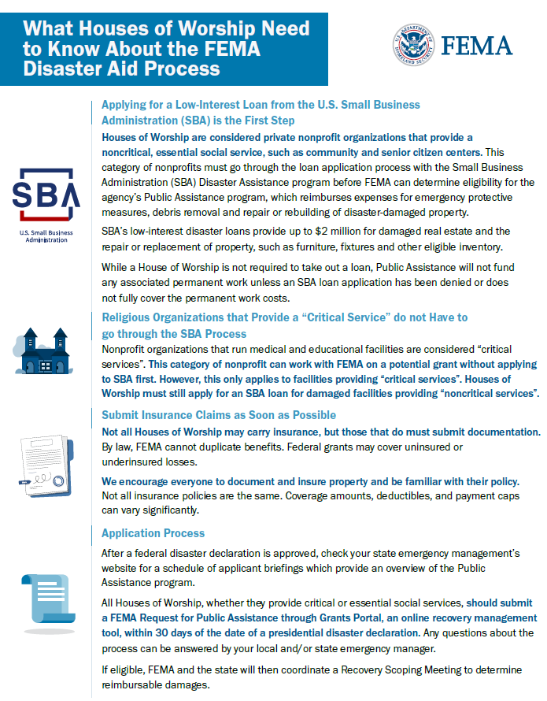
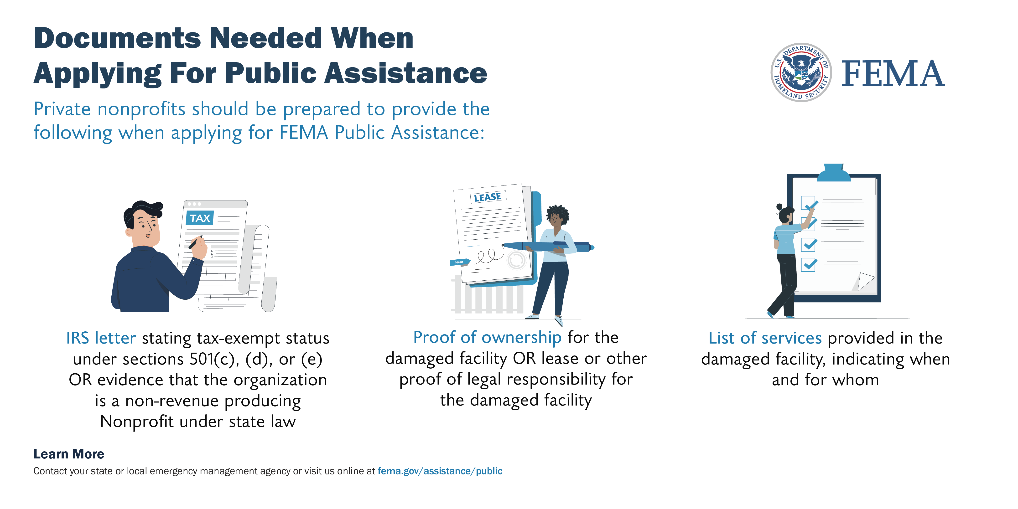
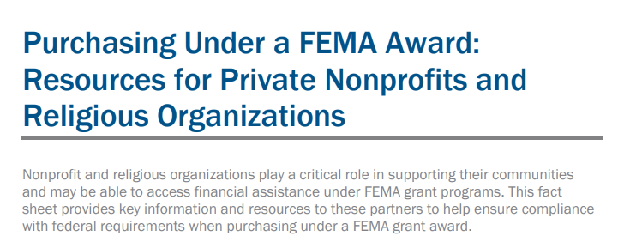
Rethinking Equity to Support Private Non-Profits Navigate Public Assistance
Documents Needed When Applying for Public Assistance Graphics
How to Develop Agreements for Mass Care Services
What Houses of Worship Need to Know About the FEMA Disaster Aid Process Flyer
Purchasing under a FEMA Award: Resources for Private Nonprofits and Religious Organizations

Slide 11
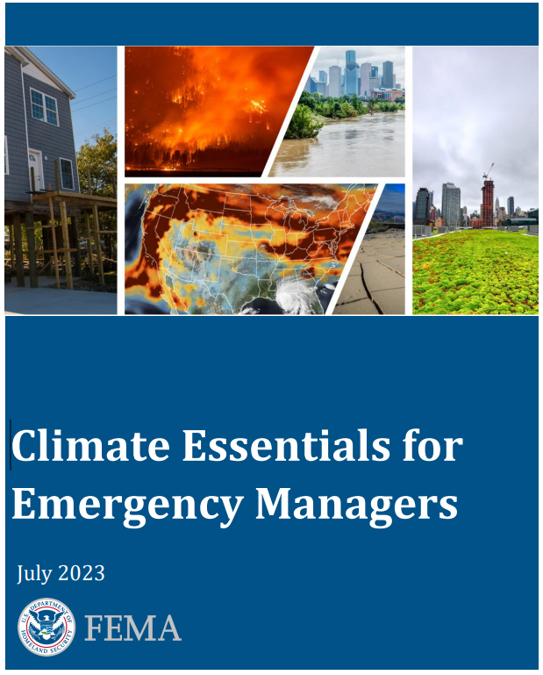
Where do we go with leading whole community climate resilience?
5-minute Check-In

Slide 12
Where FEMA is headed on Climate Resilience?
The Community Disaster Resilience Zones Act uses FEMA’s National Risk Index to identify the most at-risk and in-need communities to identify resilience zones.
Designated zones will be prioritized for targeted federal support, such as increased cost-share for resilience and mitigation projects, lessening the financial burden on communities to perform resilience-related activities.

Slide 13
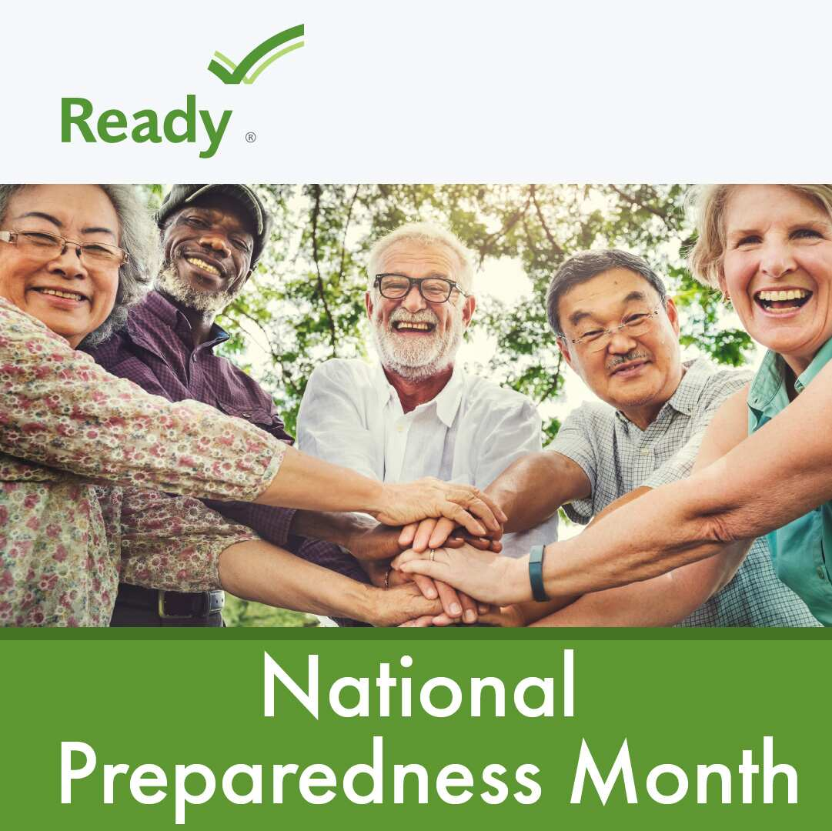
Where do we go to promote and sustain a ready nation?
5-minute Check-In

Slide 14
Where FEMA is Going to Promote a More Prepared Nation
Congregational Preparedness
Facility Preparedness
Community Preparedness

Slide 15
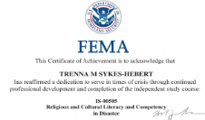
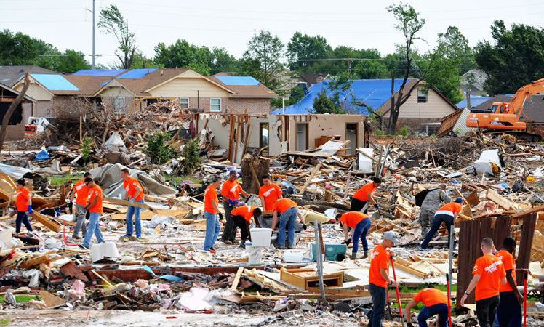
TEN FIELD SKILLS FOR SUCCESSFUL ENGAGEMENT
Resources to Help Emergency Managers and First Responders Engage Faith-Based and Community Organizations
Planning Guidance
Independent Study Course
In-Person Training
Tabletop Exercises
Click Link to Access
Click Link to Access
Click Link to Access
Click Link to Access

Slide 16
Thank You!
Contact Information for Marcus Coleman
Partnerships@fema.dhs.gov

