Slide 1
FEMA HQ DONATIONS
FEMA HQ
DONATIONS

Slide 2
About Us
Who we are …
What we do …
How to engage …
FEMA HQ
DONATIONS

Slide 3
Who We Are
FEMA HQ Donation operations has changed since start of COVID
Since March 2020, specialized team has worked virtually from across the country
Problem to solve → Resources to engage
FEMA HQ
DONATIONS

Slide 4
What We Do
Match vetted offers of in-kind donations to needs.
Letting vetted needs be known to potential donors
Work offers and needs in all phases
Preparedness
Response
Recovery
Mitigation
FEMA HQ
DONATIONS

Slide 5
What We Do
Work with FEMA Regions:
Voluntary Agency Liaisons, Logistics, Tribal Liaisons, Private Sector Liaisons
Provide support to state, local, tribal, and territorial governments, and non-profits
Keep un-needed items out of disaster area
Direct volunteers and financial support
FEMA HQ
DONATIONS

Slide 6
What We Do
Our pillars
Honor donor intent
Match offer to where it is needed most
Fair and impartial
Work offer through delivery
FEMA HQ
DONATIONS

Slide 7
How to Engage
How others can engage with us
Website: www.FEMA.gov/donate
Common Email: Donations@fema.dhs.gov
Donations Dashboard: https://fema.connectsolutions.com/Donations
FEMA HQ
DONATIONS

Slide 8
How to Engage
Website: www.FEMA.gov/donate
Search “donation” on FEMA.gov
Provides basic donation and volunteer messaging
Other FEMA webpages link to ‘How To Help’
12,283 visitors so far in 2023
FEMA HQ
DONATIONS

Slide 9
How to Engage
Common Email: Donations@fema.dhs.gov
Team monitors during working hours
Procedure is to respond within 24 hours
Received over 5,700 inquiries from March 2021 to present
FEMA HQ
DONATIONS

Slide 10
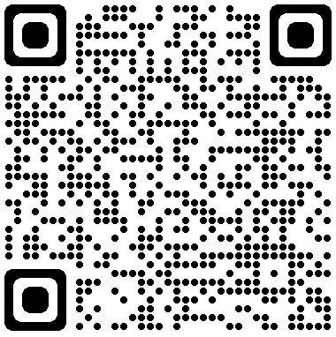
How to Engage
Donations Dashboard
https://fema.connectsolutions.com/Donations
Updated once a day by NOON ET
Share Information
Offers - Needs - Messaging - Reports
Received 3,050 guest users since creation on February 25, 2022
FEMA HQ
DONATIONS

Slide 11
Donations Numbers 2020 to Present
Running Totals - March 2020 to present
525 Offers Completed
Approx. 3,343 tractor trailer loads
524 Million items
Approx. $1.1 Billion fair market value
121 Needs Identified and Vetted
372 Donors
4,610 Recipients
FEMA HQ
DONATIONS

Slide 12
Recipient Best Practices
Recipient Best Practices
Understand and verify operational needs
Share needs - let your needs be known to us and others
Monitor Donations Dashboard for offers and reach out to team
Consider transportation to pick up donation
FEMA HQ
DONATIONS

Slide 13
Donor Best Practices
Donor Best Practices
We support the matching process
We verify the needs
Tax deductible to non-profits
One place to match all amounts of donations from <1 to 500+ loads
Team supports troubleshooting and delivery issues
FEMA HQ
DONATIONS

Slide 14
The Team
Don Bonchack
Steve Irwin
Debbi Criswell
Cheryl Brekke
Carlos Velez-Cancel
Kysa George
FEMA HQ
DONATIONS

