Slide 1
Expanding Access to Crisis and Emotional Support
Presented by Christian Burgess, LMSW
West Virginia VOAD Conference – 9/19/2023

Slide 2
Disclaimer
The views, opinions, and content expressed in this presentation do not necessarily reflect the views, opinions, or policies of the U.S. Department of Health and Human Services, the Substance Abuse and Mental Health Services Administration (SAMHSA), or the Center for Mental Health Services.

Slide 3
Introduction
Christian Burgess (he/him/his), Director, Disaster Distress Helpline
Email: cburgess@vibrant.org
Mobile: 917-842-2847
LinkedIn: /christian-burgess-4ba9386/
Twitter: @cburgessDDH

Slide 4
Agenda
Definitions- What is Crisis and Emotional Support?
Emotional and Mental Health Impacts throughout the Disaster Cycle
Expanding Access: Resources from Vibrant Emotional Health
Outreach and Collaboration in Crisis and Emotional Support
Discussion / Q&A

Slide 5
Definitions

Slide 6
Emotional Support
Care and compassion for another person(s)
Ranges from informal to formal
Encompasses many types of care
Intersects with other practices (spiritual, psychological, etc.)
Disaster Emotional Care and Disaster Spiritual Care
Crisis Support
Care for when someone is experiencing acute distress reactions
Assessment, Intervention, Referral
May or may not involve emergency services
Mobile Crisis Teams
Continuum of Care

Slide 7
Behavioral Health Care
Crisis Care
Spiritual Care
Emotional Care

Slide 8
Emotional and Mental Health Impacts throughout the Disaster Cycle

Slide 9
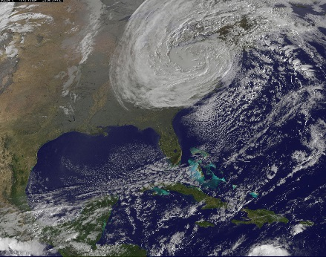
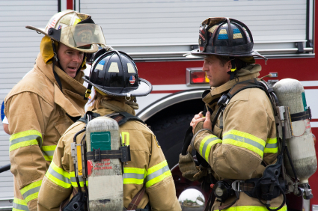
Disaster Distress Risk Factors
Exposure
Loss
Response & Recovery Work
Other factors that influence risk for distress:
Pre-disaster level of functioning
Size and scope of event
Degree of exposure/loss
Access to care post-event
Access & functional needs

Slide 10
Disaster Distress: Research
Norris, 2002: Disaster Survivors Speak 9% minimal reactions; 51% moderate; 23% severe; 17% very severe
Distress Symptoms
Mild (Transitory) → Moderate → Severe (Psychopathology)
Short-term → Long-term
Also: Post-Traumatic Growth

Slide 11
Expanding Access: Resources from Vibrant Emotional Health

Slide 12
Video: #DDHTurns10
https://www.youtube.com/watch?v=KOffayYI_M0

Slide 13
Disaster Distress Helpline: Overview
A national hotline (call or text 1-800-985-5990) available to anyone in the U.S. states/territories before, during & after natural or human-caused disasters
Goal: To assist individuals and families experiencing emotional distress related to disaster, in order to help them move forward on the path of recovery
Multi-lingual interpretation services in 100+ languages; live 24/7 crisis counseling in Spanish available via the hotline and SMS (press “2”)
Videophone for Deaf/Hard of Hearing ASL users
24/7 moderated Online Peer Support with Crisis Support Over Messenger for survivors and responders

Slide 14
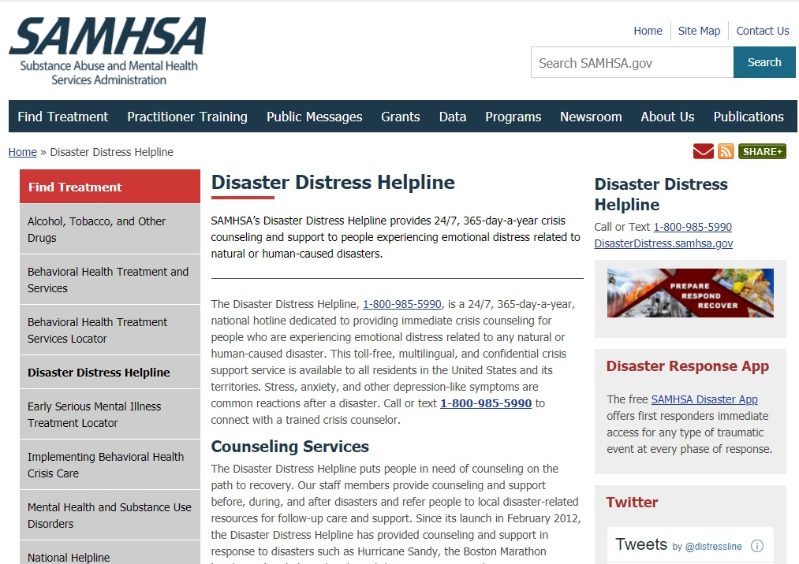
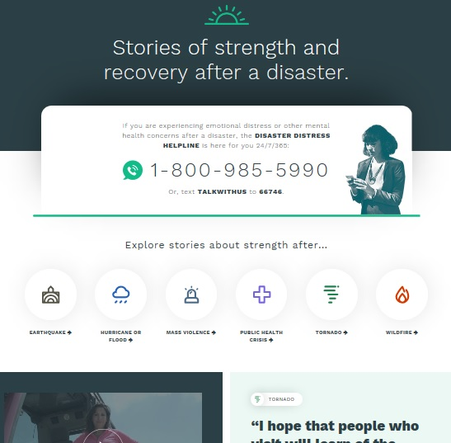
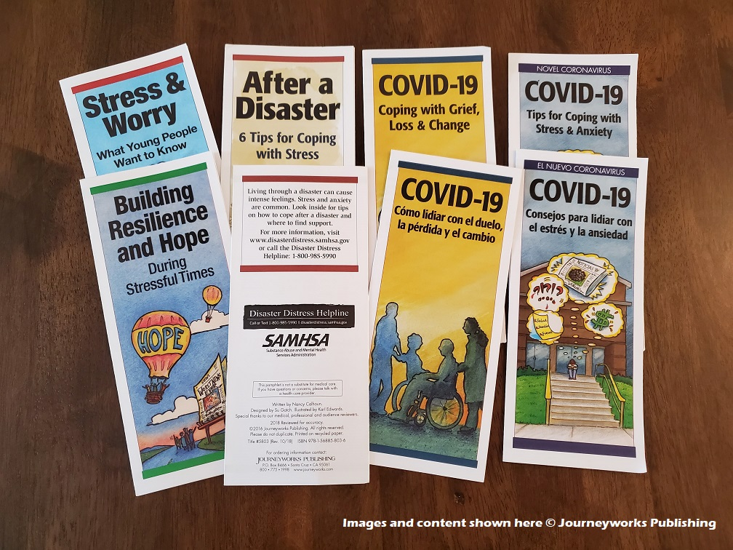
Additional DDH Resources
SAMHSA Website
http://disasterdistress.samhsa.gov
Information & resources for providers, risk groups, general public
Strength After
http://strengthafterdisaster.org
Online platform for sharing stories of hope & strength during recovery, across disasters
Social Media • DDH Materials
/distresshelpline - Brochures, Wallet Cards
@distressline - English & Spanish

Slide 15
Disaster Distress Helpline: Key Players
Funder
- Resource Coordination (DTAC, CCPs)
- Liaison w/ HHS, State DMH/DSA
Administrator
- Operations; STP; Comms; Outreach; etc.
- Steering Committees, Advisory Task Forces
- Evaluation
Primary Network
- Training/TA support in DMH, Disaster Prep, etc., for 200 Centers across the U.S.
- DDH backup & temp “Affected Area Centers”
Key Stakeholders
- Resource Coord.
- Promote disaster mental health, staff wellness, access & functional needs, etc., in the field and within organizations

Slide 16
Disaster Distress Helpline: When Someone Calls or Texts …
Psychological First Aid
- NCPTSD/NCTSN http://learn.nctsn.org
Disaster Crisis Counseling for Crisis Contact Centers
Using…
Crisis Assessment, Intervention and Referral
“Just In Time” training/TA support, post-disaster
Active Engagement
Validation
Normalization
Psycho-Education
Engage
Connect
Conclude
Explore

Slide 17
DDH Videophone for ASL Users
Offers a 24/7 direct connection to trained DDH counselors fluent in American Sign Language (ASL)
People who are Deaf, hard of hearing, or anyone for whom ASL is their primary or preferred language can connect in two ways:
Call the DDH 1-800-985-5990 via their videophone-enabled device
Access the “ASL Now” option via the SAMHSA DDH website
DeafLEAD, a Lifeline- and DDH-networked not-for-profit crisis center, staffs and responds to DDH VP calls

Slide 18
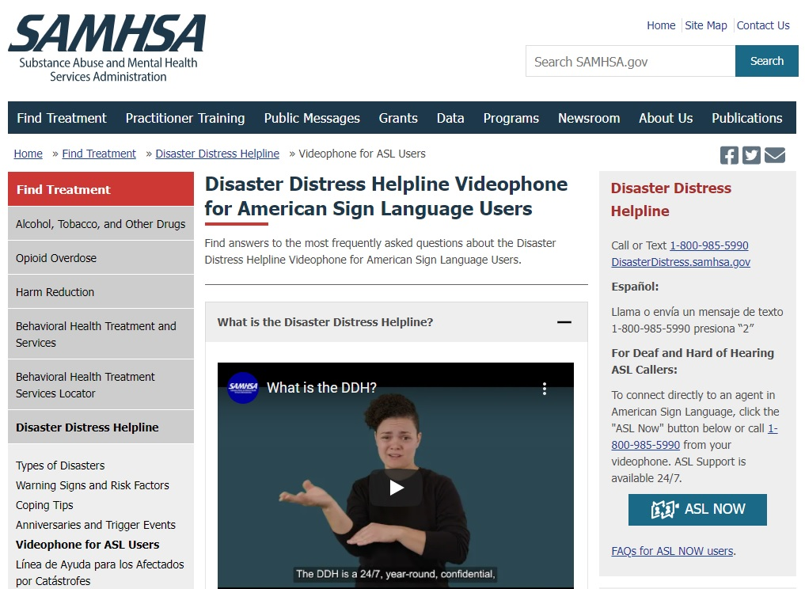
DDH Videophone for ASL Users
Additional DDH VP Resources:
Frequently Asked Questions about the service (in ASL and English) https://www.samhsa.gov/find-help/disaster-distress-helpline/asl-faq
Short PSA Video 1: https://bit.ly/3pttwl3
Short PSA Video 2: https://bit.ly/30SyNZj
Deaf Influencer Videos:
Leila Hanaumi https://bit.ly/3okVHkE
Angela Maria Nardolillo https://bit.ly/3Dm9m1d
Andy Pleasants https://bit.ly/3qL8zC4
Rikki Poynter https://bit.ly/3tO4miZ

Slide 19
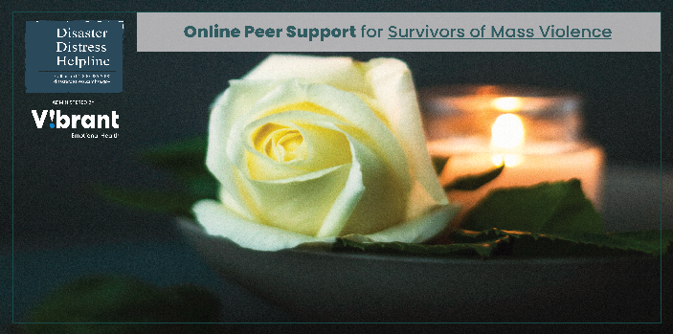
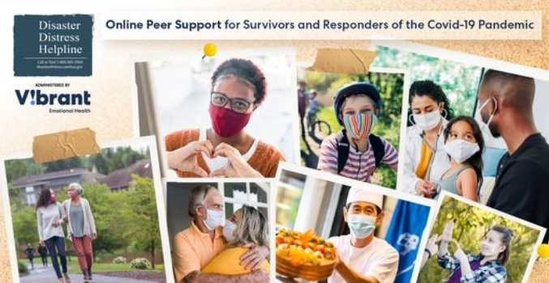
DDH Online Peer Support Communities
Private, moderated “communities” offered via Facebook Groups where disaster survivors and responders can offer/receive mutual aid & support during recovery: Access via StrengthAfterDisaster.org or https://www.facebook.com/DDHpeersupport
Currently there are two DDH OPSCs:
1. Survivors of Mass Violence (survivors/loved ones of mass shootings, terrorism, etc.)
2. Survivors and Responders of the COVID-19 Pandemic (people who have had long
COVID, loss survivors, healthcare workers, parents/caregivers, etc.)
Connect with trained DDH Peer Supporters staffed by Vibrant
Access DDH Crisis Counselors via Crisis Support Over Messenger

Slide 20
Action Steps: What You Can Do to Expand Access to Crisis and Emotional Support
Promote resources to individuals and communities served & as resource for self –care among staff/volunteers who may be at risk for vicarious trauma, burnout, etc.
Provide Vibrant/DDH with information and disaster-specific, relevant resources for consideration of inclusion in our crisis center resource databases to assist DDH callers and texters experiencing distress, other behavioral health concerns related to migration;
Connect through social media before, during and after disasters to share resources, communicate with the public re. behavioral health, coping, etc.; include DDH and other disaster emotional care services in press releases, blog updates, other communications as appropriate (particularly when large-scale disasters impact multiple regions- as a reminder, after providing crisis counseling DDH always refers callers back to local services for follow-up care & support);
Coordinate service delivery before, during and after disasters w/ local, state and national disaster emotional and spiritual care leadership/teams, others
Communication – Coordination – Collaboration – Cooperation (VOAD)

Slide 21
Additional Resources

Slide 22
Vibrant’s Crisis Emotional Care Team
Over 900 mental health professional volunteers across the US
Provides care to communities and organizations after disasters or crises
Conducts regular trainings and webinars on disaster mental health
Hosts annual Disaster Behavioral Health Symposium
Responses include:
Supporting US refugees and immigrants
Supporting KY flood survivors
Trainings for mental health professionals following mass violence incidents
Trainings for frontline healthcare workers on disaster mental healthcare

Slide 23
https://www.vibrant.org/cect
Crisis Emotional Care Team
crisisemotionalcare@vibrant.org
Amy Carol Dominguez, MPA, Program Director
adominguez@vibrant.org

Slide 24
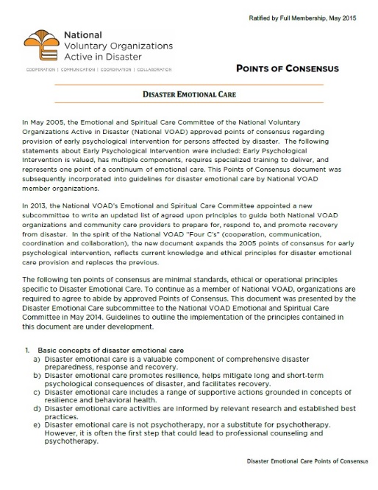
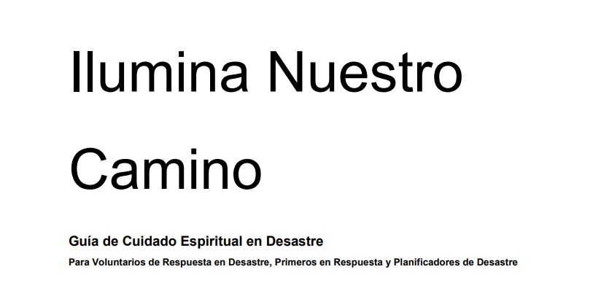
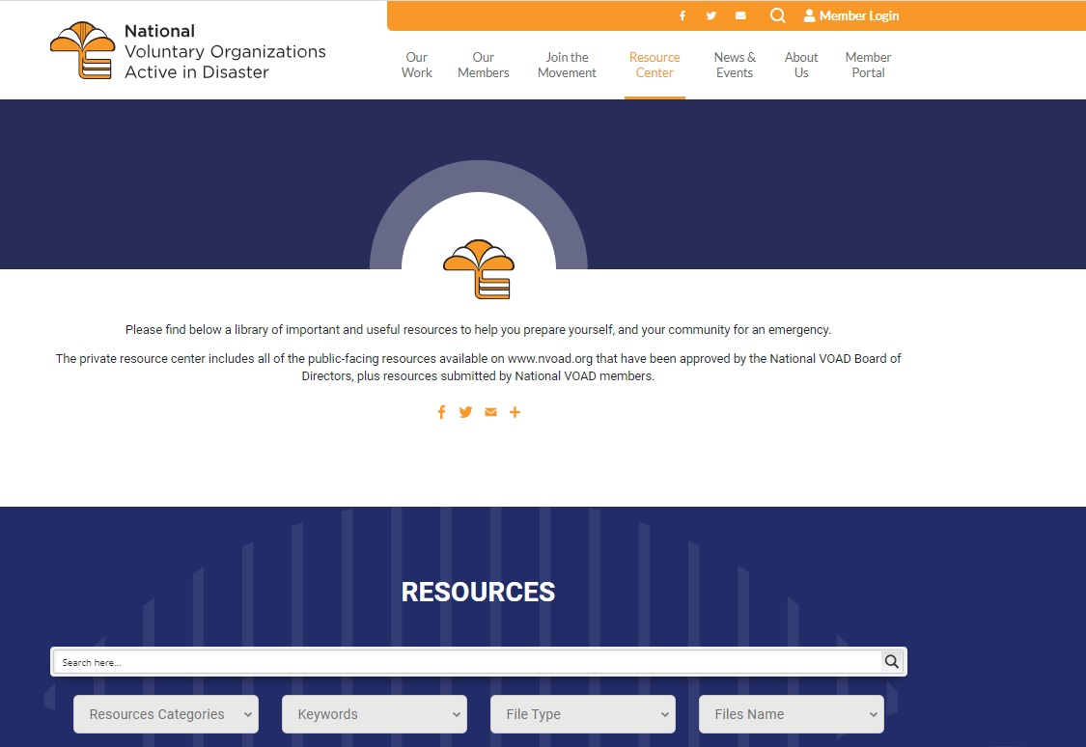
National VOAD Emotional and Spiritual Care Resources
NVOAD.org/resources-center
Points of Consensus, Guidelines, Light Our Way, “Quick Guides”, more
Webinars to guide you through resources (captioned + with ASL interpretation)
Points of Consensus and Light Our Way also available in Spanish

Slide 25
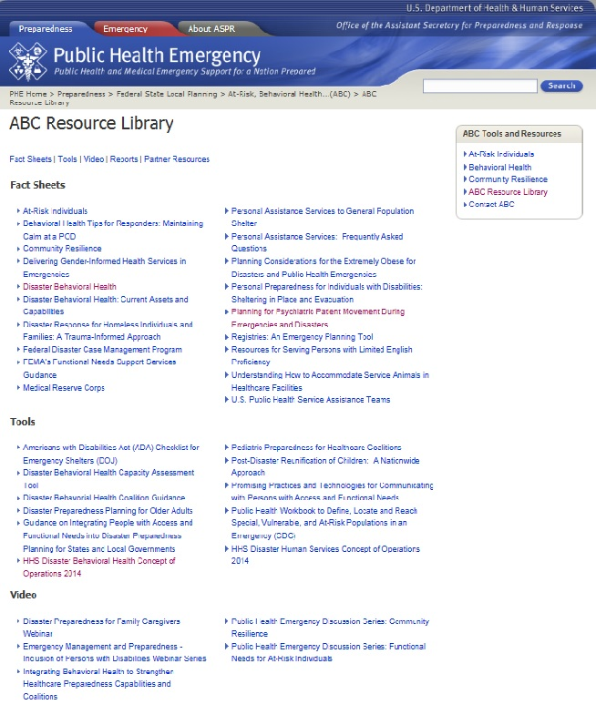
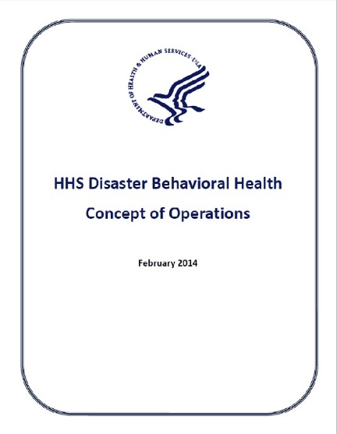
FEMA ESF / RSF:
Dept. of Health and Human Services
Support Agency for ESF 6
Coordinator / Primary Agency for ESF 8
Coordinating Agency for RSF Health and Social Services
HHS Disaster Behavioral Health Concept of Operations (ConOps)
Updated February 2014
Available at HHS ASPR “At-Risk, Behavioral Health & Community Resilience” (ABC) Resource Section: http://www.phe.gov/preparedness/planning/abc

Slide 26
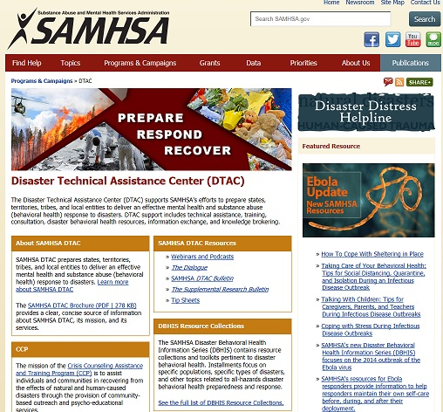
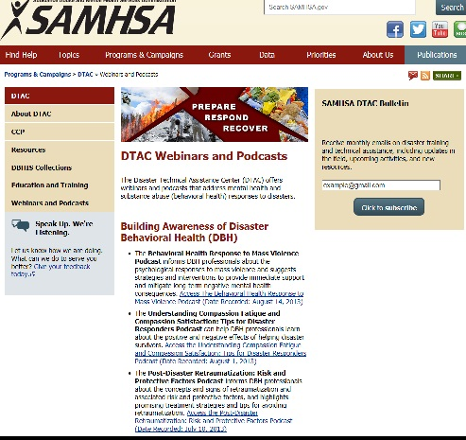
SAMHSA Disaster Technical Assistance Center (DTAC)
http://www.samhsa.gov/dtac

Slide 27
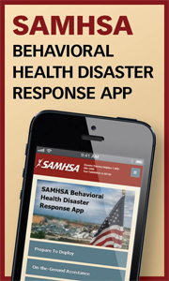
New SAMHSA Disaster Mobile Application
Available at / More Info: Bit.ly/disasterapp
SAMHSA set out to develop a mobile app that:
Provides the evidence-based resources of the Disaster Kit.
Identifies local treatment facilities.
Shares resources directly from the app via text message or email.
Functions with limited internet connectivity.
Would be a valuable tool for behavioral health disaster responders.

Slide 28
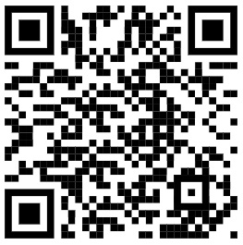
Christian Burges, Director, DDH
cburgess@vibrant.org
@cburgessDDH / christian-burgess-4ba9386
For more information, questions, DDH materials and other coordination or requests, email us:
ddh@vibrant.org
/distresshelpline
@distressline

