Slide 1
West Virginia
Voluntary Organizations Active in Disaster
2023 Conference
The Focus of Presbyterian Disaster Assistance

Slide 2
PDA Mission
Presbyterian Disaster Assistance enables congregations and mission partners of the Presbyterian Church (U.S.A) to witness to the healing love of Christ through caring for communities adversely affected by crisis and catastrophic event.
Presbyterian Disaster Assistance (PDA) is the emergency and refugee program of the Presbyterian Church U.S.A. The core budget, including staff and administrative costs, is funded through the One Great Hour of Sharing, and its program work is additionally funded through designated gifts.

Slide 3
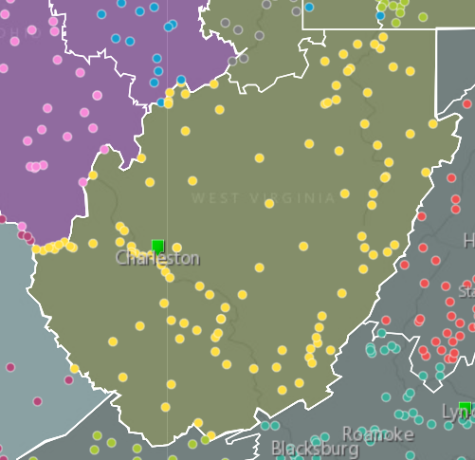
Connection

Slide 4
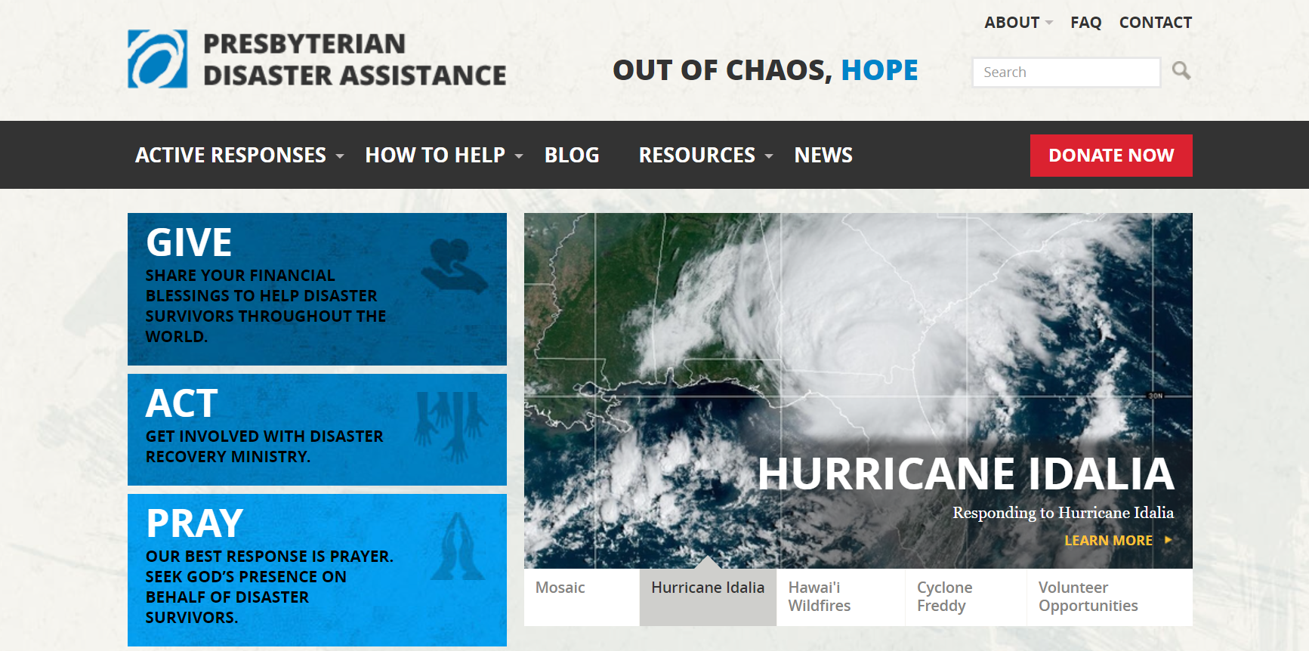
www.pcusa.org/pda

Slide 5
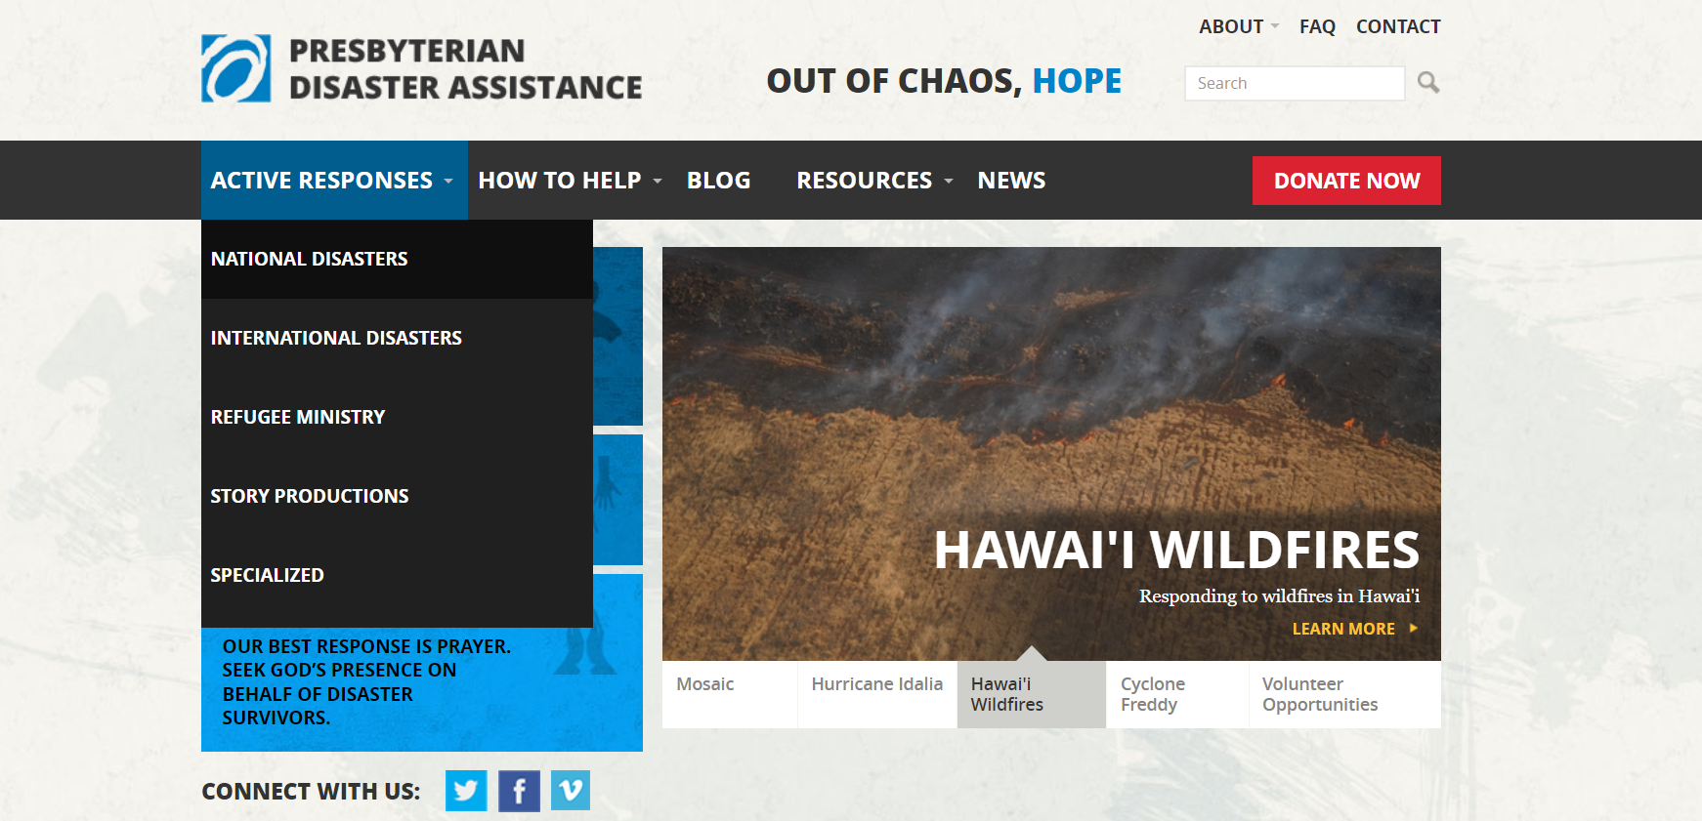
www.pcusa.org/pda

Slide 6
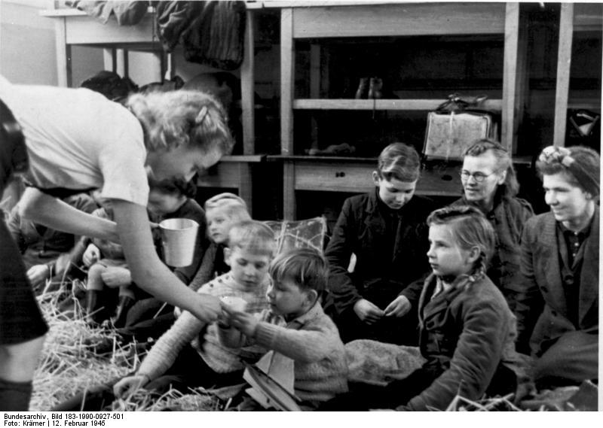
Refugee Ministry
Known first as Presbyterian World Service, PDA started after WWII to help refugees around the world.
Bundesarchiv Bild 183-1990-0927-501, Dänemark, deutsche Flüchtlinge" by Bundesarchiv, Bild 183-1990-0927-501 / Krämer / CC-BY-SA. Licensed under CC BY-SA 3.0 de via Wikimedia Commons - http://commons.wikimedia.org/wiki/
Notes:
What is Presbyterian Disaster Assistance (PDA)? PDA began as Presbyterian World Service, which was a refugee assistance program that started after WWII.

Slide 7
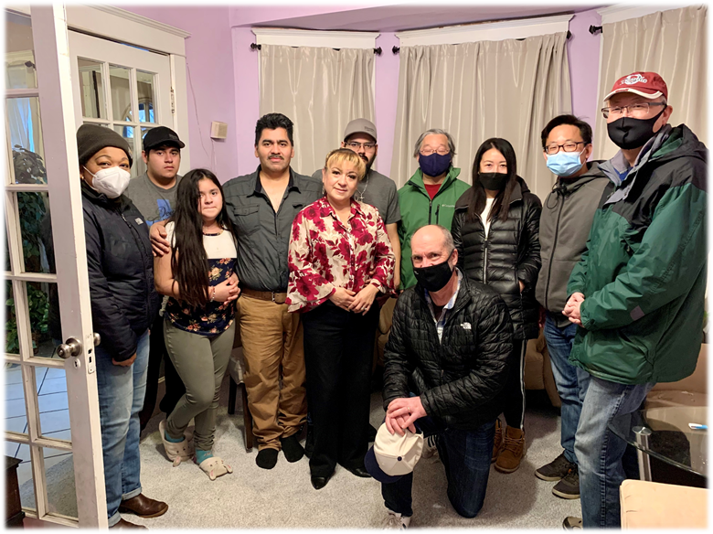
PDA’s Support for Mid Councils
Basic information & referrals to partners
Educational events & Resources
Accompaniment/Technical Support
Connecting concerns to public policy
Grants to local initiatives, partnerships
Notes:
PDA Associate for Refugees & Asylum – responds to individual inquiries to answer basic questions, refer churches to existing educational resources,
referrals to local partners such as local resettlement offices, non-profit legal projects, etc.
Accompaniment/Technical Support = assisting congregational leaders actively involved in refugee ministries -- in their discernment, listening, constructive feedback and guidance
Connecting local to larger response = being informed by local experience and context in our national advocacy and outreach, connecting refugees with root causes
Financial support – grant making made possible through OGHS and special appeals

Slide 8
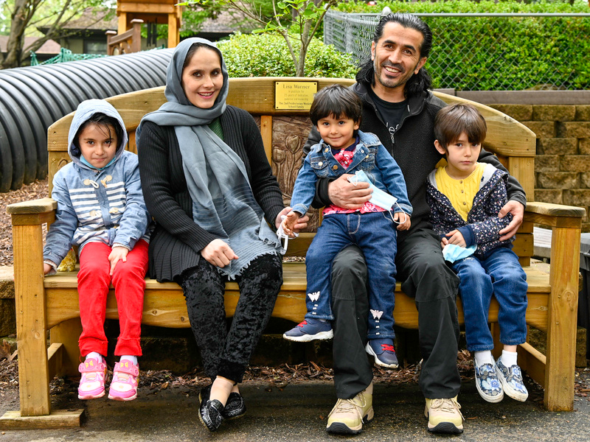
Afghan Refugees
Notes:
Over 100,000 Afghans already expected to arrive in the U.S. between end of August and March 2022. Many more expected in the years ahead.
Afghans may arrive as part of chartered flights coordinated by the US Government, arriving at one of several US military bases.
Other Afghans may arrive on their own through the help of family, friends and advocates
Long-term response
Department of Defense
Department of Homeland Security
Department of State
Department of Health & Human Services – Office of Refugee Resettlement
Continuing Resolution passed on Sept. 30th

Slide 9
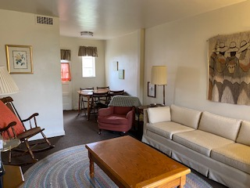
Refugee Ministry
Afghan Resettlement Support through a partnership with Shenandoah Presbytery, FPC Winchester, VA, Massanetta Springs Camps and Conference Center and PDA
The camp provided temporary housing for Afghan refugees.
Local Presbyterians worked with CWS to help with resettlement and more permanent housing.

Slide 10
Story Ministry

Slide 11
Story Ministry

Slide 12
International Ministry
Notes:
Hi Jim,
Below is information about a few projects we are funding internationally. I know that you only have 10 minutes so I only included 2-3 projects for each area that have, or will receive funding during the first quarter of the year, with the exception of LAC.
I am particular excited about the women’s livelihood project we are funding with MECC (Middle East Council of Churches. A special Facebook page will be created to showcase the crocheted items created by the trainees. This is a great opportunity for local churches to get involved. I am in conversation with other program areas to explore ways we can collaborate around this type of work and a achieve a larger impact…..anyhow, I hope this is helpful.
Dayna
LAC
Haiti
Assistance to families affected by earthquake in August 2021
As of today PDA has provided two solidarity grants through our local partners, FONDAMA and ADLH.
These two organizations are providing assistance to the affected communities in Pestel and Roseaur in the Department of Grand Anse, and in the localities of Saint Louis du Sud and Cavaillon in the southern departments, the second section of Camp-Perrin in Cayes and Sainte Hélène (Maniche).
They are providing water, food, first aid kits, blankets hygiene kits and tarpaulins.
PDA was able to set a mayor appeal through our denomination in response to the events in Haiti.
PDA has also provided an additional grant to continue assisting in this emergency stage.
Together with David Guervil, ADLH and FONDAMA, PDA is also developing strategies for medium and long term response.
David Guervil has visited some of the areas affected by the earthquake and TS and has provided feedback on the needs and an assessment of the situation.
Mexico
Assistance to families affected by earthquake in September 2021
Support of 600 affected families in: Ecatepec, Tula and Guerrero, with which we aim to provide assistance to 2500 people:
1. Delivering purified water.
2. Delivering cleaning and sanitation supplies and products.
3. Providing food for affected individuals to carry out their functions, until the minimum subsistence standard is restored (1800 calories per person per day):
-Mass feeding: Meals are prepared in a central kitchen and distributed to the affected population.
- General food distribution: Dry food (non-perishable food) is distributed to people who are able to prepare their own meals.
- Supplementary feeding: In addition to the ration (dry food or prepared food) for the whole family, biologically vulnerable groups (children under five, with special attention to the 0-2 age group; pregnant and lactating women, the sick and the elderly) will receive an additional ration or meal to meet their particular needs.
4. Support in maintaining an acceptable psychological state through pastoral (psycho-spiritual) care with chaplain visits twice a week.
Guatemala
Strengthen the resilience of people who were affected by the ETA/IOTA storms and the COVID-19 pandemic.
100 people benefited. Each person in the target population received the following care:
- 1 Psychosocial kits.
- 1 Face-to-face self-care workshop of 2 hrs.
- 1 Face-to-face workshop of pastoral accompaniment of 2 hrs.
- 4 audios through WhatsApp.
- 2 telephone calls for pastoral accompaniment.
- 10 informative articles. Elaboration of scientific content, design and publication in social networks of CEDEPCA (through Facebook, Instagram and WhatsApp 97,391 people were reached and there were 4,635 interactions)
- 1 Virtual forum with a medical, psychological and spiritual approach with the participation of 52 people.
Dominican Republic
Rubuilding of homes affected by Hurricane María
Sow project with initially 20 families of Haitian immigrants and Dominicans of Haitian ancestry who live in vulnerable conditions, and without a stable source of income.
Bahamas
Rebuilding of homes affected by Hurricane Dorian.
Backup diesel generator installation for a Children’s Home
AFRICA
Liberia & Sierra Leone
WAI Project in partnership with Growing Hope Globally
Will be implemented through the ongoing West Africa Initiative (WAI) program in Liberia and Sierra Leone – a rural development program that was initiated by the PCUSA and implemented by Agricultural Missions, Inc., and has been operating since 2010.
Project will be implemented within the West Africa Initiative Program (WAI) in Liberia and Sierra Leone and specifically, the Youth Agriculture Program.
Objectives/Activities:
To improve the food security status in 18 villages – three per year in each country- by the end of 2023 through the development of locally controlled and resilient food systems.
Target areas are 3 rural villages in each country per year- in Liberia in Bong, Nimba and Grand Bassa Counties and Tonkolili, Bombali and Kenema Districts in Sierra Leone- with a total of 18 villages over 3 years
Provide livelihood opportunities to the youth of the communities and promotion of ecologically sound and sustainable farming practices.
to build a one- year food reserve, to be replenished each year, by engaging the youth in the local production and storage of food staples to provide food in times of high food insecurity and to serve as a seed bank.
village-based nutrition training and the promotion of home gardens to provide families with vegetables.
Construction of a 144 square foot food storage facility, engaging the youth in growing at least 5 acres of staple crops, properly preparing and storing the harvest and the development and training of local committees to manage these facilities.
Cameroon
RELUFA Project in partnership with Growing Hope Globally
This program has a team on the ground working on food insecurity. Over the years, the cereal banks already operational has impacted directly and indirectly more than 25,000 beneficiaries in 45 villages in the Far North Region. Our focus will be to fight food insecurity through agricultural production promotion and cereal banks. After three years,
Project aims to reduce the number of food insecure people in the far north region of Cameroon who have been impacted by the ongoing conflict.
By ensuring food availability for at least 600 households through the establishment of and strengthening the sustainability of cereal banks
By supporting increased agricultural production in at least 150 beneficiary households
South Sudan
Emergency relief to flood impacted communities in South Sudan
More than 96,000 people were displaced from the southern part of Rubkona County of South Sudan's Unity State as heavy floods ravaged the area.
Project aims to respond to Covid-19 pandemic prevention as well as provision of NFIs to 55 households (385 individuals) in Rubkuona county.
Beneficiaries will be provided with mosquito nets, sleeping mats, plastic sheets for making shelter, rubber ropes for setting the plastic sheets, blankets and energy saving stoves
ASIA
Philippines
Emergency relief to disaster-stricken communities (Typhoon Rai/Odette).
Distribution of essential food items, clean water, hygiene kits and medicine for disaster survivors.
Provisions for emergency shelter, fuel, and medical supplies.
Cash assistance to access food and building materials in restoring their destroyed houses
India
Emergency relief to the most vulnerable flood affected families form social excluded communities in Andrha Pradesh
Distribution of dry ration kits to 800 families
Distibution of hygiene/dignity kists to 800 families for lactating women and young children
Ongoing COVID-19 response
MIDDLE EAST
Women’s livelihood project
Aimed at reducing the vulnerability of people that are affected by negative economic and resiliency impact of the evolving of COVID-19 in refugee and host communities" , and the expected outcome is to :
Skills training to serve as “coping mechanism of affected women through the provision of soft vocational training are enhanced" .
40 vulnerable Syrian and Iraqi refugee women, in addition to vulnerable women from the Jordanian host communities , will be trained in soft practical vocational training in areas that can be practiced at home and provide modest income to trained women.
The training course is to teach women to do Crochet products that can be used at home or in any occasions such as wedding, gifts, Christmas decoration, personal items (naps or table cloth etc.. ) .
A special Facebook page will be designed to market the product so that other partners may join this project in order to be sustainable in the years to come.
After the training MECC will organize an exhibition to sale the products and raise income to the trainees.
NESSL 2022 Appeal
Continued support of humanitarian relief efforts and funding of refugee school projects with National Evangelical Synod of Syria and Lebanon, providing schooling to Syrian refugee children in Lebanon.

Slide 13
International Ministry
Presbyterian Disaster Assistance
Focuses on the long-term recovery of disaster impacted communities.
Provides training and disaster preparedness for presbyteries and synods.
Works Collaboratively with church partners and members of the ACT Alliance (Action by Churches Together) internationally, and nationally with other faith-based responders.
Connects partners locally and internationally with key organizations active in the response — United Nations, NVOAD (National Voluntary Agencies Active in Disaster), World Food Program, Red Cross, FEMA and others.

Slide 14
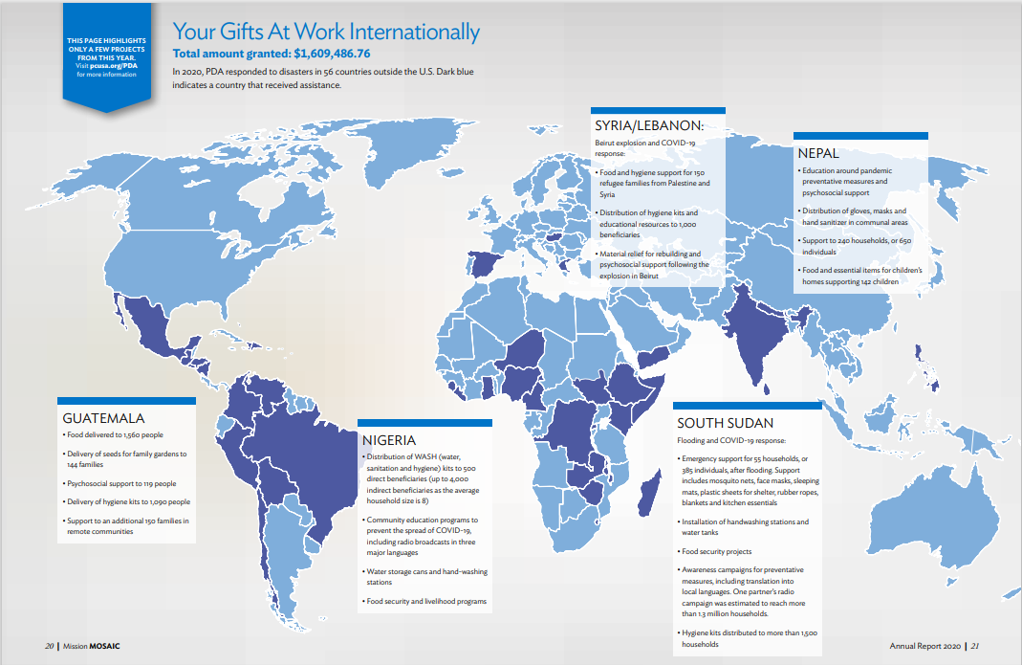
International Ministry

Slide 15
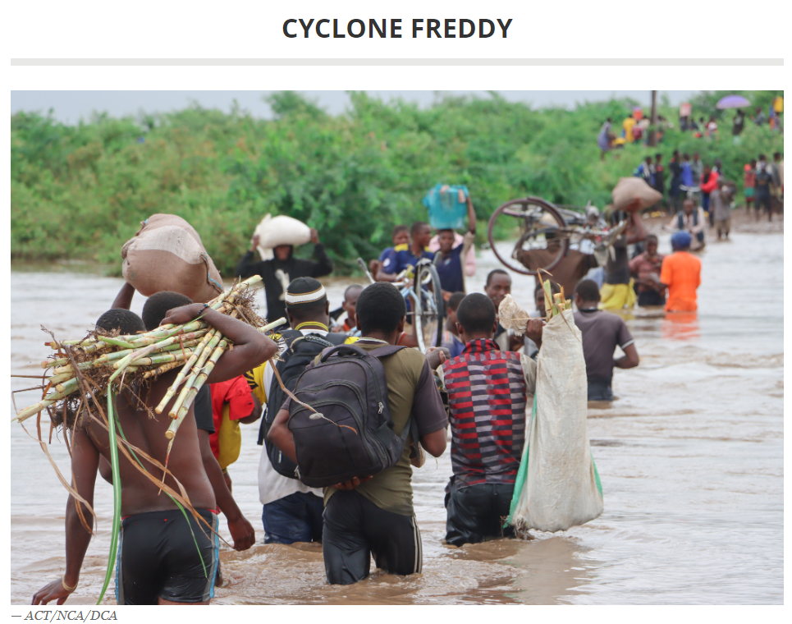
International Ministry
Cyclone Freddy lasted five weeks in February and March 2023, affecting southern Africa, notably Malawi, Mozambique and Madagascar.
Notes:
Cyclone Freddy lasted five weeks in February and March 2023, affecting southern Africa, notably Malawi, Mozambique and Madagascar. According to Reuters, "Freddy holds the record for most accumulated cyclone energy (ACE), a measure based on a storm's wind strength over its lifetime, of any storm in the southern hemisphere and possibly worldwide."
PDA is working with Presbyterian World Mission and our partners to respond to the emergency needs (food, water, sanitation, hygiene, shelter) and strategize for a long-term response.

Slide 16
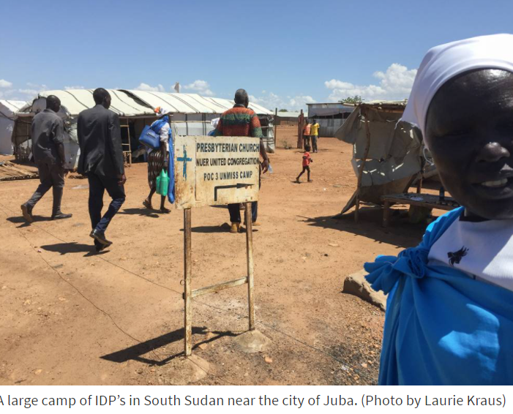
International Ministry
Ongoing Humanitarian Crises in South Sudan
Notes:
PDA is funding large-scale emergency relief projects and working through Presbyterian Relief and Development Agency (PRDA), the humanitarian arm of the Presbyterian Church of South Sudan (PCOSS), to find solutions to the growing challenges which are now spilling over into neighboring countries as hundreds of thousands leave their homes.

Slide 17
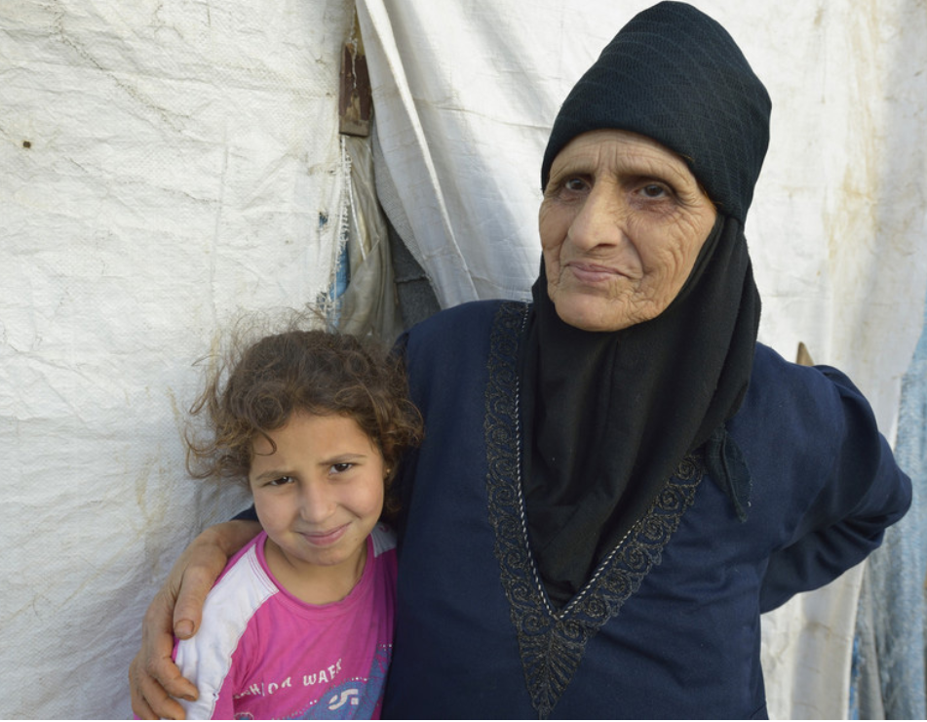
International Ministry
Women’s Livelihood Project in partnership with the Middle East Council of Churches
Notes:
Situation
Just a little more than two weeks after thousands of people died in the massive earthquake that struck on April 25, a second earthquake hit Nepal. The second earthquake measuring 7.4 struck north-east of Kathmandu on May 12, 2015.At least 64 people were killed and 2,000 people injured. This figure is likely to keep rising as rescue services gain access to those affected. The quake has caused an increase in landslides in many areas of the previously affected districts. Houses and buildings that were partially damaged from the previous earthquake have now collapsed, and damage to areas that had sustained little or no damage from the first earthquake is now being reported.
PDA Response
PDA is partnering with local grassroots organizations in Nepal that are staffed by Nepalis. Our partners, Together for Nepal and Juneli Nepal, are working in very remote areas where the needs are great. Projects for clean water, livelihood restoration and training, hygiene kits, school computers and more have been funded by PDA since 2015

Slide 18
Domestic Ministry
Placeholder for international picture with Haiti

Slide 19
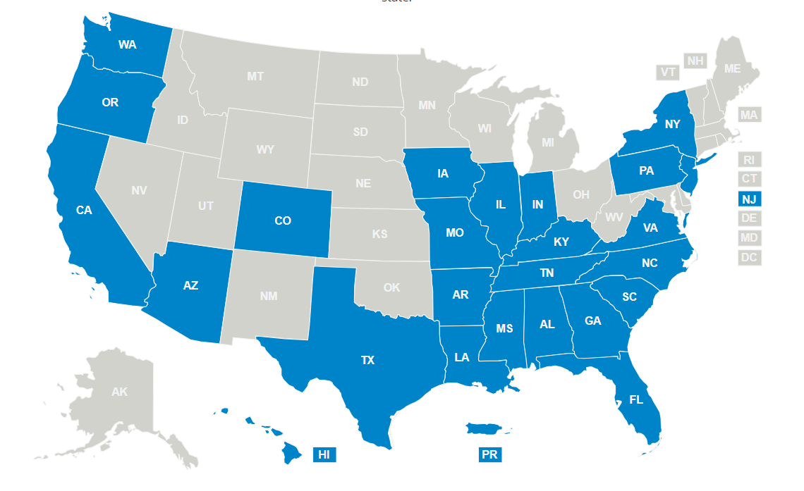
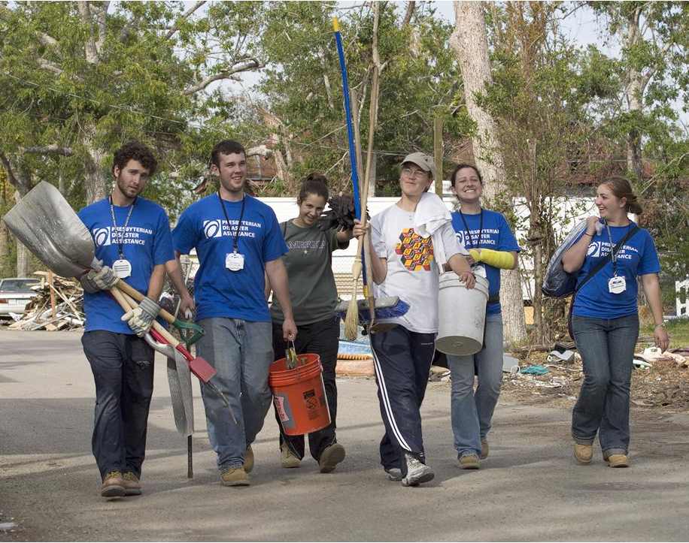
Domestic Ministry
The U.S. response program works primarily through volunteers

Slide 20
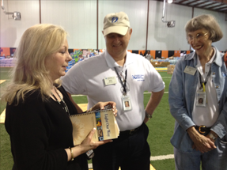
Domestic Ministry
National Response Team
Respond to domestic disasters, both natural and human-caused
80+ volunteers from around the country
Have training and experience in disaster response
Deploy in collaboration with the presbytery and interfaith partners
Photo by Sue Renault NRT
Notes:
The primary vehicle of response is the National Response Team or the National Volunteer Team. (Explain bullet points in the slide.)
The requirements and training for NRT and NVT are the same. All PDA NRT & NVT members go through a self-selection process, then a discernment weekend before they are added to the team. The only difference between the two teams is the time commitment. NRT members agree to serve a minimum of three years and commit to 4 weeks of active service – 2 weeks in the field (deployed) and 2 weeks of training, including 1 week at the annual meeting. NVT members are not expected to commit at that same level.
NRT, on early deployments, assess the needs and provide “Ministry of Presence.”
While NVT members are not expected to commit as much time as the National Response Team, they generally are available to represent PDA at meetings or to take on “other duties as assigned” – help with host sites, etc.

Slide 21
Volunteer Host Sites
Domestic Ministry
Before COVID, the National Call Center (NCC) was working with 40 hosting sites in 16 states and 1 territory. The National Call Center (NCC) supports these host sites through the PDA website – www.pda.pcusa.org
Currently there are 14 volunteer host sites in 10 States and Territories
Notes:
Volunteer host sites are often a local response to a disaster. With PDA support, churches and other local organizations open their doors to host volunteers who come to a disaster to help with clean up and rebuilding. You may be familiar with the volunteer villages after Katrina. Did any of you spend time in a pod somewhere on the Gulf Coast? Volunteer villages have evolved into host sites and are usually housed in churches whose congregations have responded to God’s call to assist the survivors of a disaster.
(This slide should be updated at least once a year to ensure the numbers are correct. To explore volunteer opportunities, visit the PDA website and click on “Act”.)

Slide 22
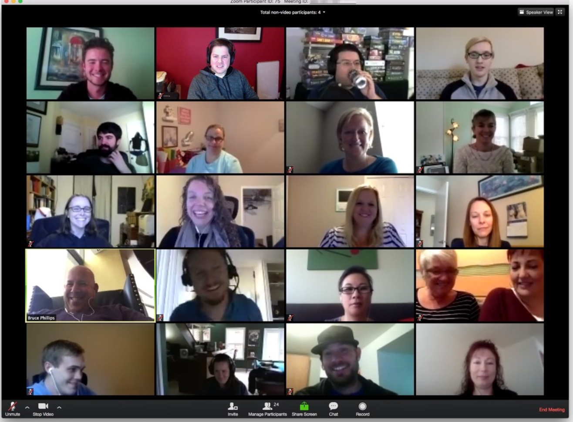
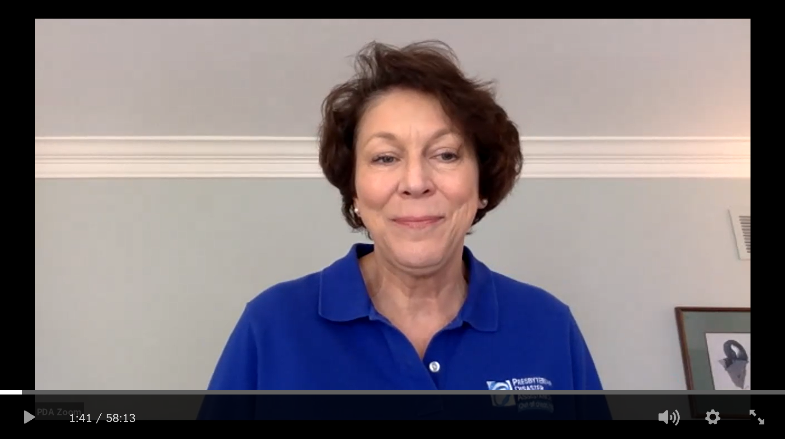
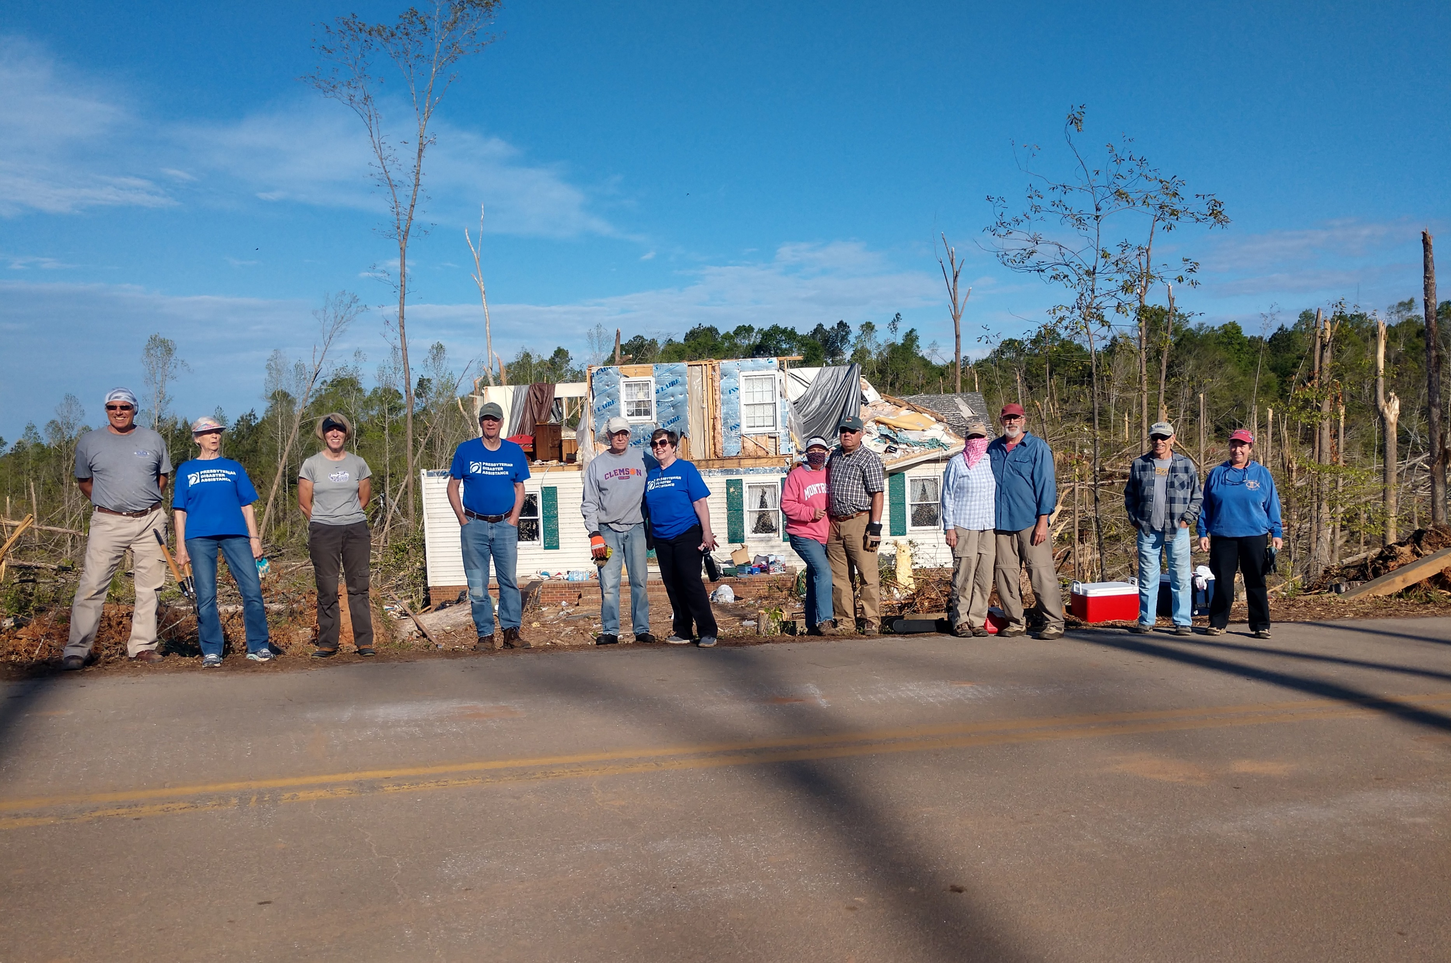
Domestic Ministry
Virtual Deployments
Resilience Webinars
Commuter Volunteers
Renewed Commitment to Empowering the Local Response a. There are four Presbyterian regional networks for disaster preparedness and response. The networks are in the Synod of the Sun (Texas, Arkansas, Oklahoma, and Louisiana), Puerto Rico, Florida, and South Carolina
Notes:
1.The primary vehicle of response is the National Response Team or the National Volunteer Team.
The requirements and training for NRT and NVT are the same. All PDA NRT & NVT members go through a self-selection process, then a discernment weekend before they are added to the team. The only difference between the two teams is the time commitment. NRT members agree to serve a minimum of three years and commit to 4 weeks of active service – 2 weeks in the field (deployed) and 2 weeks of training, including 1 week at the annual meeting. NVT members are not expected to commit at that same level.
NRT, on early deployments, assess the needs and provide “Ministry of Presence.”
While NVT members are not expected to commit as much time as the National Response Team, they generally are available to represent PDA at meetings or to take on “other duties as assigned” – help with host sites, etc.
2. Volunteer host sites are often a local response to a disaster. With PDA support, churches and other local organizations open their doors to host volunteers who come to a disaster to help with clean up and rebuilding. Some of you may remember the volunteer villages after Katrina. Volunteer hosting has evolved into sites and are usually housed in churches whose congregations have responded to God’s call to assist the survivors of a disaster.
3. The work is done in collaboration with local long-term recovery organizations that usually provide supervision and support for the work teams. Because volunteers provide a lot of the labor, the money donated for rebuilding and repair goes much farther than if LTRGs had to pay contractors.
4. The PDA National Call Center manager, Eden Roberts, works with churches and partners on the paperwork and physical criteria necessary for hosting volunteer work teams.
While the work the teams do is important, it takes second place to the most important thing that work teams do – and that is provide a Ministry of Presence. 99% of the value of what we do in disaster response is just who up and show the survivors the healing love of Christ.

Slide 23
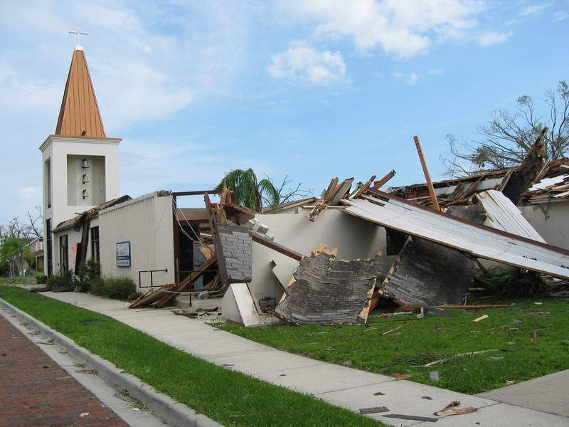
Domestic Ministry
Grants
Church Damage Grant to support
Continuation of ministry
Only when validated by the presbytery
Not intended as a substitute for insurance or insurance deductible
Notes:
PDA supports the continuation of the church’s ministry and does not provide an insurance supplement.
Note: The funding for church damage is $5,000 per church with a maximum of $25,000 per disaster per presbytery. In other words, if a single presbytery had had six churches damaged by Sandy, it could have had $25,000 to divide among the six.

Slide 24
Domestic Ministry
Grants
Presbytery Initial Assistance Grant
To provide immediate financial support to the Presbytery’s response to the needs of the community in the wake of the disaster
These funds are used in a variety of ways depending on the needs in the community and the gaps left by other responding agencies and groups
In one disaster funds were used to buy and distribute plastic sheeting to cover the belongings of survivors
In another funds were used to pay for items left off the supply truck from the Red Cross.
Notes:
PDA supports the continuation of the church’s ministry and does not provide an insurance supplement.
Note: The funding for church damage is $5,000 per church with a maximum of $25,000 per disaster per presbytery. In other words, if a single presbytery had had six churches damaged by Sandy, it could have had $25,000 to divide among the six.

Slide 25
Domestic Ministry
Seed Grants
Supporting host site development
Special Project Grants
Long term recovery infrastructure
Building materials
Presbytery disaster coordinators
Other

Slide 26
Domestic Ministry
Voluntary Organizations Active in Disaster (VOAD)
PDA is a member of National VOAD and Jim Kirk is a current board member
PDA is represented on 28 State/Territory VOADs
Forrest Palmer is the PDA representative on the West Virginia VOAD

Slide 27
Domestic Ministry
2022 At a Glance
Awarded grants in 28 states/territories and 35 countries
113 National Response Team members were deployed to 25 states both virtually and in-person
Supported 1343 work team volunteers who help with post-disaster rebuilding in California, North Carolina, Puerto Rico, Texas, Louisiana, Western Kentucky, and Florida.
New volunteer host sites in 2023 are in Mississippi, West Virginia (WVMAW), Eastern Kentucky
Notes:
Here are some other things that PDA does in US disasters.
Provides $7,500 initial funding to presbyteries – requested directly to Rick Turner, National Associate for Disaster, by the Presbytery Executive
Long-term recovery organizing & funding
Offers emotional & spiritual care and Care for Caregivers retreats
Disaster preparation training – in collaboration with Presbyterian Women
Collaboration with ecumenical & other partners through National VOAD

Slide 28
PDA Mission
Presbyterian Disaster Assistance enables congregations and mission partners of the Presbyterian Church (U.S.A) to witness to the healing love of Christ through caring for communities adversely affected by crisis and catastrophic event.
Presbyterian Disaster Assistance (PDA) is the emergency and refugee program of the Presbyterian Church U.S.A. The core budget, including staff and administrative costs, is funded through the One Great Hour of Sharing, and its program work is additionally funded through designated gifts.

